Slide 1
Machine Learning for the Quantified Self
Lecture 1
Introduction

Slide 2
Quantified Self definition (1)
Term first coined by Gary Wolf and Kevin Kelly in Wired Magazine
Let’s watch a video first:
  https://www.youtube.com/watch?v=OrAo8oBBFIo

Slide 3
Quantified Self definition (2)
What is the quantified self?
  Swan (2013): “The quantified self is any individual engaged in the self-tracking of any kind of biological, physical, behavioral, or environmental information. There is a proactive stance toward obtaining information and acting on it.”

Slide 4
Quantified Self definition (3)
  We: “The quantified self is any individual engaged in the self-tracking of any kind of biological, physical, behavioral, or environmental information. The self-tracking is driven by a certain goal of the individual with a desire to act upon the collected information.”

Slide 5
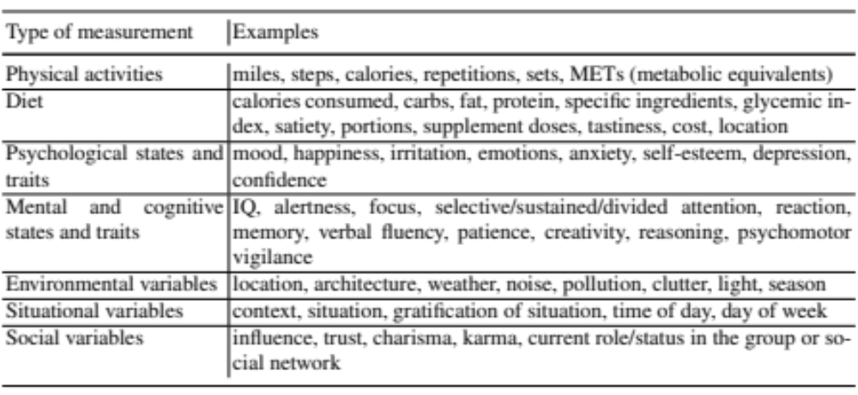
Quantified Self: measurements
Augemberg (2012):

Slide 6
Quantified Self: why? (1)
Choe, 2014:
  Interview with 52 quantified selfs
  Three categories:
    Improved health (cure or manage a condition, execute a treatment plan, achieve a goal)
    Improve other aspects of life (maximize work performance, be mindful)
    Find new life experiences (have fun, learn new things)

Slide 7
Quantified Self: why? (2)
Gimpel, 2013:
  Identify “Five-Factor Framework of Self-Tracking Motivations:
    Self-healing (become healthy)
    Self-discipline (rewarding aspects of it)
    Self-design (control and optimize “yourself”)
    Self-association (associated with movement)
    Self-entertainment (entertainment value)

Slide 8
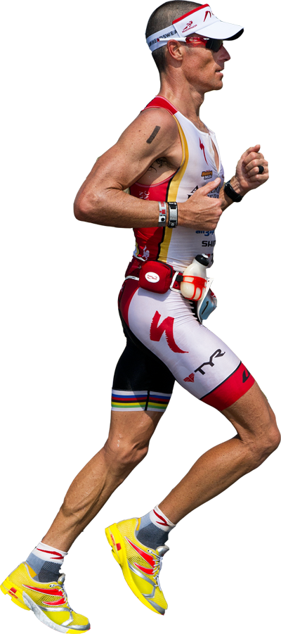
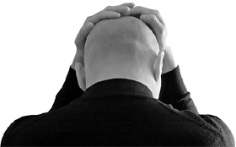
Quantified Self: Arnold and Bruce
Use two running examples
Bruce:
Diabetic
Susceptible for depression
Smart watch
Device to measure blood glucose level
……
Arnold:
Loves sports
Wants to participate in IRONMAN
Gadget freak
Smart phone/watch/…
Electronic scale
Chest strap
……

Slide 9
Moving on the machine learning
Machine learning: “Machine learning is to automatically identify patterns from data”
What could we learn for Arnold and Bruce?

Slide 10
What could we learn?
Arnold:
  Advising the training to make most progress towards a certain goal based on past outcomes of training.
  Forecasting when a certain running distance will be feasible based on the progress made so far and the training schedule.
Bruce:
  Predict the next blood glucose level based on past measurements and activity levels.
  Determine when and how to intervene when the mood is going down to avoid a spell of depression.
  Finding clusters of locations that appear to elevate one’s mood.

Slide 11
Why is the Quantified Self so different?
Sensory noise
Missing measurements
Temporal data
Interaction with a user
Learn over multiple datasets

Slide 12
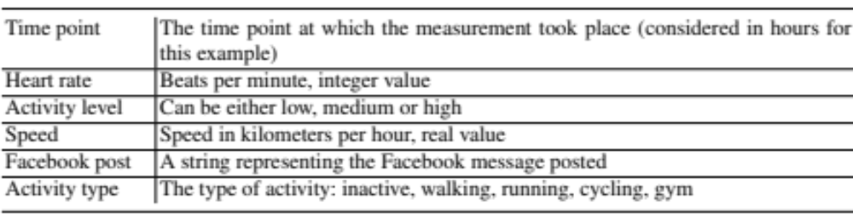
Basic Terminology (1)
A measurement is one value for an attribute recorded at a specific time point.

Slide 13
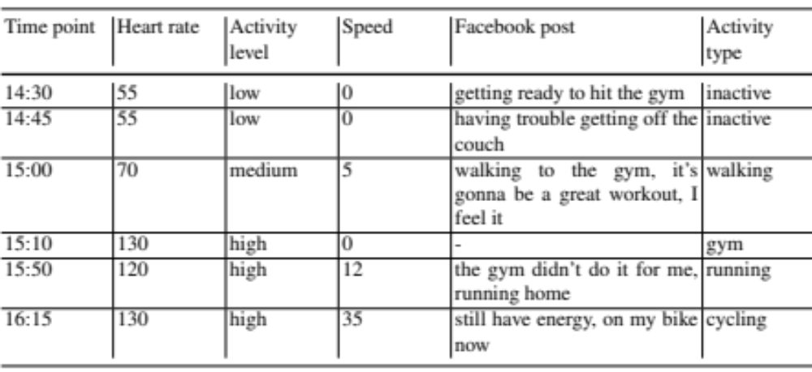
Basic Terminology (2)
A time series is a series of measurements in temporal order.

Slide 14
Basic Terminology (3)
Machine learning terminology is assumed to be known, for your convenience:
  Supervised learning is the machine learning task of inferring a function from a set of labeled training data
  In unsupervised learning, there is no target measure (or label), and the goal is to describe the associations and patterns among the attributes
  Reinforcement learning tries to find optimal actions in a given situation so as to maximize a numerical reward that does not immediately come with the action but later in time.

Slide 15
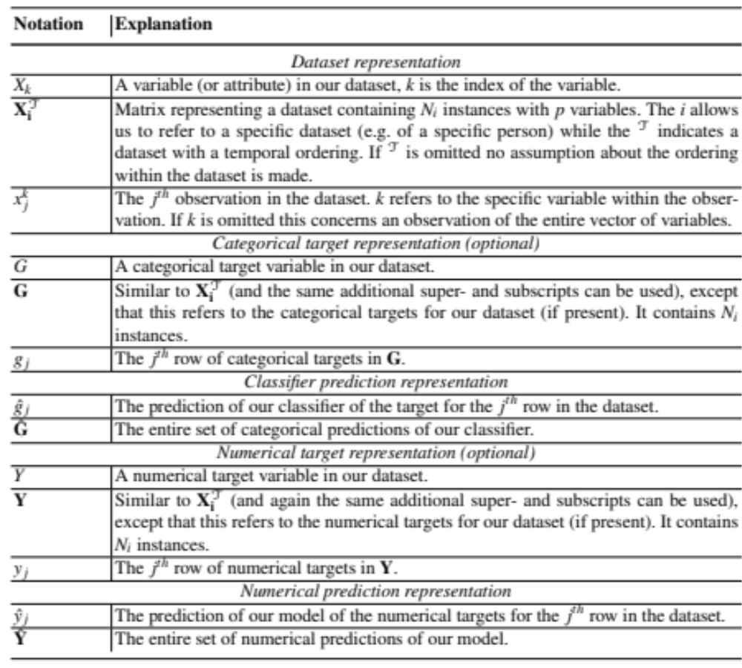
Mathematical notation (1)

Slide 16
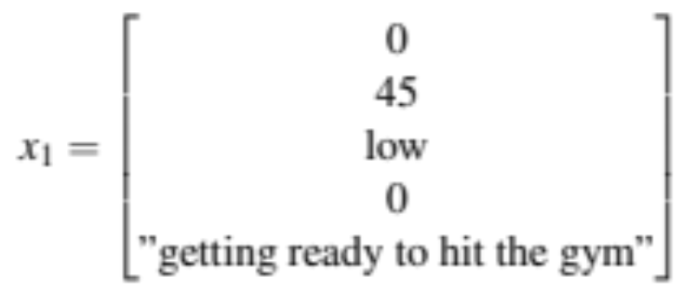

Mathematical notation (2)
Some examples:
  An instance:
  A target for the instance:

Slide 17
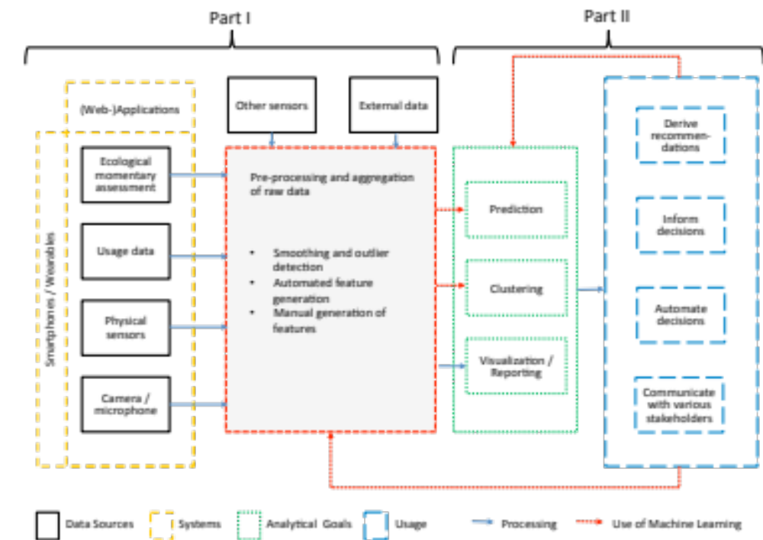
Overview of the course (1)

Slide 18
Overview of the course / the book (2)
We will discuss the following topics:
  Sensory data (+ case study) (Chapter 2)
  Handling noise (Chapter 3)
  Feature extraction (Chapter 4)
  Clustering (Chapter 5)
  Theoretical foundations (Chapter 6)
  Predictive modeling without time (Chapter 7)
  Predictive modeling with time (Chapter 8)
  Reinforcement learning (Chapter 9)
  Look towards the future (Chapter 10)

