Slide 1
Machine Learning for the Quantified Self
Lecture 2
Basic of Sensory Data

Slide 2

Dataset (1)
During the course we will use a running example provided by CrowdSignals.io
People share their mobile sensors data (smart phone and smart watch) and get paid for annotating their data with activities

Slide 3
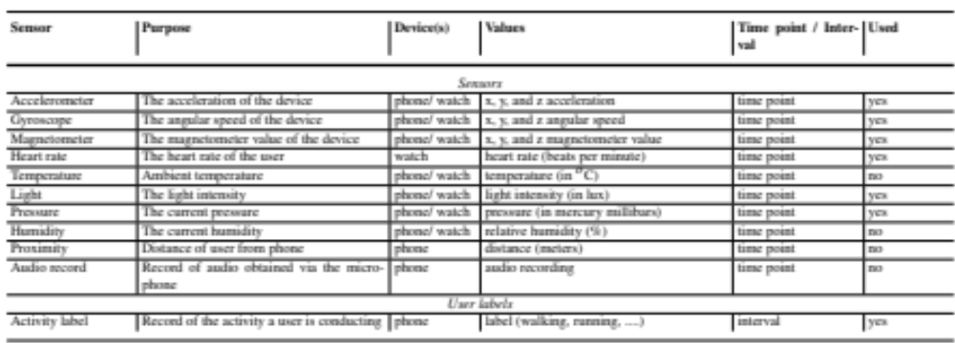
Dataset (2)

Slide 4
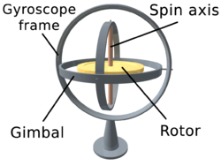
Mobile phone measurements (examples)
Accelerometer
  Measures the changes is forces upon the phone in the x-y-z plane
Gyroscope
  Orientation of the phone compared to the earth’s surface
Magnetometer
  Measures x-y-z orientation compared to the earth’s magnetic field

Slide 5
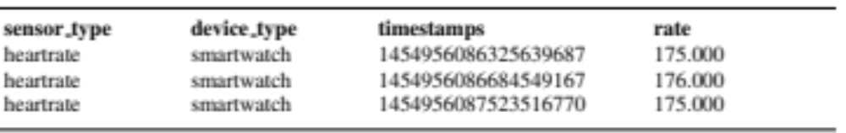
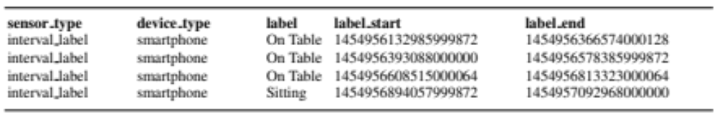
The raw data
What does the raw CrowdSignals data look like?
  Separate tables per measurement
  Specific time point measurements:
  Interval measurements

Slide 6

Transforming the raw data (1)
Need to combine these table, but how?
Select a step size Δt you want to consider in the data
  this will represent one discrete time step
  start at the earliest time point in the data
  find all measurements for each single attribute associated with each interval
  we consider categorical features (e.g. label) as a number of binary features
  combine their values (e.g. average for heart rate or accelerometer or sum for the label)

Slide 7
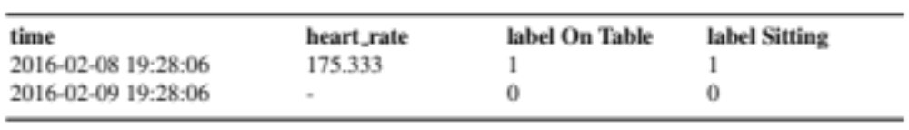
Transforming the raw data (2)

Slide 8
Exploring the data (1)
Let us consider a dataset from CrowdSignals which covers around 2 hours of data
Imagine we take a step size of Δt = 1 minute and Δt = 250 milliseconds
What difference would you expect in the spread of the data?
What are the pros and cons of a higher value for Δt (less fine grained)?

Slide 9
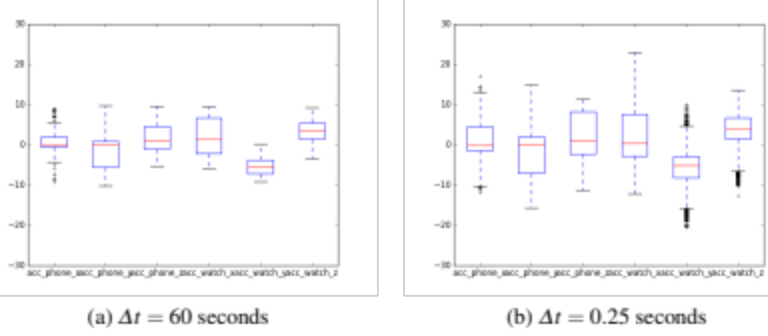
Exploring the data (2)

Slide 10
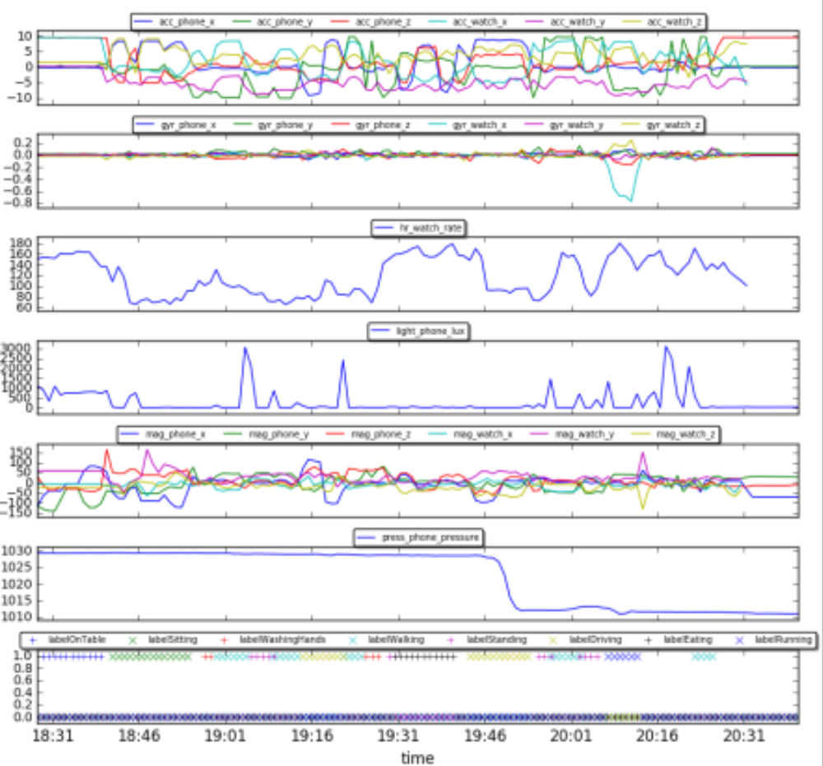
Exploring the data (2)

Slide 11
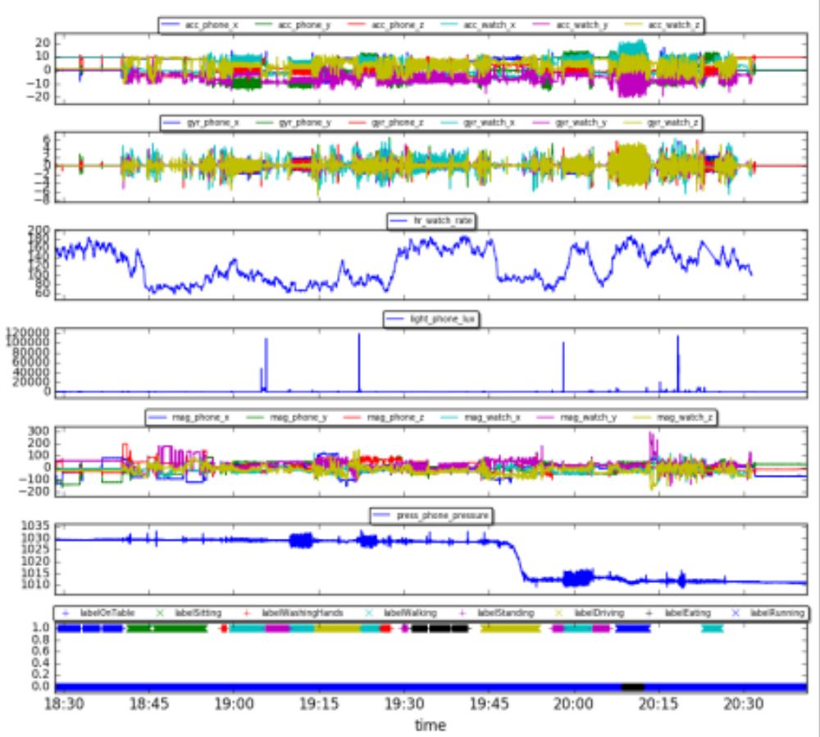
Exploring the data (2)

Slide 12
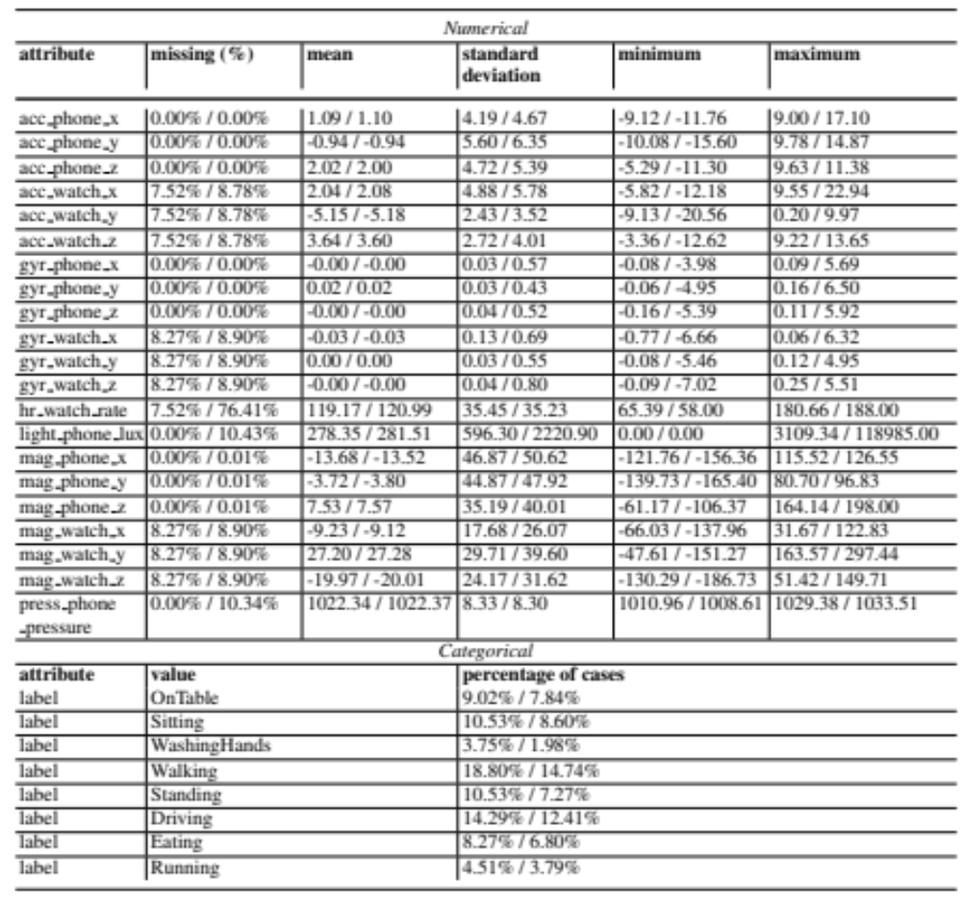
Exploring the data (5)

Slide 13
Machine Learning Tasks
What kind of tasks could we identify in this dataset?
  a classification problem, namely predicting the label (i.e. activity) based on the sensors
  a regression problem, namely predicting the heart rate based on the other sensory values and the activity

