Slide 1
Machine Learning for the Quantified Self
Chapter 3
Handling Noise and Missing Values in Sensory Data

Slide 2
Overview
Previously: we collected the data
Today: Removing noise from the data
  Removal of outliers
  Imputation of missing values
  Transform the data to select the most useful information

Slide 3
Removal of outliers (1)
What is an outlier?
An outlier is an observation point that is distant from other observations
Causes?
  Measurement error (Arnold with a heart rate of 400)
  Variability (Arnold trying to push his limits with a heart rate of 190)

Slide 4
Removal of outliers (2)
Difference between measurement and variability outlier?
  Former generated by another mechanism
How to remove?
  Domain knowledge (heart rate cannot be over 220)
  Without domain knowledge (our focus)
Have to be cautious as you do now want to remove valuable information

Slide 5
Removal of outliers (3)
Two types of outlier detection:
  Distribution based (we assume a certain distribution of the data)
  Distance based (we only look at the distance between data points)

Slide 6
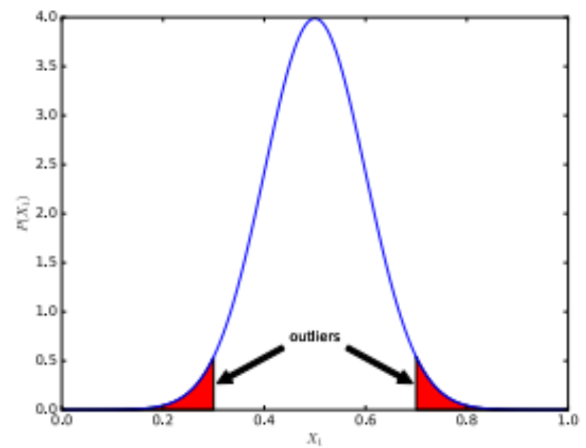
Distribution-based outlier detection (1)
Let us start with Chauvenet’s criterion
Assume a normal distribution, single attribute (X_{i})

Slide 7
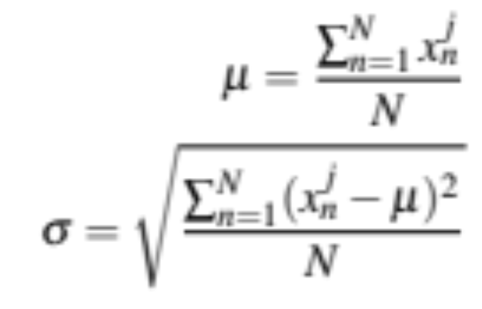
Chauvenet’s criterion (1)
Take the mean and standard deviation for an attribute j in our dataset:

Slide 8
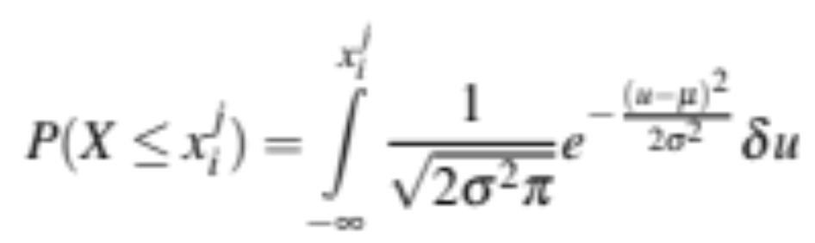
Chauvenet’s criterion (2)
Take those values as parameters for our normal distribution
For each instance i for attribute j compute the probability of the observation:

Slide 9
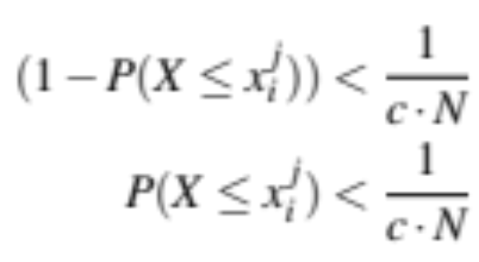
Chauvenet’s criterion (3)
Define it as an outlier when:
Typical value for c is 2

Slide 10
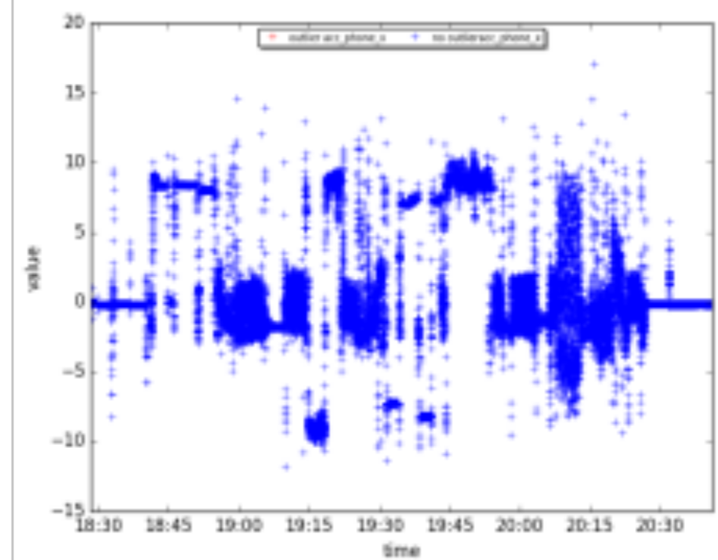
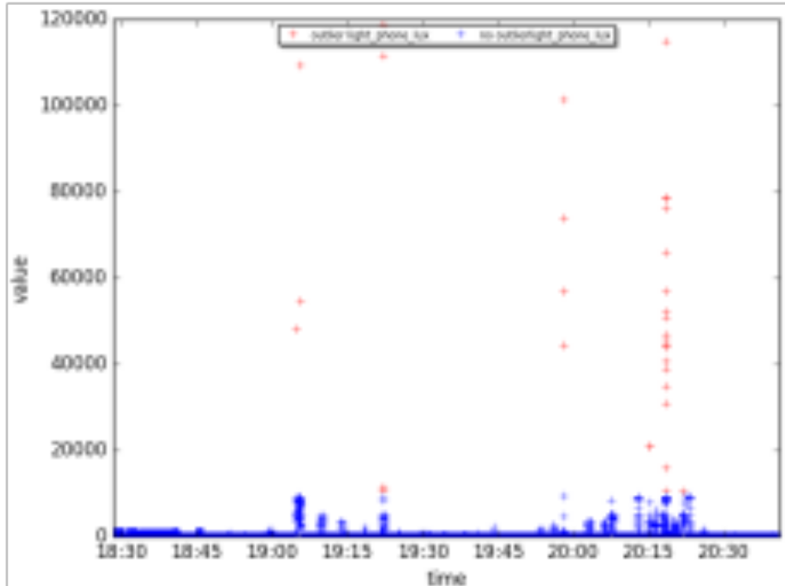
Chauvenet’s criterion (4)
CrowdSignals example (c=2):

Slide 11
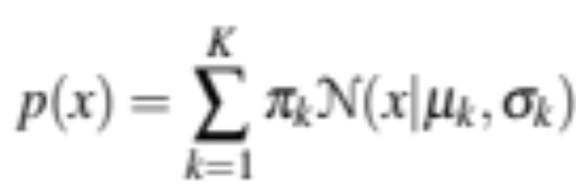
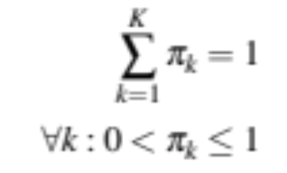
Distribution-based outlier detection (2)
Assuming the data of an attribute to follow a single distribution might be a bit too simple
We can also use mixture models
Assume the data can be described with K normal distributions
with

Slide 12
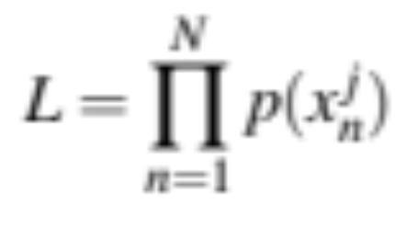
Mixture models (1)
We can find the best for the parameters by mean of maximizing the likelihood:
We can for example use the expectation maximization algorithm
How many distributions should we use?

Slide 13
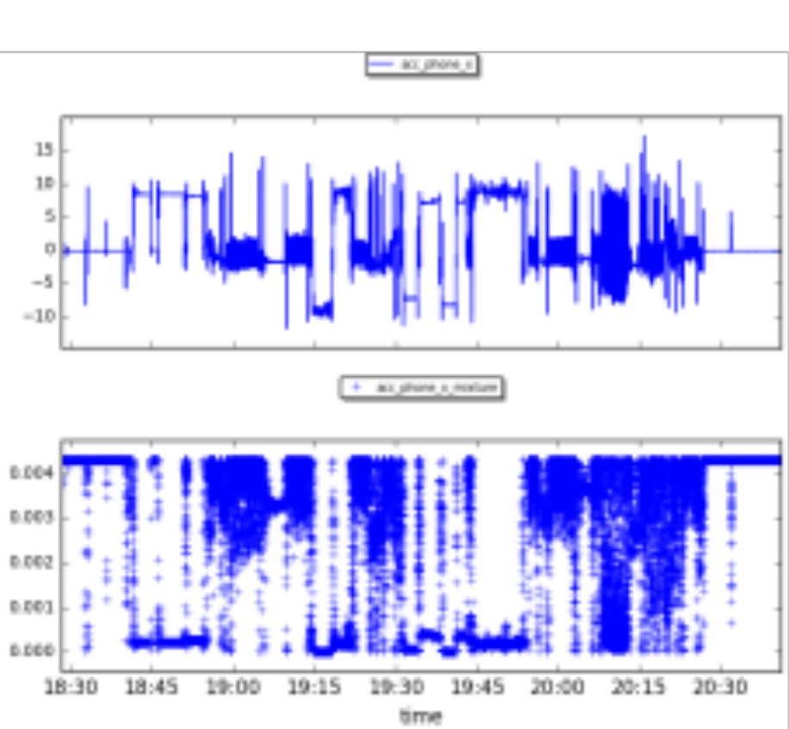
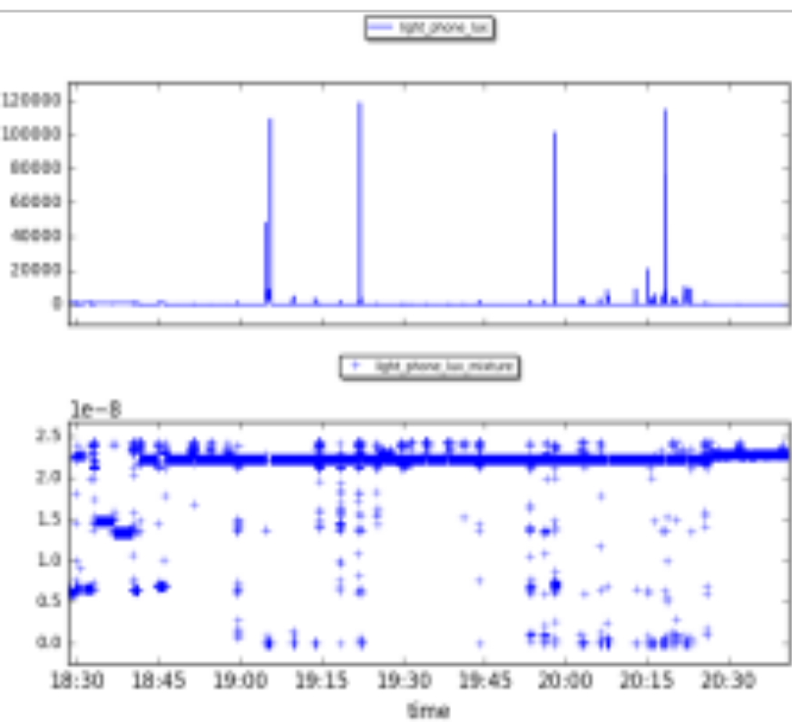
Mixture models (2)
CrowdSignals example (K=3):

Slide 14
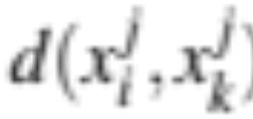
Distance-based outlier detection (1)
Let us move away from distributions and just consider the distance between points
We will consider the actual distance metrics later (Chapter 5), but e.g. think of Euclidean distance
We will use to represent the distance between two values of an attribute j

Slide 15
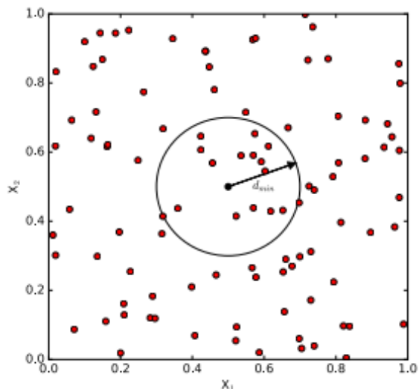
Simple distance-based approach (1)
We call point close if they are within distance d_{min}
Points are outliers when there are more than a fraction f_{min} far away (i.e. outside of d_{min})

Slide 16
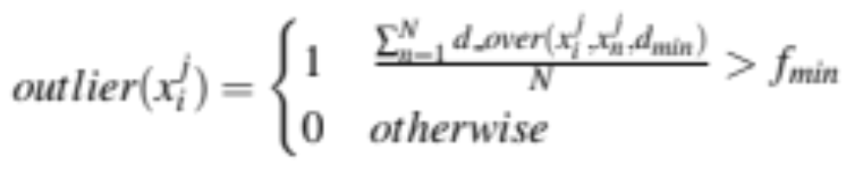
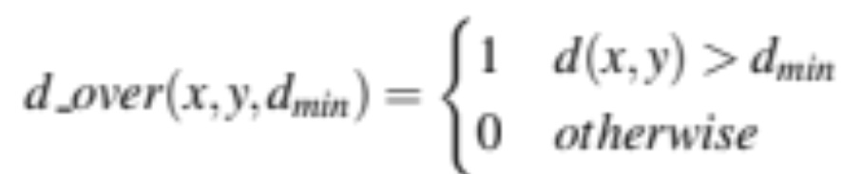
Simple distance-based approach (2)
Formal:
with

Slide 17
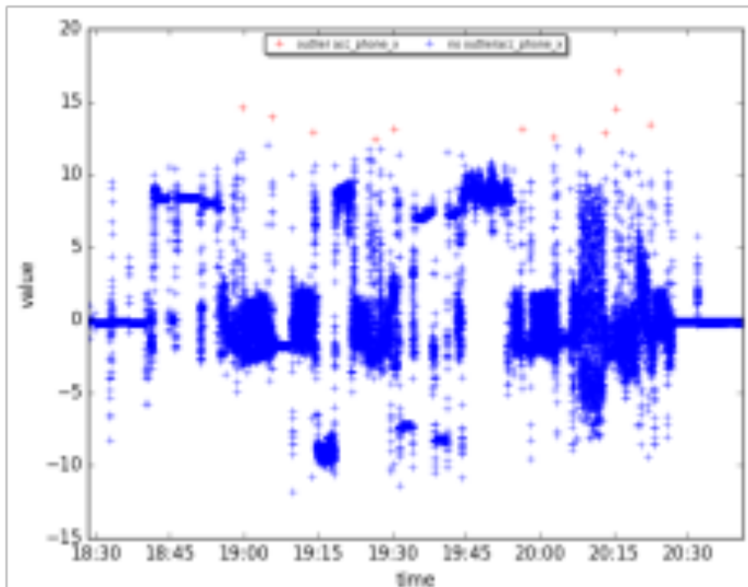
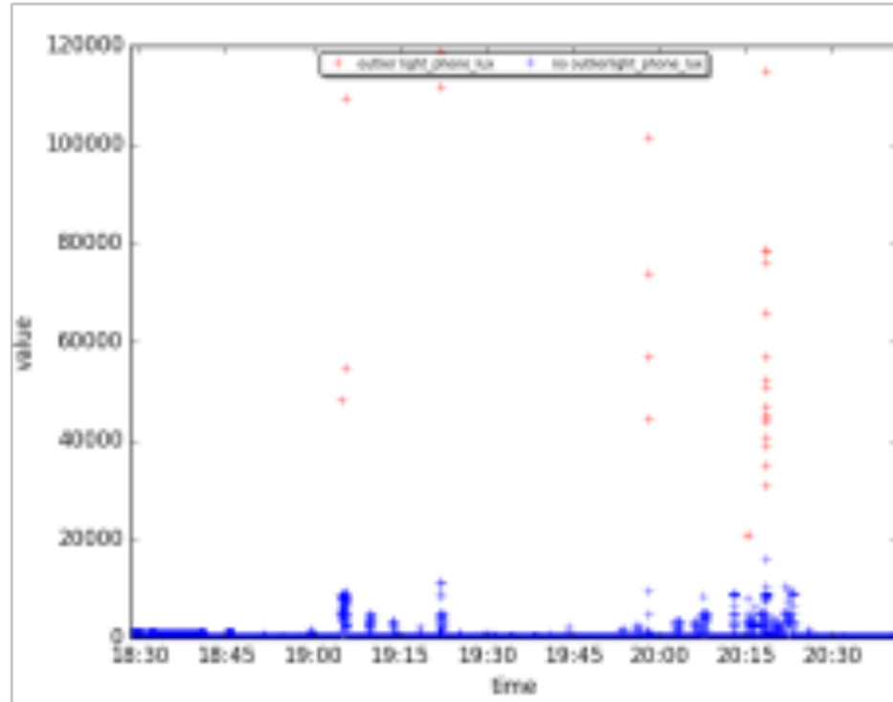
Simple distance-based approach (3)
CrowdSignal example (d_{min}=0.1, f_{min}=0.99)

Slide 18
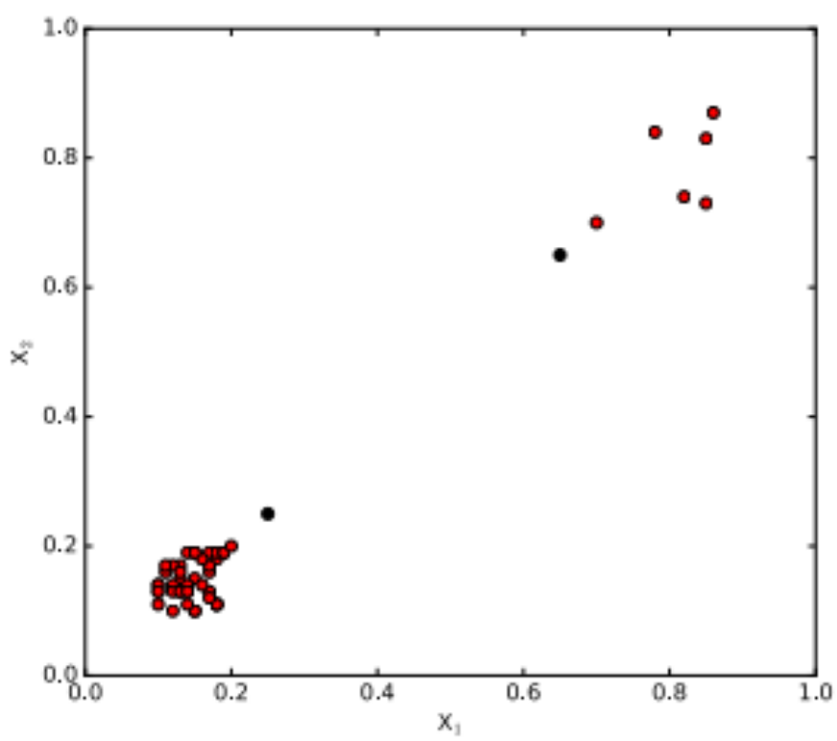
Distance-based outlier detection (2)
The previous approach did not take the local density into account, imagine:

Slide 19
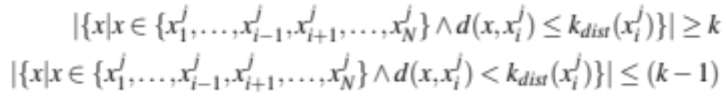
Local outlier factor (1)
Local outlier factor does take this density into account
We first define the distance k_{dist} for a point x_{i} ^{j} as the largest distance to one of its k closest neighbors:

Slide 20
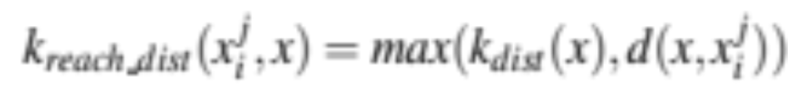
Local outlier factor (2)
The set of neighbors of x_{i} ^{j} within k_{dist} is called the k-distance neighborhood k_{dist_nh}
We define the reachability distance of x_{i} ^{j} to x as (we remove small distances within k_{dist})

Slide 21
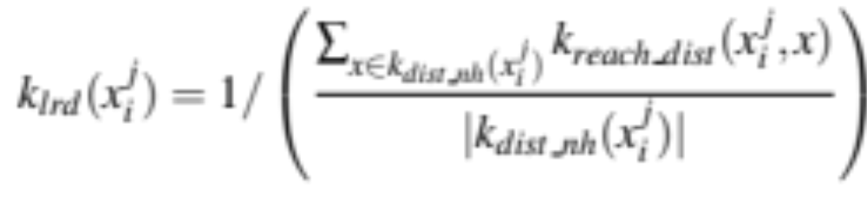
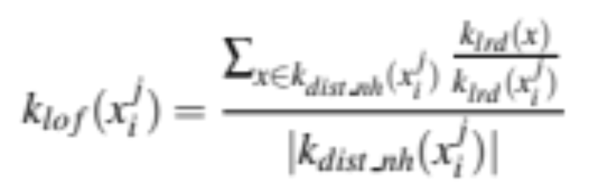
Local outlier factor (3)
Now we define the local reachability distance of our point x_{i} ^{j}:
And we compare this to the neighbors:

Slide 22
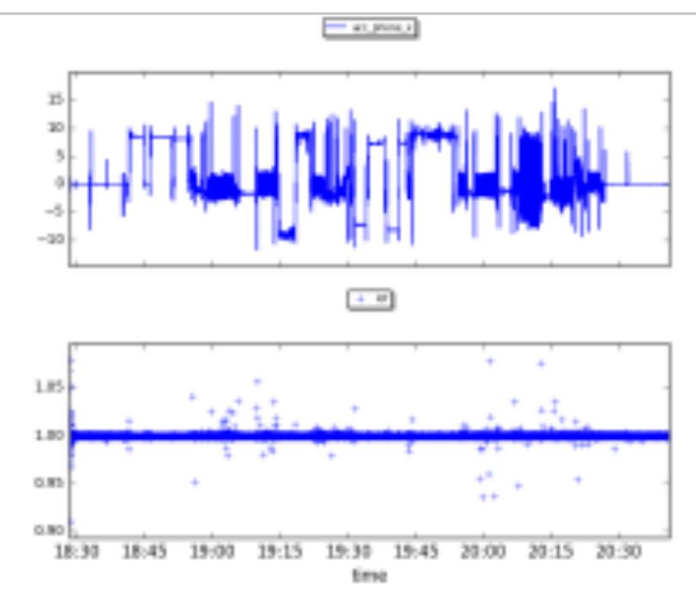
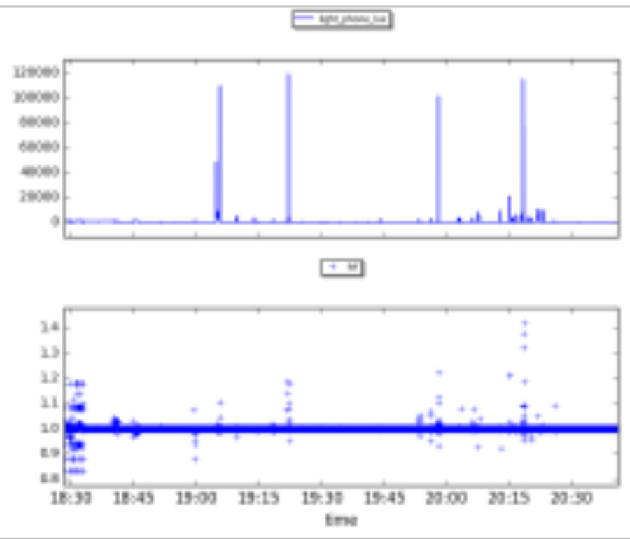
Local outlier factor (4)
CrowdSignals case (k=5):

Slide 23
Outlier detection
We remove all elements we have considered to be an outlier
We replace them with the value missing

Slide 24
Missing values (1)
We naturally move to missing values
We can replace missing values by a substituted value (imputation)
What should these values be?
  mean (numeric)
  mode (categorical and numeric)
  median (numeric)

Slide 25


Missing values (2)
We can also take more advanced approaches:
  Use other attribute values in the same instance (Chapter 7):
  Use values of the same attributes from other instances (need a ordered/temporal attribute):

Slide 26
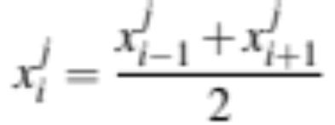
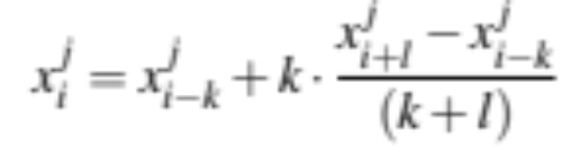
Missing values (3)
Some examples of the second case in case of a single missing measurement:
In case of multiple missing measurements:

Slide 27
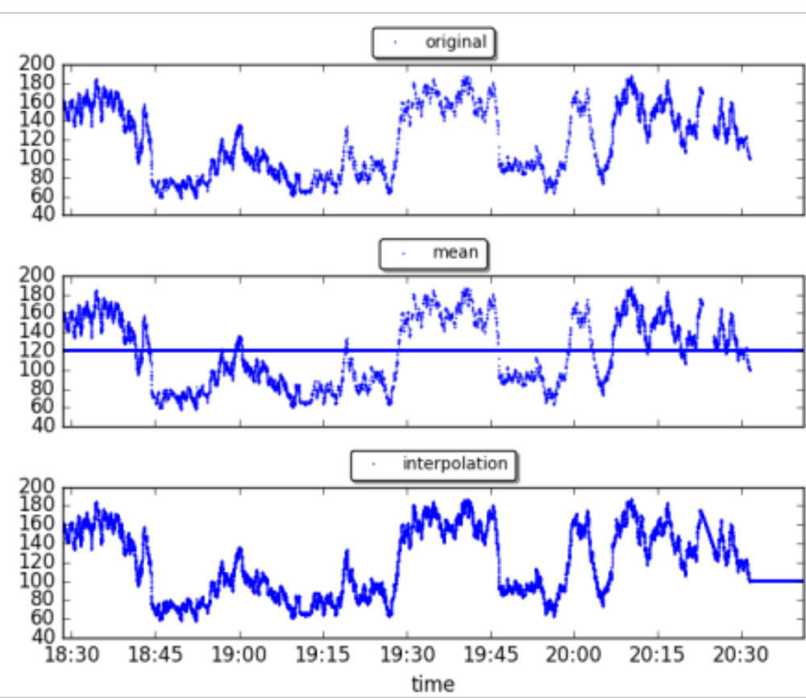
Missing values (4)
CrowdSignal example:

Slide 28
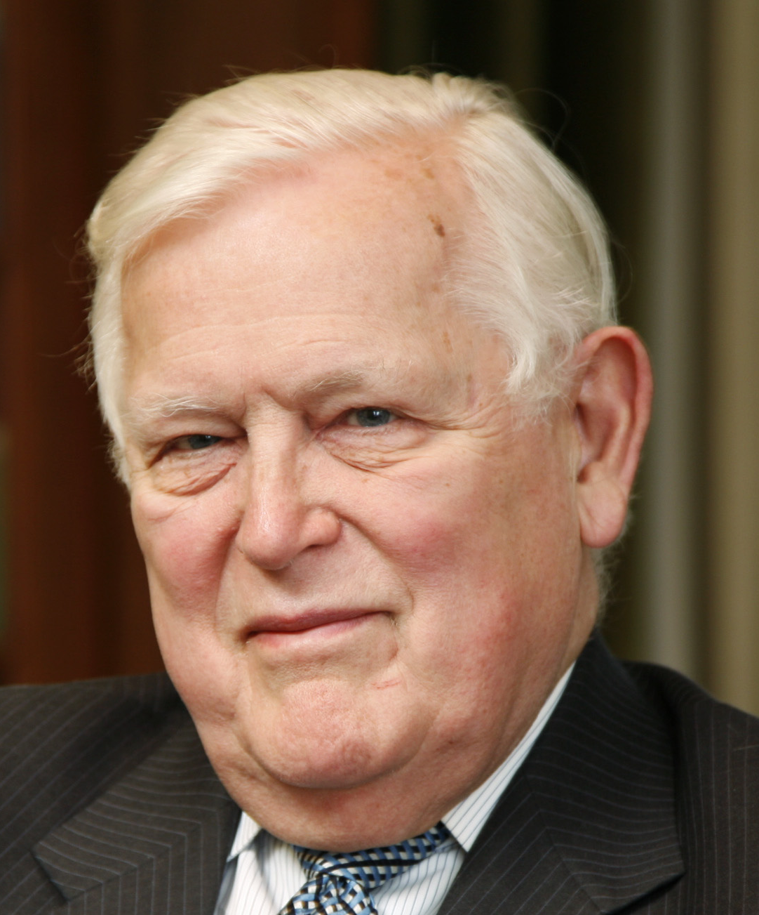
Outlier detection + imputation
Approaches that combine outlier detection and value imputation exist as well
The Kalman filter is a well known one:
  it estimates expected values based on historical data
  if the observed value deviates too much (i.e. an outlier) we can impute with the expected value

Slide 29
Kalman filter (1)
Assume some latent state s_{t} which can have multiple components
  Our quantified self data x_{t} performs measurements about this state
For example:
  s_{t} is Arnold’s presence at a position and velocity
  x_{t} is the GPS data and step counter

Slide 30

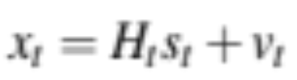
Kalman filter (2)
The next value of a state is defined as:
  u_{t} is a control input state (e.g. sending a message)
  w_{t} is white noise
  F_{t} and B_{t} are matrices
The measurement associated with s_{t} is:
  v_{t} is white noise

Slide 31
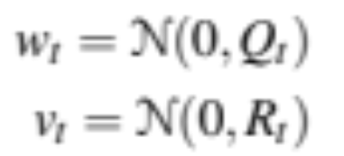
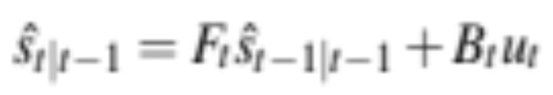
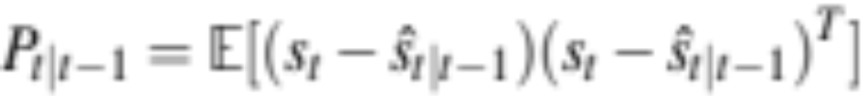
Kalman filter (3)
For the noise we assume that:
Now let us try to predict a next state (denoted by a hat):
And let us also estimate our prediction error (matrix of variances and co-variances):

Slide 32
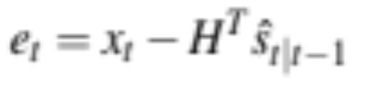
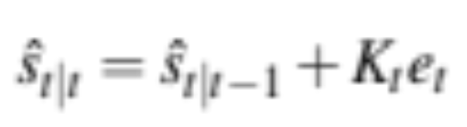
Kalman filter (4)
Based on our prediction of the state, let us look at the error:
Given this error we come with an updated prediction of our state
K_{t} is a matrix derived based on an algorithm for which P_{t|t-1} is used

Slide 33
Kalman filter (5)
Of course the matrices contain models (that we might not always know) but you can even do without (one measurement directly related to one latent state)
Once we observe a large error, our x_{t} might be of and we can substitute it by the expected value
Nice more extensive explanation: http://www.bzarg.com/p/how-a-kalman-filter-works-in-pictures/

Slide 34
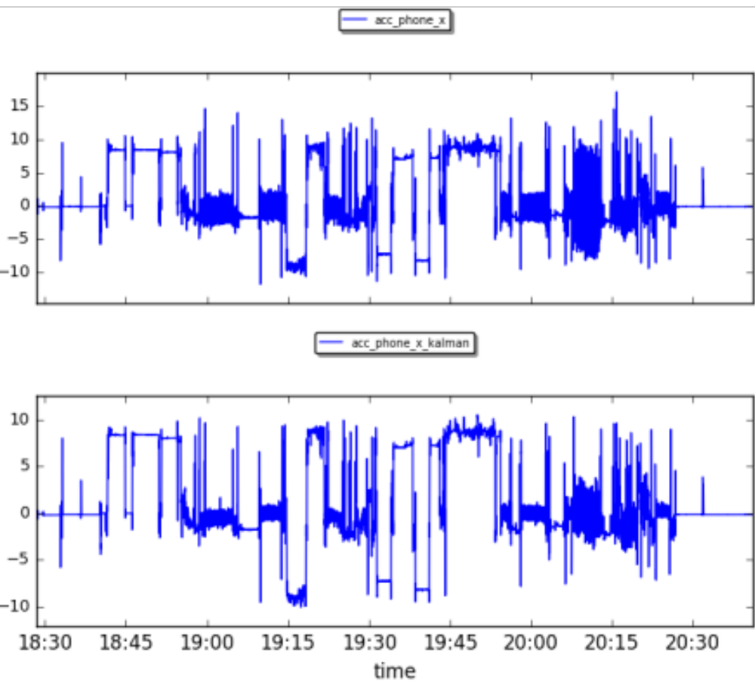
Kalman filter (6)
CrowdSignal example:

Slide 35
Transforming the data (1)
Even though we have removed the outliers and imputed missing values we could still suffer from noise in our dataset that could distract the learning process
Approaches exist that filter our this more subtle noise
  Lowpass filter
  Principal Component Analysis

Slide 36
Lowpass filter (1)
Main idea: some data has periodicity (e.g. walking, running)
You can decompose a series of values into different periodic signals:
  come with their own frequency
  we will see about this in Chapter 4
Some frequencies might be more interesting than others

Slide 37
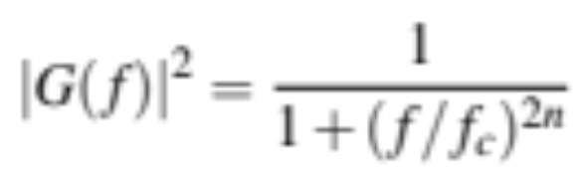
Lowpass filter (2)
For example: we do not care about running (higher frequency), but we do care about walking
We can filter out the higher frequency data
The lowpass filter does exactly this:
  |G(f)| is the magnitude of the filter
  f_{c} is the cutoff frequency
  n is the order of the filter

Slide 38
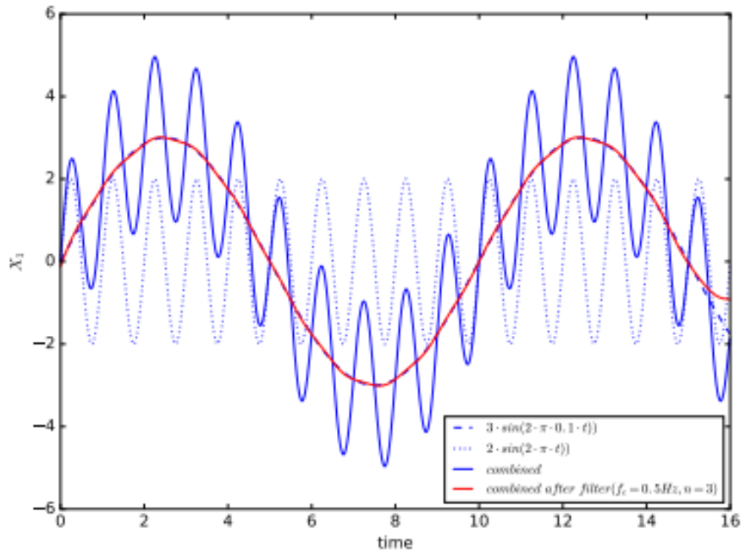
Lowpass filter (3)

Slide 39
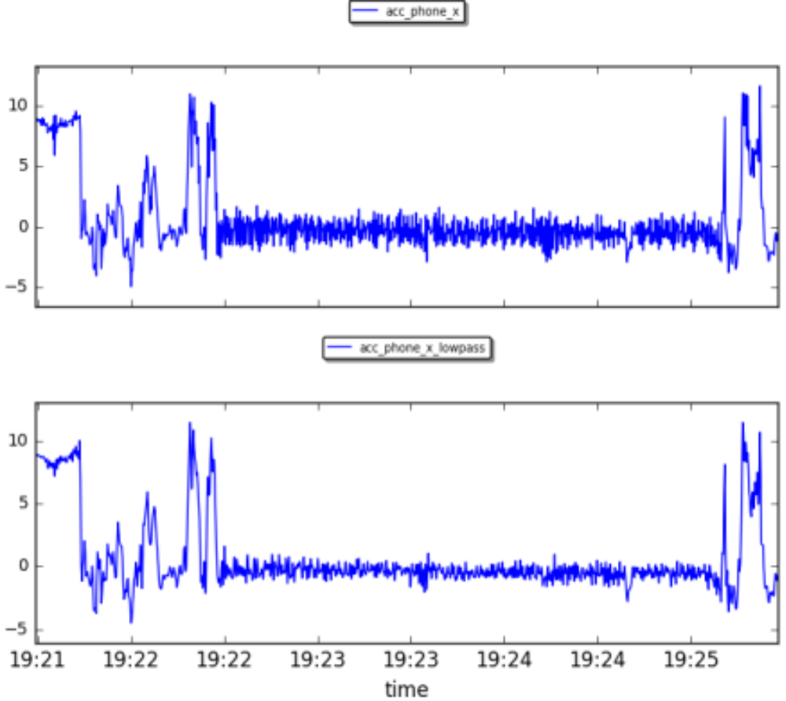
Lowpass filter (4)
CrowdSignal example (f_{c}=1.5Hz, n=20):

Slide 40
Transforming the data (2)
We can also apply principal component analysis:
  find new features that explain most of the variability in our data
  select the number of components based on the explained variance
  since most are familiar, I will not provide all details, see the book

Slide 41
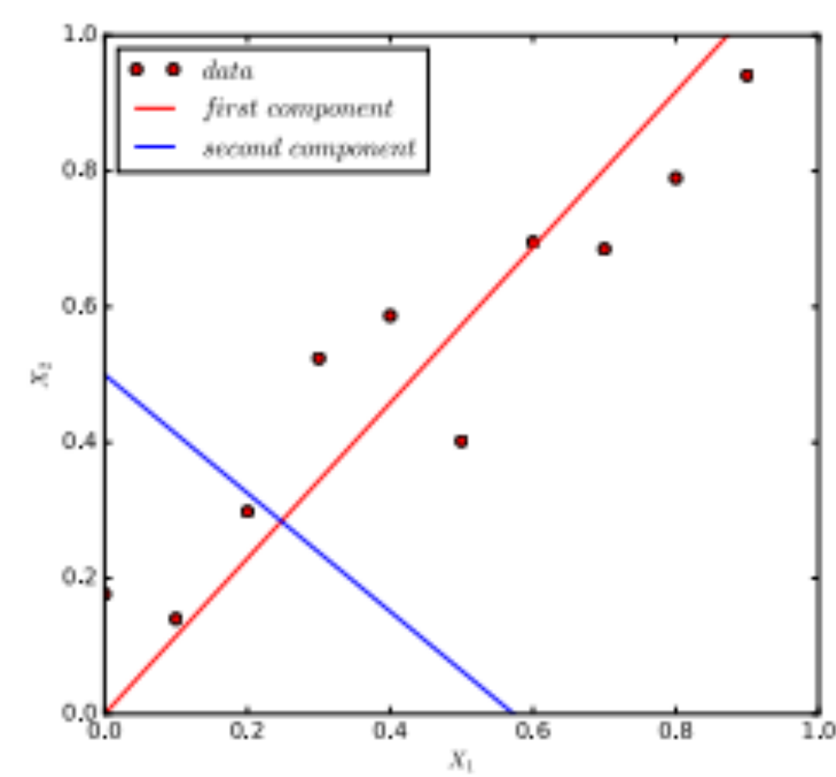
Principal component analysis (1)

Slide 42
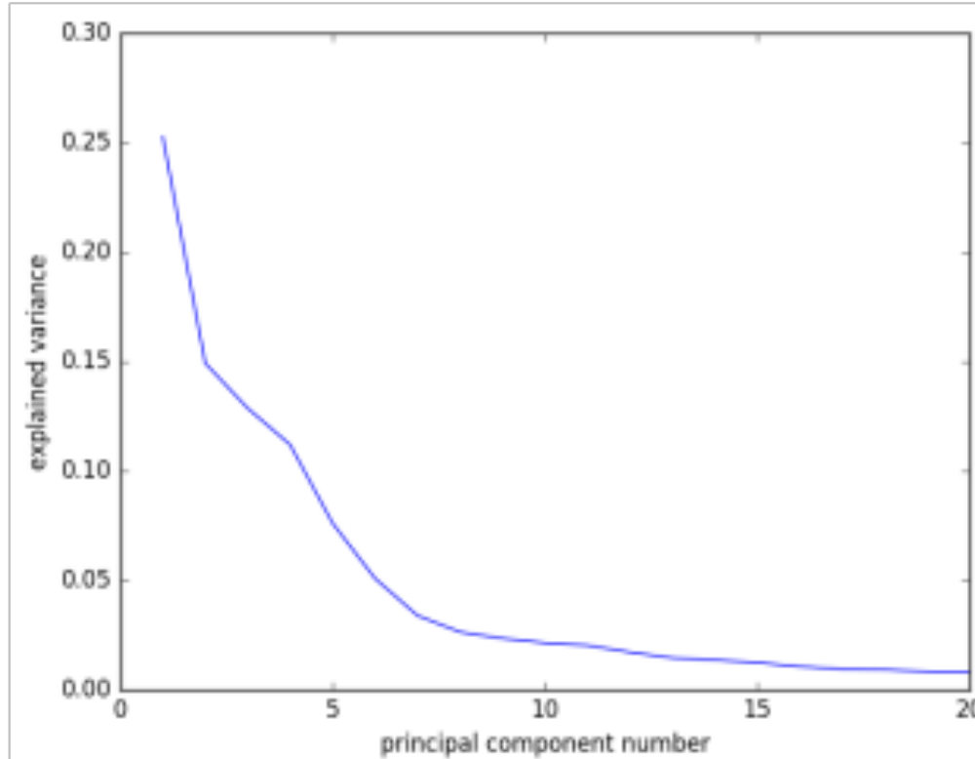
Principal component analysis (2)
CrowdSignals:

Slide 43
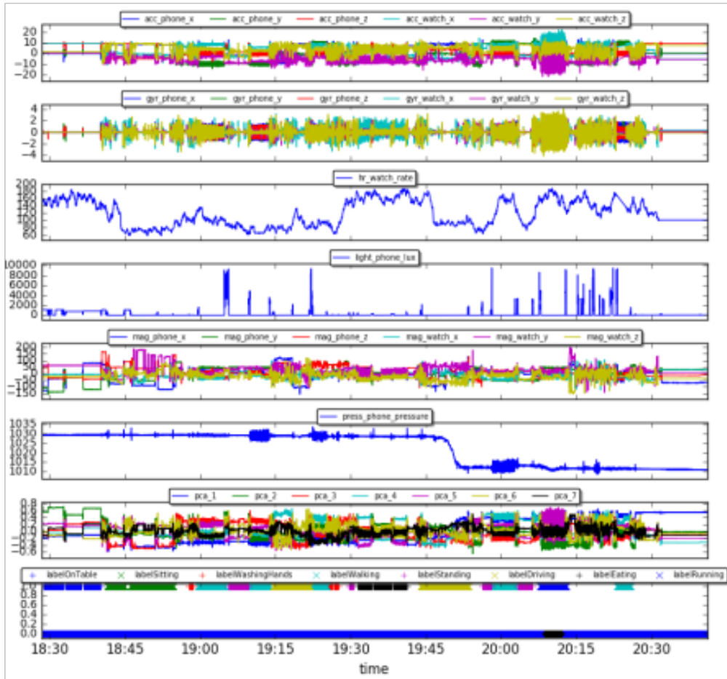

Slide 44
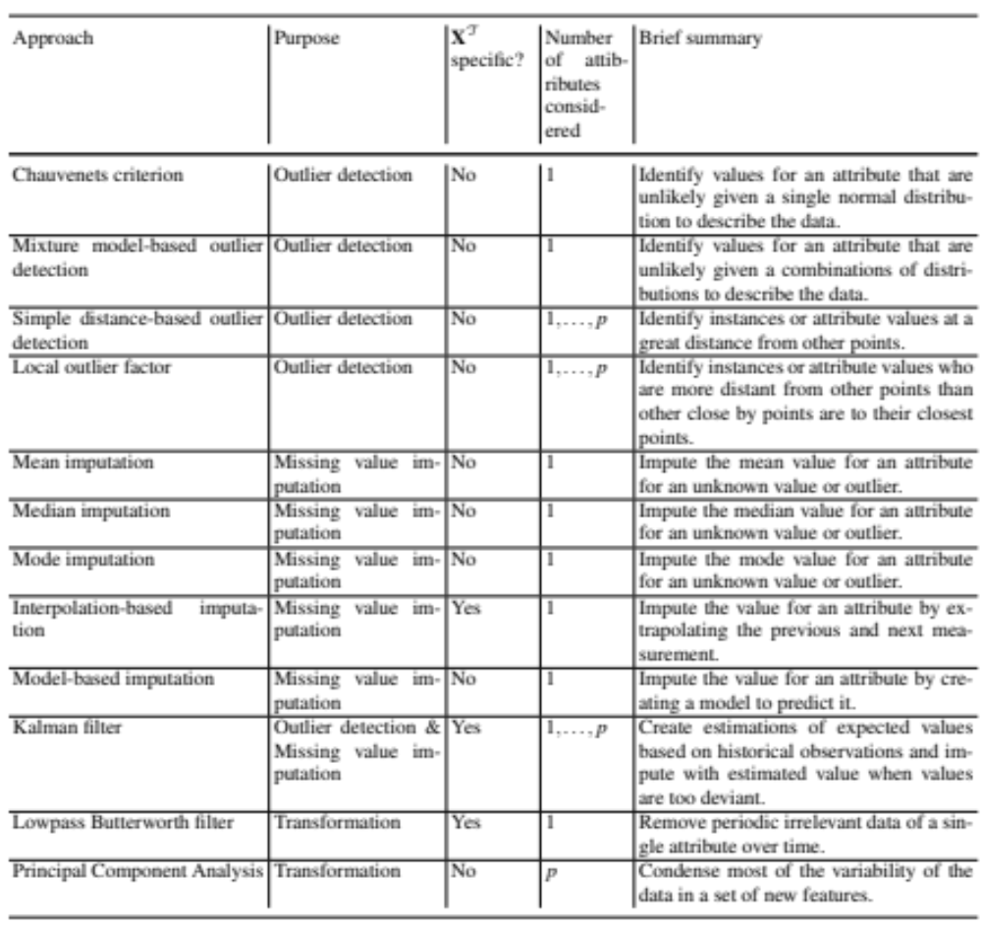
Summary

Slide 45
Summary
Have learned how to handle all the noise in our data using various approaches
This will help our machine learning algorithms later
Next time: feature extraction

