Slide 1
Machine Learning for the Quantified Self
Chapter 4
Feature Engineering Based on Sensory Data

Slide 2
Overview
Previously: we collected the data and removed the noise from the dataset
Today: creating useful features
  Time domain
  Frequency domain
  Sensor specific features

Slide 3
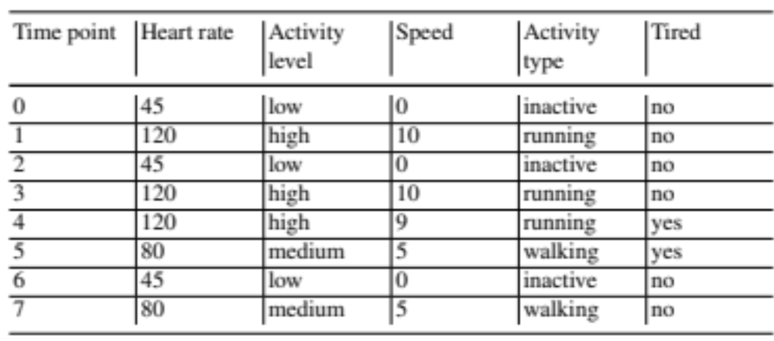
Time Domain
Imagine the following sequence

Slide 4
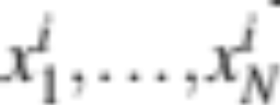
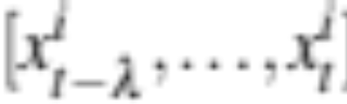
Time Domain: numerical (1)
We want to summarize values of a numerical attribute i in a certain window
We assume a temporal ordering in the dataset:
We select a windows size λ (1 in the previous example)
For each time point t we select the proper values:

Slide 5
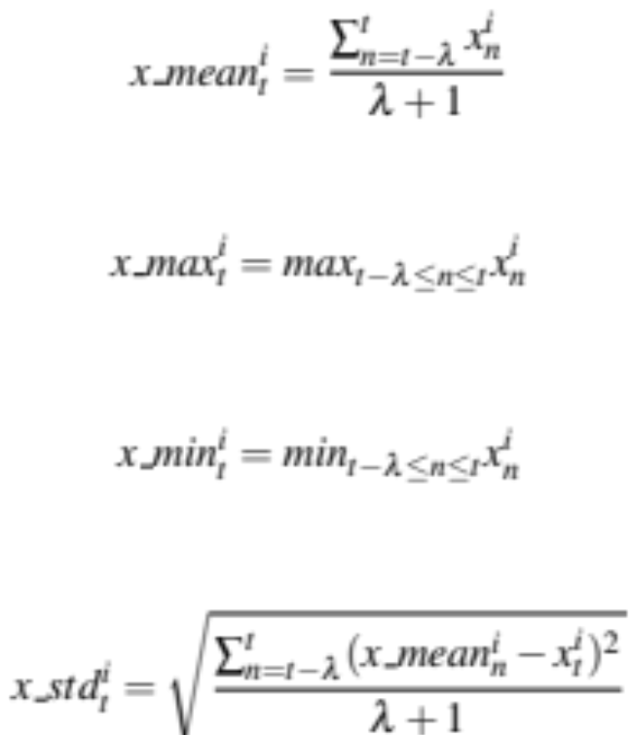
Time Domain: numerical (2)
We compute a new value per time point of a feature over each of these values:

Slide 6
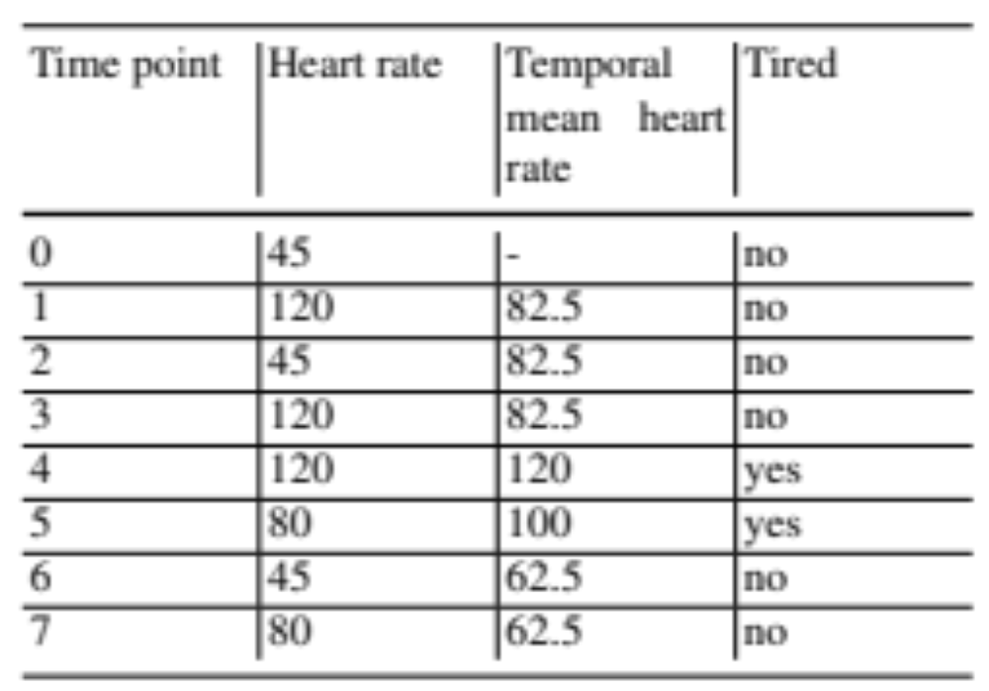
Time Domain: numerical (3)
Example outcome:

Slide 7
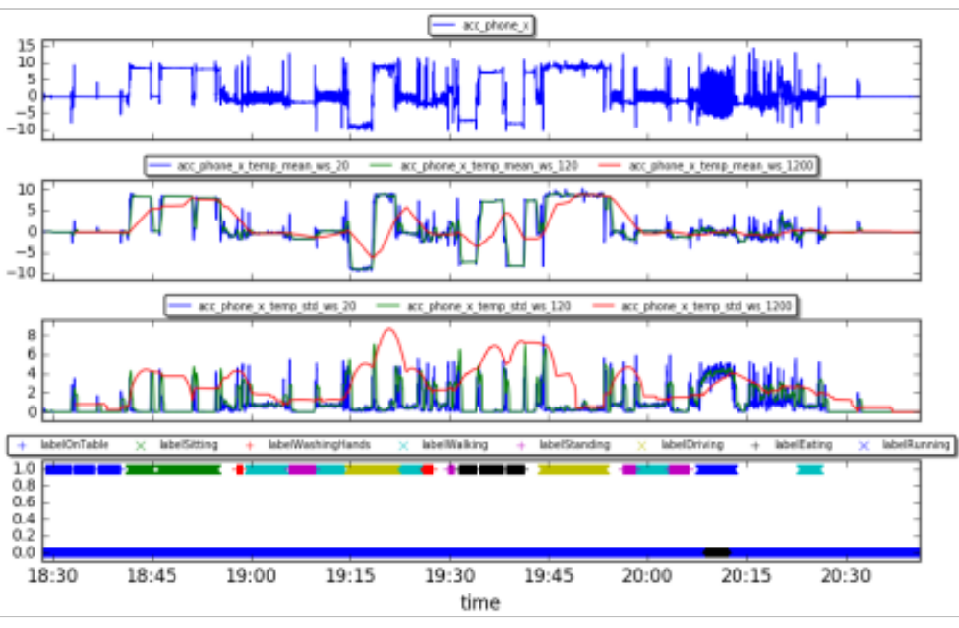
Time Domain: numerical (4)
CrowdSignals data:

Slide 8
Time Domain: categorical (1)
What if we have categorical features?
We generate patterns that combine categorical values over time
Follow an approach by Batal et al. (2013)
Again consider a window size λ
We consider different relationships
  succession (b)
  co-occurrence (c)

Slide 9
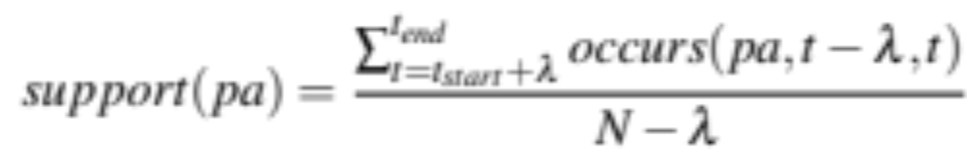
Support (1)
Example patterns:
  Activity level = low (c) Activity = running
  Activity = running (b) Activity = running
How do we find these patterns?
  We consider the notion of support
  What fraction of all time points does the pattern occur?

Slide 10
Support (2)
Support for Activity level = low (b) Activity type = running (λ=1)
Support =
2/7 ≈ 0.29

Slide 11
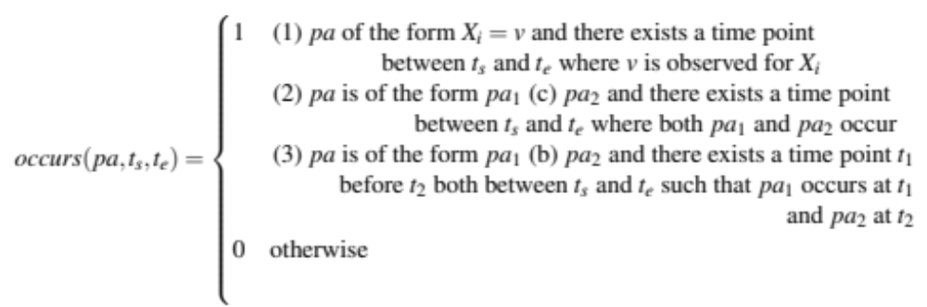
Support (3)
How can we define formally whether a pattern occurs?

Slide 12
Pattern generation (1)
We only want to focus on patterns with sufficient support
  Otherwise it will not be a good feature anyway
  We start with patterns of single attribute value pairs with sufficient support
  We extend these patterns to more complex patterns and select those with sufficient support
  As we move to more complex patterns of size k we only extend patterns of size k-1 that were among the ones with sufficient support

Slide 13
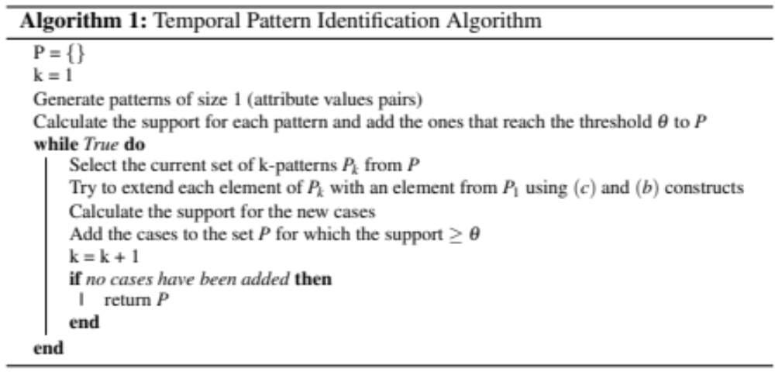
Pattern generation (2)

Slide 14
Pattern generation (3)
Let us consider our dataset again
  Assume a minimum support Θ=2/7 and λ=1
  What patterns would we get if we just consider Activity type?

Slide 15
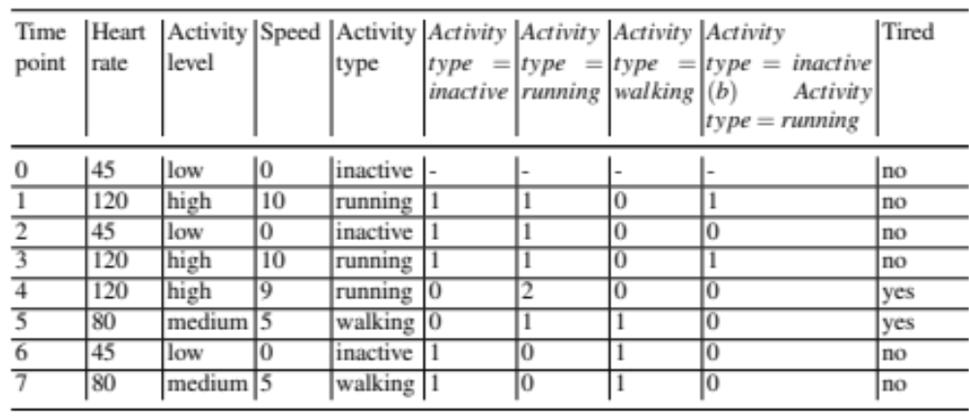
Pattern generation (4)
The resulting dataset:

Slide 16
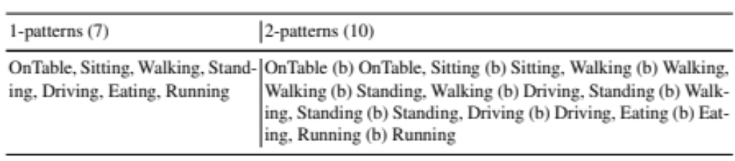
Time Domain: categorical (2)
CrowdSignals data (labels, λ=1200, Θ=0.03)

Slide 17
Time Domain: mixed data
We can make categories from the numerical values
  Use ranges (low, normal, high)
  Use temporal relations (increasing, decreasing)
We apply the categorical approach to those

Slide 18
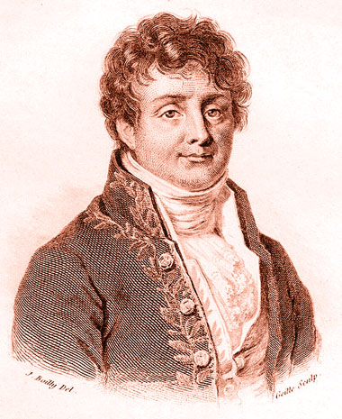
Frequency domain
Next to summarizing the values we can also look at the frequency domain
  Periodic data, e.g. a walking pattern
Let us consider our series of values again within a certain window of size λ:
Perform a Fourier transformation to see what “frequencies” we observe within the window

Slide 19
Fourier transformation (1)
How do we move from a time series to frequencies?
We create sinusoid functions with different periods
  from one period within our window to as many periods as we can fit in given our discrete time points
  We figure out how they can together account for the values we measure by finding the best amplitudes

Slide 20
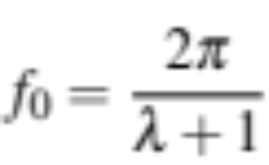
Fourier transformation (2)
Assume a base frequency:
The lowest frequency with a complete sinusoid period in it
We can look at multiples k of this base frequency (k full sinusoid periods)
  k runs from 0 to our window size

Slide 21
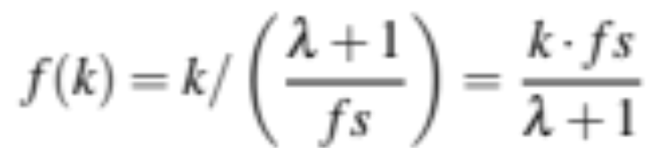

Fourier transformation (3)
We can compute a frequency per second given a value of k
  Let fs represent how many data points represent a second
  Then the frequency of a sinusoid with value k
  We need λ + 1 frequencies:

Slide 22
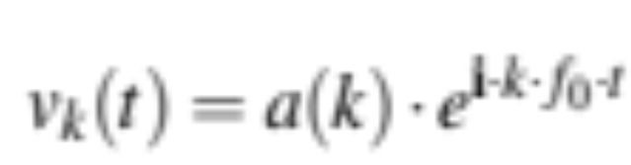
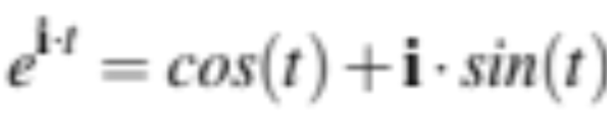
Fourier transformation (4)
We need to find the amplitudes a(k) associated with the frequencies
  The value of the sinusoid at a time point t is specified as:
  Why do we have e^{i}? Well, it just represents a sinusoid function (cf. Euler):

Slide 23
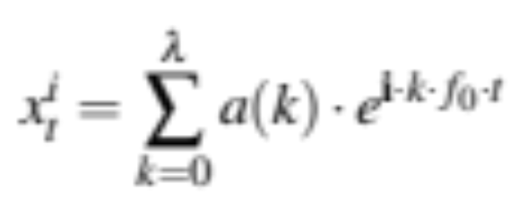
Fourier transformation (5)
And now our value at time point t is:
We can find the best values for a(k) for a given window of time points using Fast Fourier Transform

Slide 24
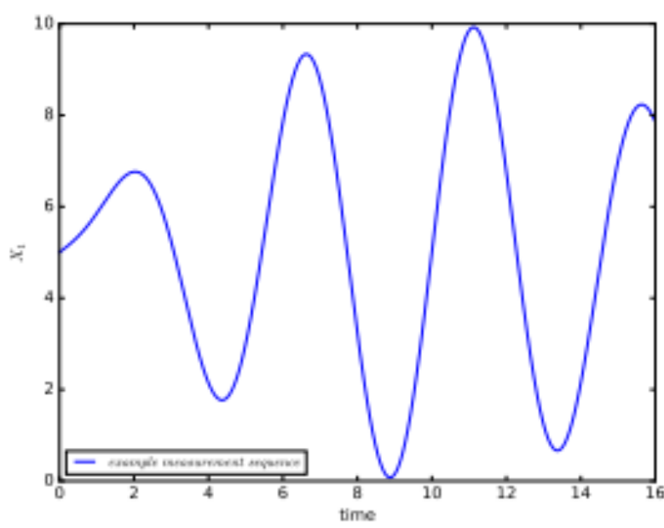
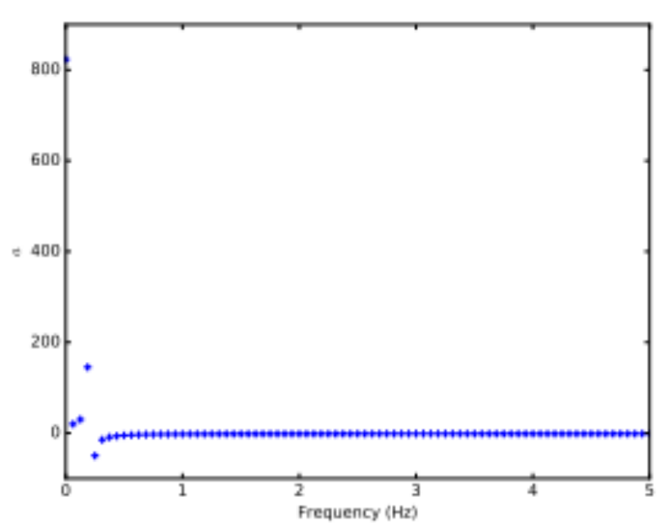
Fourier transformation (6)
Let us look at an example:

Slide 25
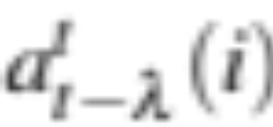
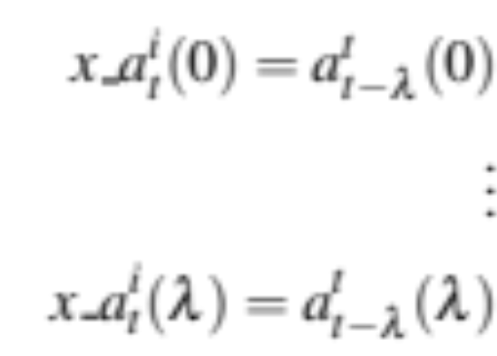
And now…. get feature values (1)
We have different values for a(k) per time point
We can start to derive value
  The actual values of the amplitudes for each frequency:

Slide 26
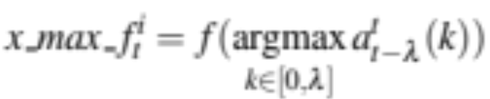
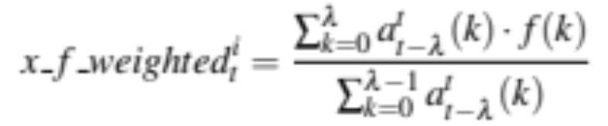
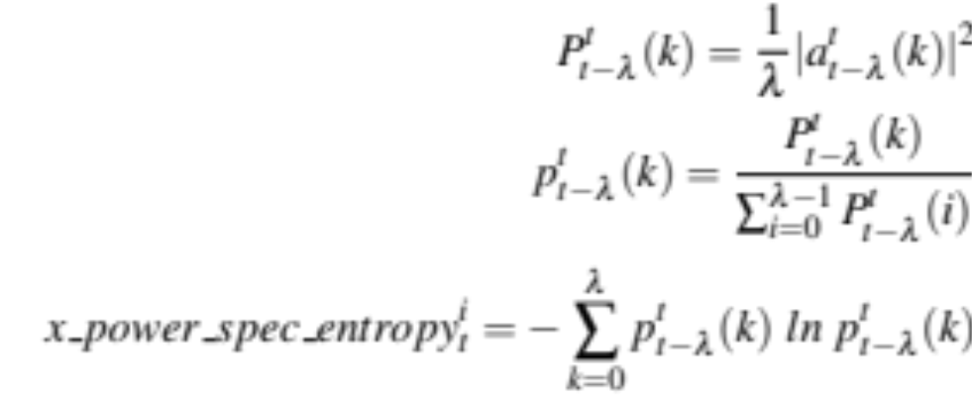
And now…. get feature values (2)
  The highest amplitude frequency:
  The frequency weighted signal average:
  And the amount of information in the signal (power spectrum entropy):

Slide 27
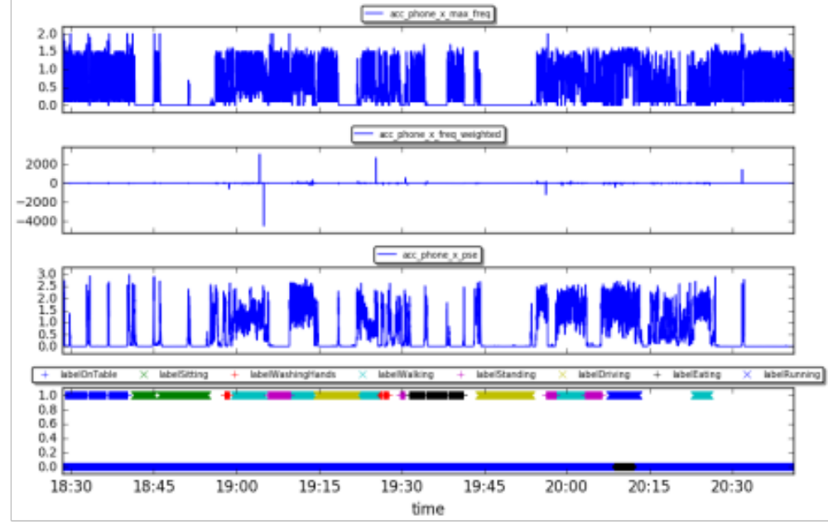
Frequency domain (2)
CrowdSignal example (λ=40)

Slide 28
Features for unstructured data
Ok, we have seen a lot of possibilities for structured data
How do we handle more unstructured data?
  Free text
  Images
  Audio
  Video
  ……
Look at text only in this lecture

Slide 29
Features for text (1)
Let us take an example from Bruce:
  Bruce: ”I really felt bad yesterday. Got fired at work.”
  We perform a number of steps first:
    Tokenization
      identify sentences and words within sentences
    Lower case
      change the uppercase letters to lowercase
    Stemming:
      Identify the stem of each word to reduce words to their stem and map all different variations of for example verbs to a single term
    Stop word removal:
      remove known stop words as they are not likely to be predictive.

Slide 30
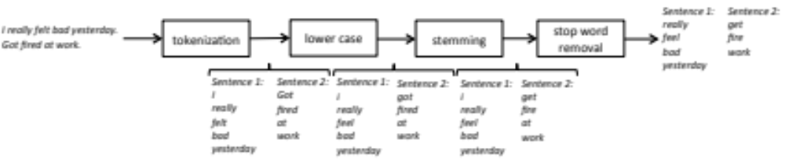
Features for text (2)
Let us take an example from Bruce:
  Bruce: ”I really felt bad yesterday. Got fired at work.”

Slide 31
Features for text (3)
Approaches:
  Bag of words
  TF-IDF
  Topic modeling

Slide 32
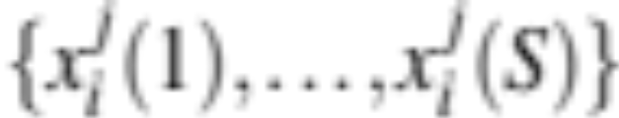
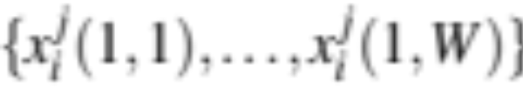
Bag of words (1)
Count occurrences of n-grams within text
n-gram: n consecutive words
Assume that we note down the S sentences we have found within an instance i at for attribute j as follows:
And the words within the sentences:

Slide 33
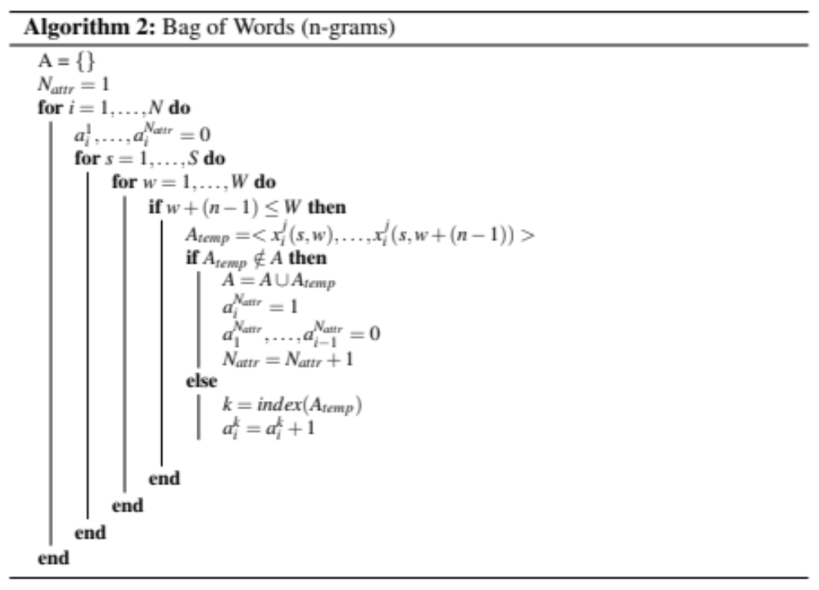
Bag of words (2)

Slide 34

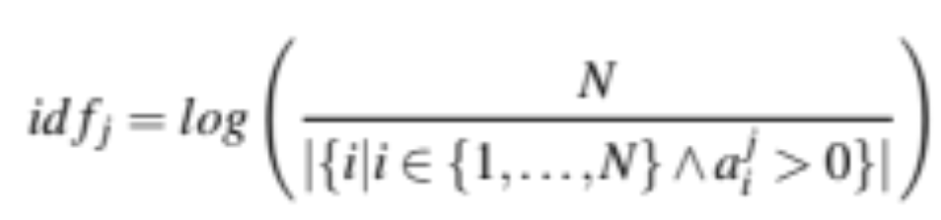
TF-IDF (1)
Bag of words does not account for the “uniqueness of words”
Assume that we have found the number of occurrences of a word (using bag of words):
The inverse document frequency is:

Slide 35
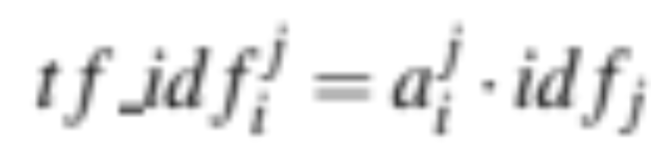
TF-IDF (2)
And we multiply this with the number of times it occurs:
Gives more weight to unique words
Avoids very frequent (and probably not very predictive words) to become too dominant

Slide 36
Topic Modeling (1)
Instead of looking at words, let us look at the topics the free text is about
We assume that the texts contain k topics
Topics are associated with words, certain words make up a topic
  The depression topic might contain words such as “bad”, “down”, “mood”, etc.
For each topic, a word has a certain weight:

Slide 37
Topic Modeling (2)
How do find topics?
  We can use Latent Dirichlet Allocation (LDA) (cf. Blei, 2003)
  It assumes text are generated with:
    certain words in mind (using a Poisson distribution)
    a distribution over topics (using a Dirichlet distribution)
  We assume words fully belong to a single topic initially
  We update the weights to maximize the probability of observing the texts

Slide 38
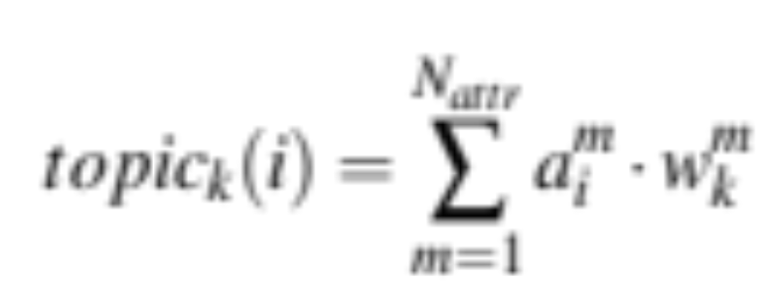
Topic Modeling (3)
And we score the topics as follows:

Slide 39
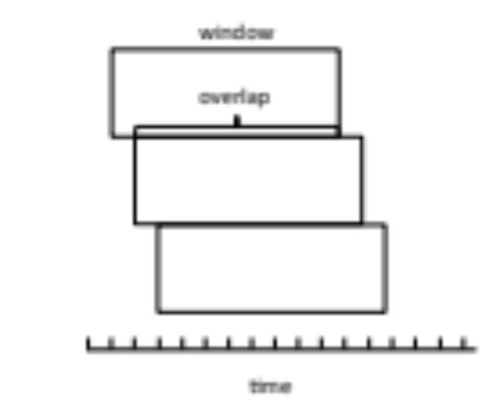
Composition of final dataset (1)
With our new features we might have very low variation on the values
  If we have a large windows size, will it matter that we move one time point?
  Disadvantages?

Slide 40
Composition of final dataset (2)
We allow for a certain percentage of overlap (typical: 50%, us: 90%)
We only have 2895 remaining instances (out of 31838)

