Slide 1
Machine Learning for the Quantified Self
Chapter 5
Clustering

Slide 2
Overview
Previously: we identified features
Today: let us use the features to cluster
  Learning setup
  Distance functions
  Clustering algorithms

Slide 3
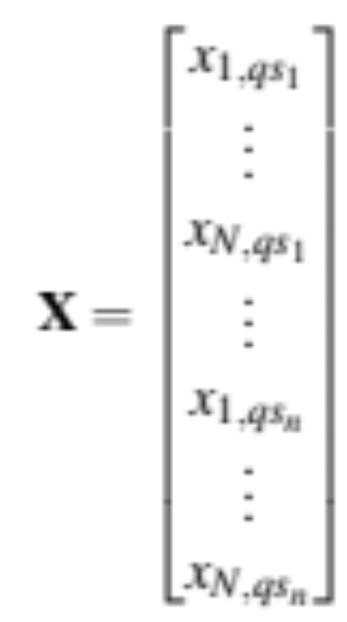

Learning setup (1)
Per instance:
x_{1, qs1}
x_{1, qs1}
x_{2, qs1}
x_{N, qs1}
x_{N, qs1}
x_{2, qs1}
x_{2, qsn}
x_{N, qsn}
x_{2, qsn}
x_{1, qsn}
x_{2, qsn}
x_{N, qsn}

Slide 4
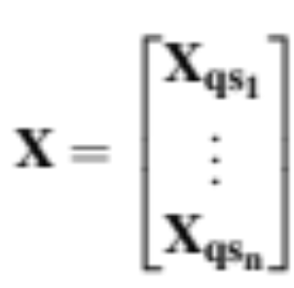
Learning setup (2)
Per person:
x_{1, qs1}
x_{2, qs1}
x_{N, qs1}
x_{1, qsn}
x_{2, qsn}
x_{N, qsn}

Slide 5
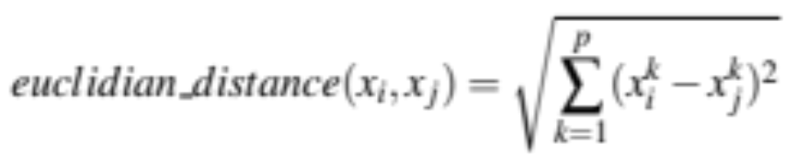
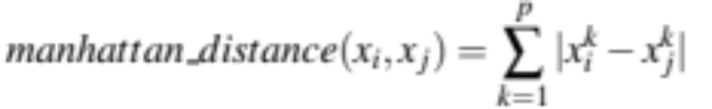
Distance metrics (1)
Need different distance metrics per scenario
Individual distance metrics (between an instance x_{i} and x_{j} over all attributes p):
  Euclidean distance
  Manhattan distance

Slide 6
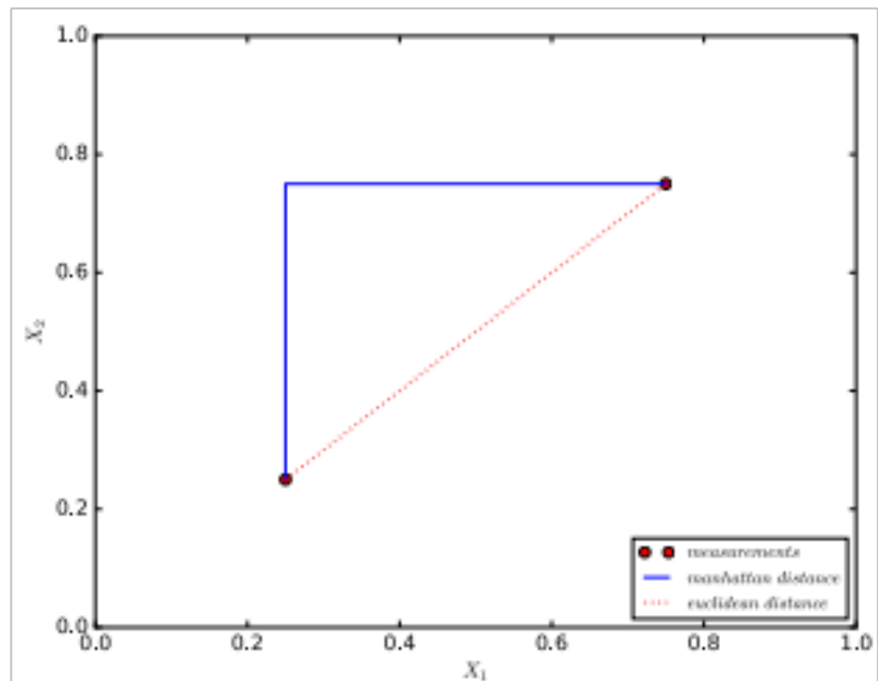
Individual distance metrics (1)
The difference:

Slide 7
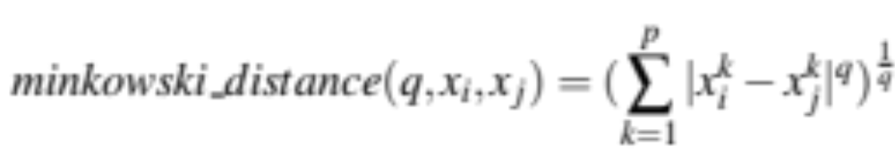
Individual distance metrics (2)
Generalized form:
Important to consider: scaling of data
These all assume numeric values, what if we have other types?
  We can use Gower’s similarity

Slide 8
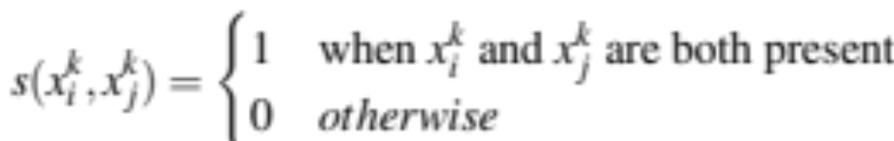
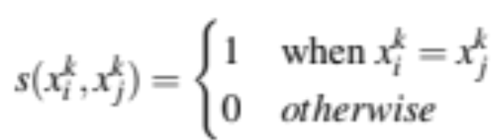
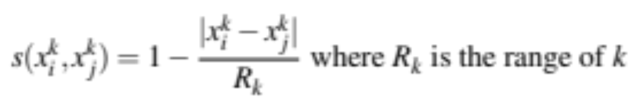
Individual distance metrics (3)
Gower’s similarity for different types of features:
  Dichotomous attributes (present or not)
  Categorical attributes:
  Numerical attributes:

Slide 9
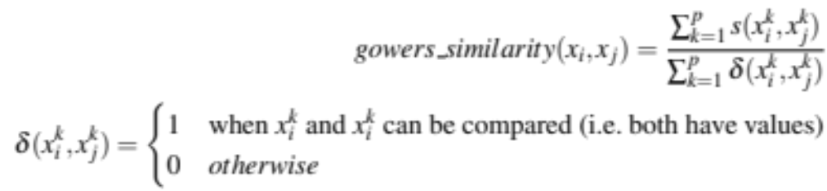
Individual distance metrics (4)
And we computer the final similarity as:

Slide 10
Distance metrics (2)
What if we need to compare datasets instead of individual instance?
We can identify person level distance metrics
These are available in different forms:
  For datasets without an explicit ordering
  For datasets with a temporal ordering

Slide 11
Non-temporal personal level distance metrics (1)
We have a number of options:
  Summarize values per attribute i over the entire dataset into a single value
    e.g., mean, minimum, maximum, …..
    use the same distance metrics we have seen before
  Estimate parameters of distribution per attributes i and compare those(e.g. N(μ,σ²))
    e.g. normal distribution N(μ,σ²)
    use the same distance metrics we have seen before upon the found parameter values
  Compare the distributions of values for an attribute i with a statistical test
    e.g. use a Kolmogorov Smirnov test, resulting in a p-value
    Take 1-p as a distance metric

Slide 12
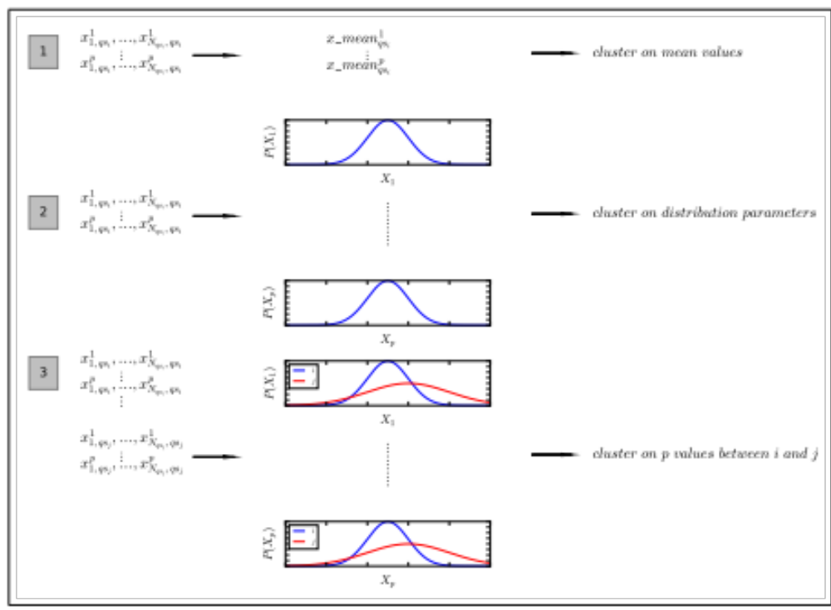
Non-temporal personal level distance metrics (2)

Slide 13
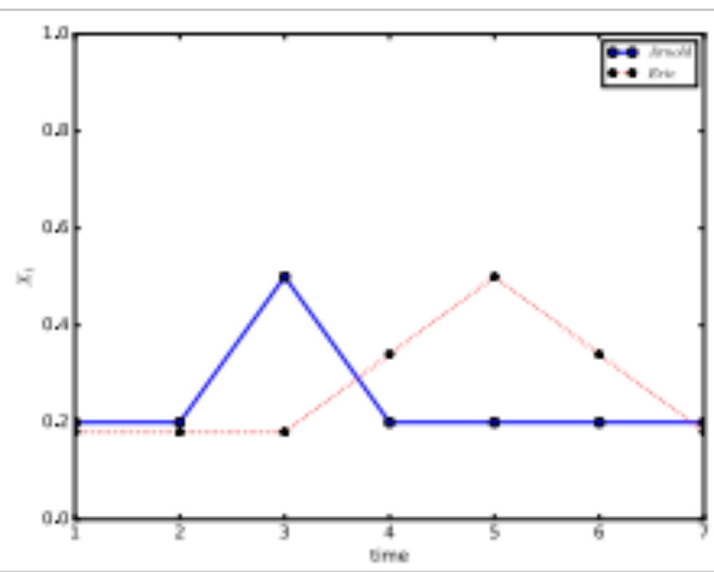
Temporal personal level distance metrics (1)
What if we do have an ordering?
  Raw-data based
  Feature-based
  Model-based

Slide 14
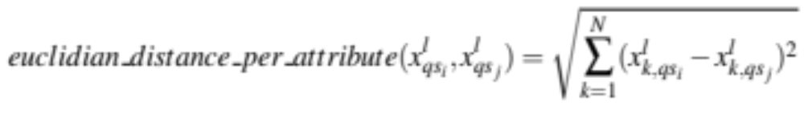
Raw-data based distances (1)
Simplest case: assume an equal number of points and compute the Euclidean distance on a per point basis:

Slide 15
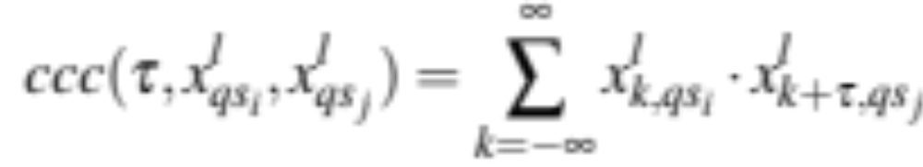
Raw-data based distances (2)
What if the time series are more or less the same, but shifted in time?
We can use a lag to compensate, we denote the amount of time shifted by τ
The cross correlation coefficient between two dataset is computed by:

Slide 16
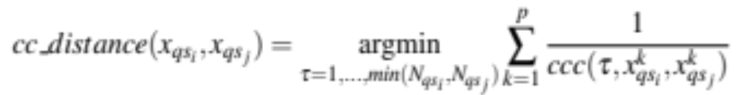
Raw-data based distances (3)
What is the best value τ to shift?
This is an optimization problem (note: one shift over all attributes):

Slide 17
Raw-data based distances (4)
Next to this, we can also think about different frequencies at which different persons perform their activities
We can use dynamic time warping for this purpose
We try to make the best pairs of instances in sequences to find the minimum distance

Slide 18
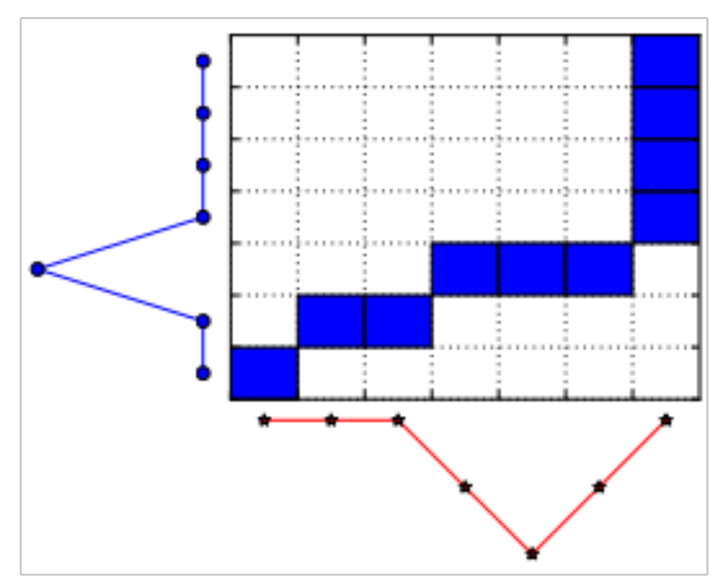
Dynamic Time Warping (1)
Pairing?

Slide 19
Dynamic Time Warping (2)
Requirements of pairing
  Time order should be preserved
    monotonicity condition
  First and last points should be matched
    boundary condition
  assume seq(k, q_{sj}) to represent the sequence number (in terms of instance ) of pair k with respect to the dataset q_{sj}

Slide 20
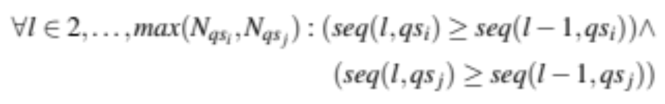
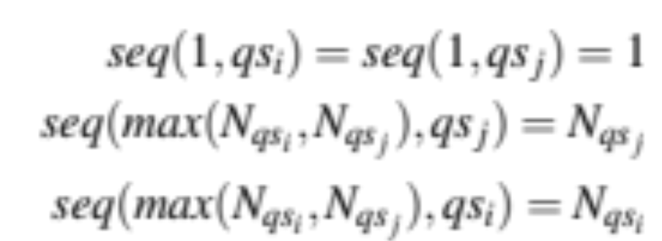
Dynamic Time Warping (3)
Requirements of pairing
  monotonicity condition
  boundary condition

Slide 21
Dynamic Time Warping (4)
boundary condition
monotonicity condition
boundary condition
monotonicity condition

Slide 22
Dynamic Time Warping (5)
How do we find the best path?
  We start at (0,0) and move up and to the right
  Per pair we compute the cheapest way to get there given our constraints and the distance between the instances in the pair
  As distance between instance we can for example use the Euclidean distance
  Let us look at the algorithm…..

Slide 23
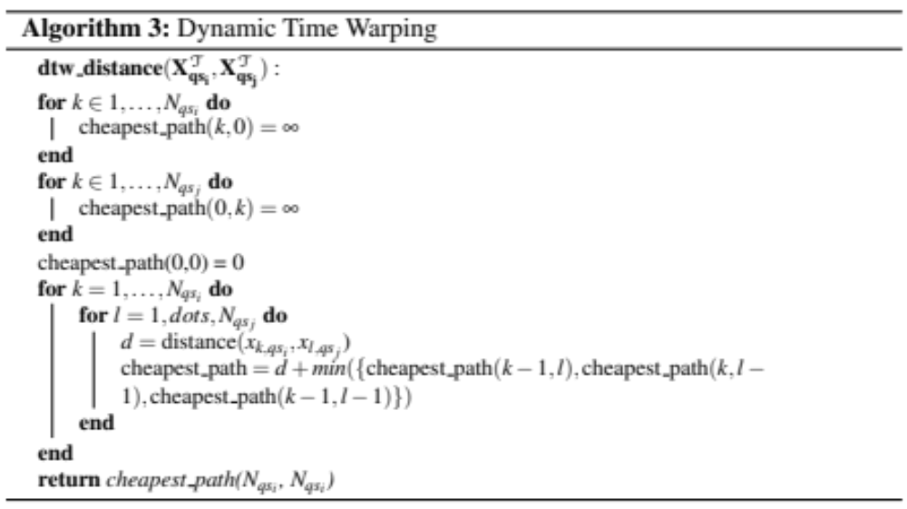
Dynamic Time Warping (6)

Slide 24
Dynamic Time Warping (7)
Computationally expensive
  Improvement: Keogh bound
Would you be willing to allow for all matches provided they meet the conditions?
Would the best match always be the best distance metric?

Slide 25
Temporal personal level distance metrics (2)
What if we do have an ordering?
  Raw-data based v
  Feature-based
    Same as non-temporal case we have seen
  Model-based
    Fit a time series model and use those parameters (again in line with the non-temporal case, except for the type of model being different)

Slide 26
Clustering approaches
Ok, we know how to define a distance, now what clustering approaches do we have?
Assume you do have some basic understanding
Will scan through the options briefly
  k-means
  k-medoids
  hierarchical clustering

Slide 27
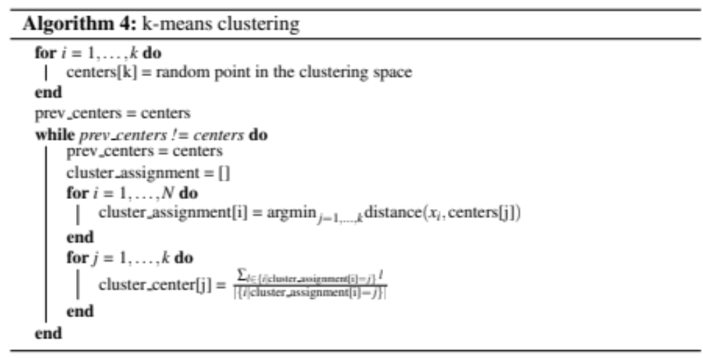
k-means clustering (1)

Slide 28
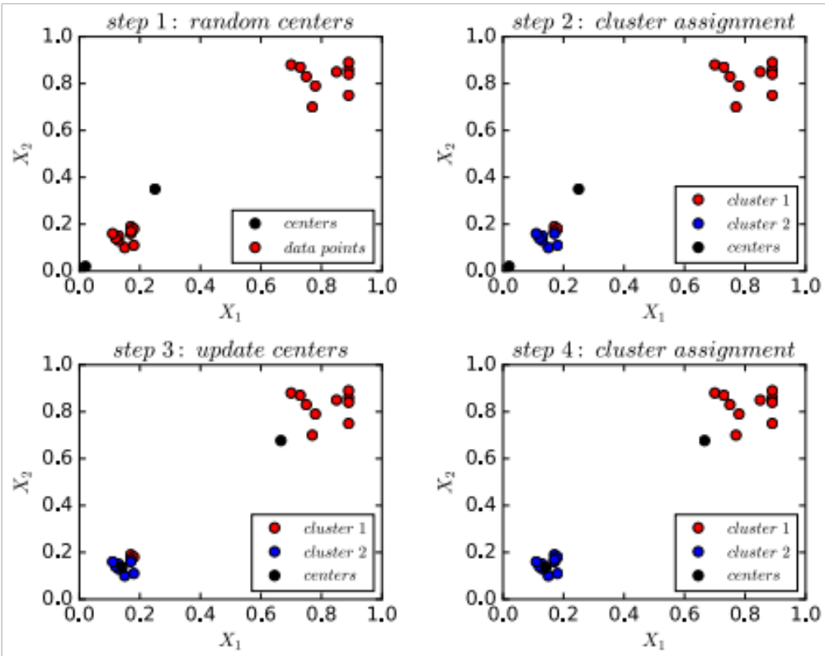
k-means clustering (2)

Slide 29
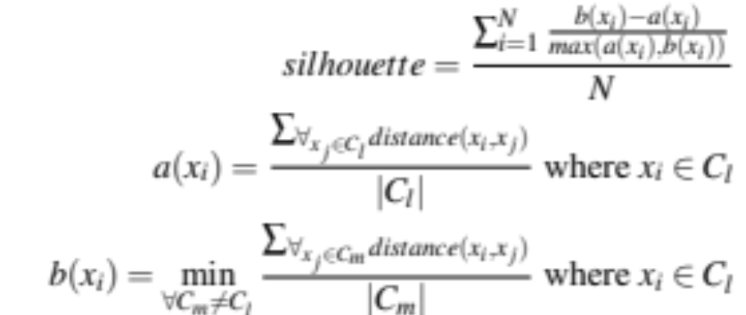
Performance metric
How do we select the best value for k?
How do we evaluate whether a clustering is good?
Silhouette can be used ([-1, 1], 1 is best)

Slide 30
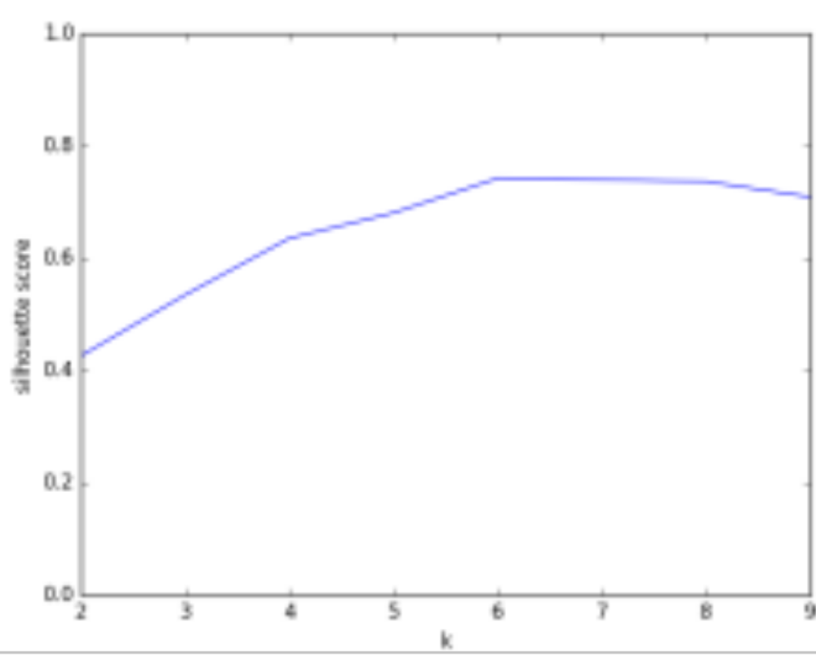
k-means clustering (3)
CrowdSignals accelerometer data

Slide 31
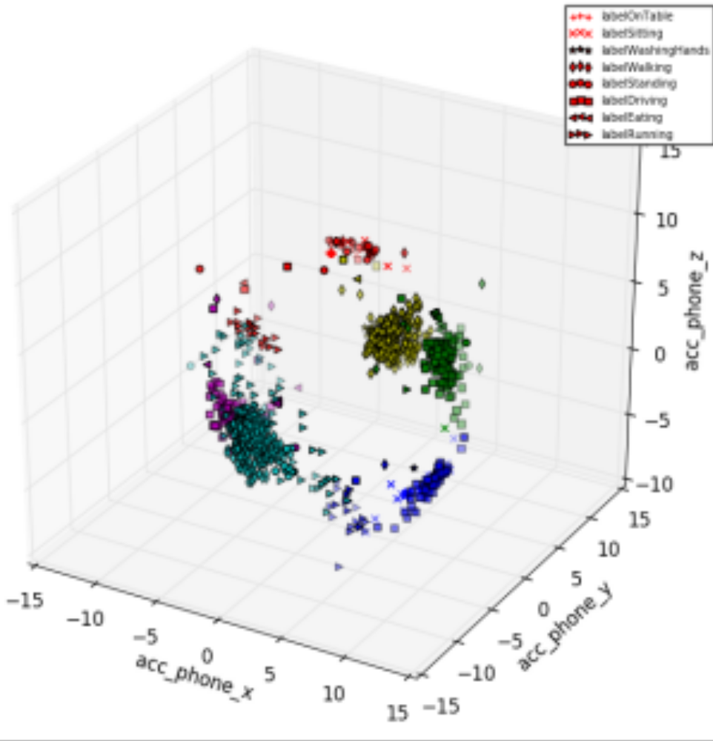
k-means clustering (4)

Slide 32
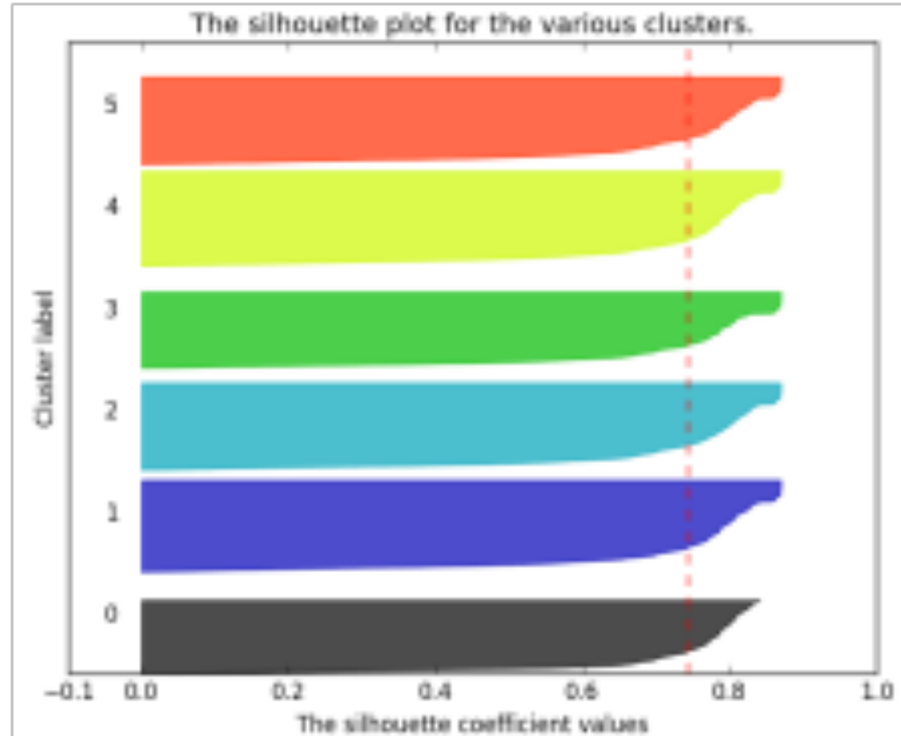
k-means clustering (5)
CrowdSignals accelerometer data

Slide 33
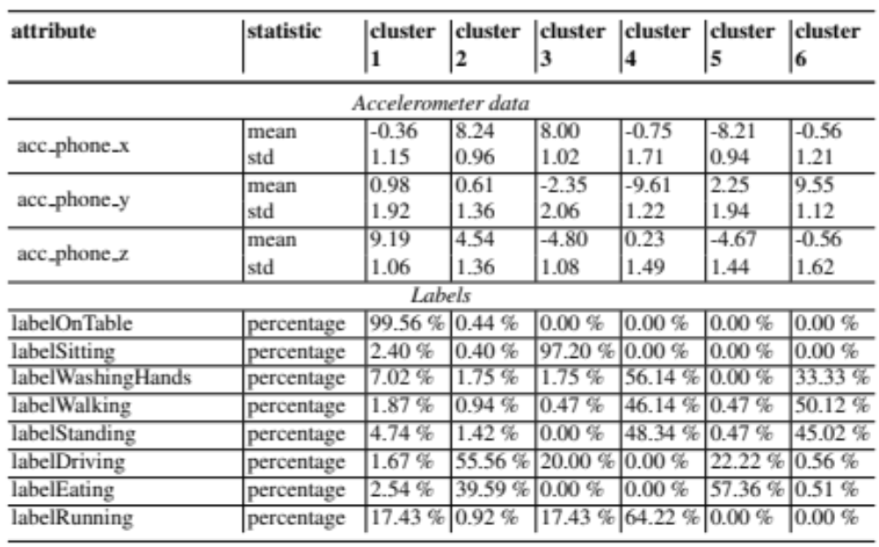
k-means clustering (6)

Slide 34
k-medoids clustering (1)
k-medoids: same as k-means, except that we do not use artificial mean centers, but actual points
k-means: suitable for person level distance metrics?
  k-medoids is known to be more suitable

Slide 35
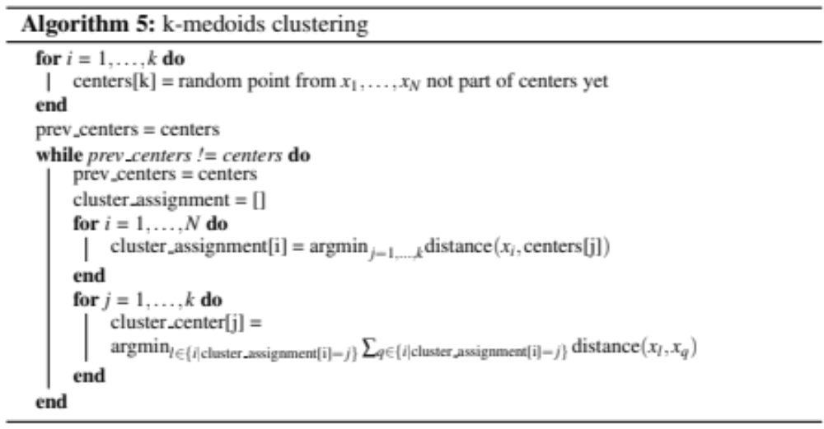
k-medoids clustering (2)

Slide 36
Hierarchical clustering (1)
Can also take a more iterative approach:
  Divisive clustering
    Start with one cluster, make a split in each step
  Agglomerative clustering
    Start with one cluster per instance and merge
  Can be visualized using a dendrogram

Slide 37
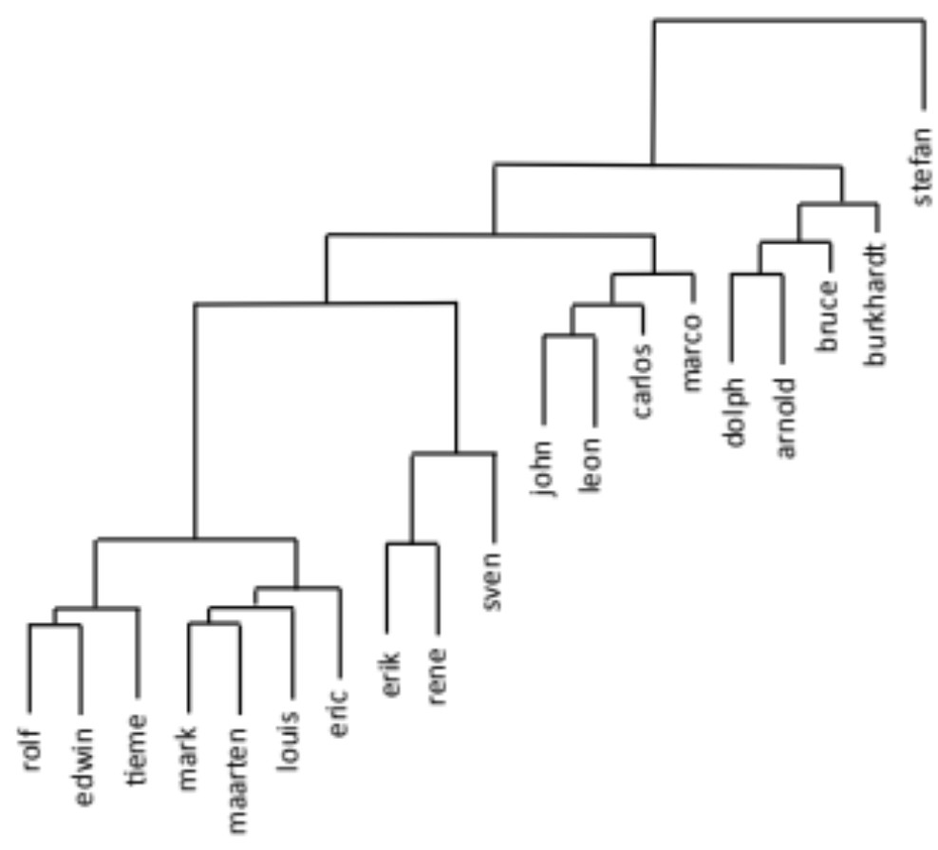
Hierarchical clustering (2)

Slide 38
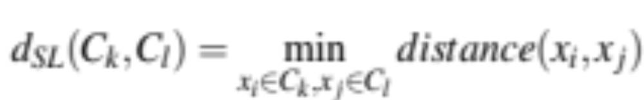
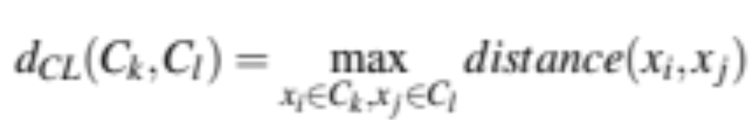
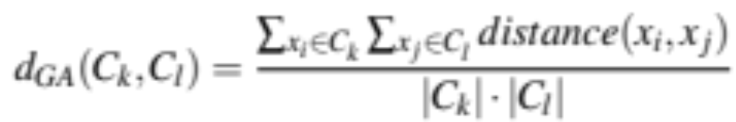
Agglomerative clustering (1)
We need to know which clusters to merge
Different criteria:
  Single linkage
  Complete linkage
  Group average

Slide 39
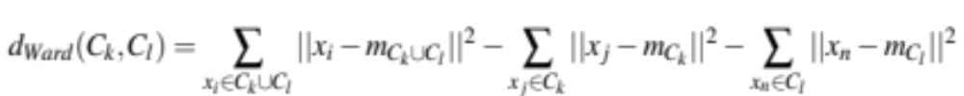
Agglomerative clustering (2)
We need to know which clusters to merge
Different criteria:
  Ward’s criterion (minimize standard deviation):

Slide 40
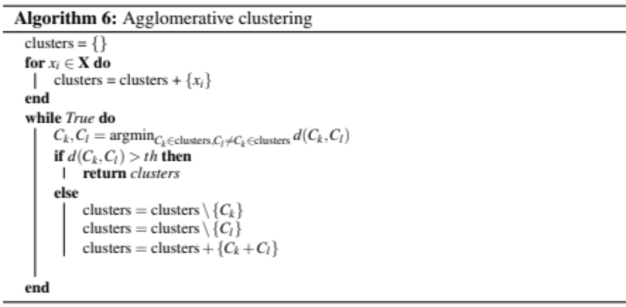
Agglomerative clustering (3)

Slide 41
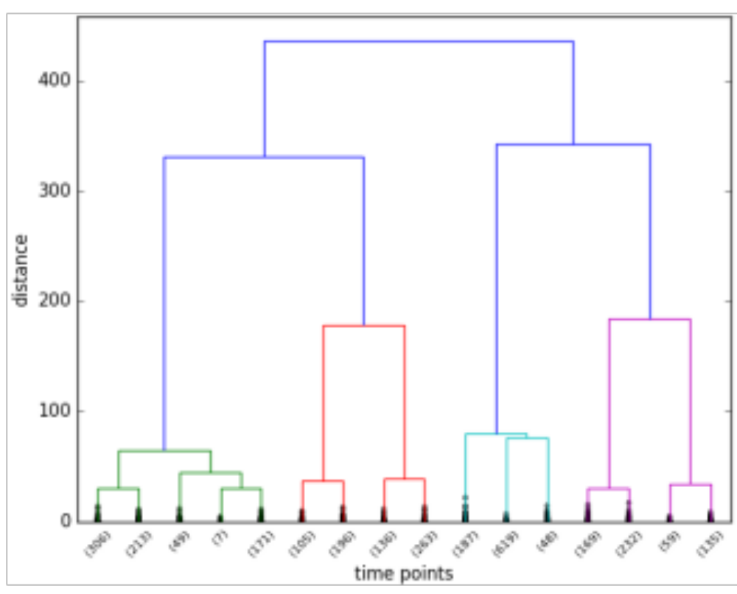
Agglomerative clustering (4)
CrowdSignal example (Ward’s criterion)

Slide 42
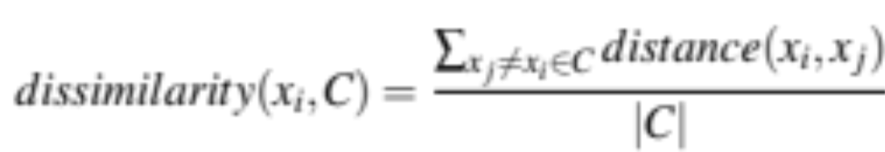
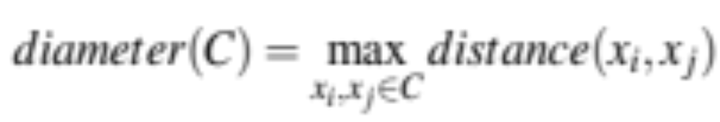
Divisive clustering (1)
We start with a big cluster and split
We define a dissimilarity of a point to other points in the cluster C:
We create a new cluster C’ and remove the most dissimilar points from C to C’ until these are more dissimilar to points in C’
What C should we select?
  One with the largest diameter:

Slide 43
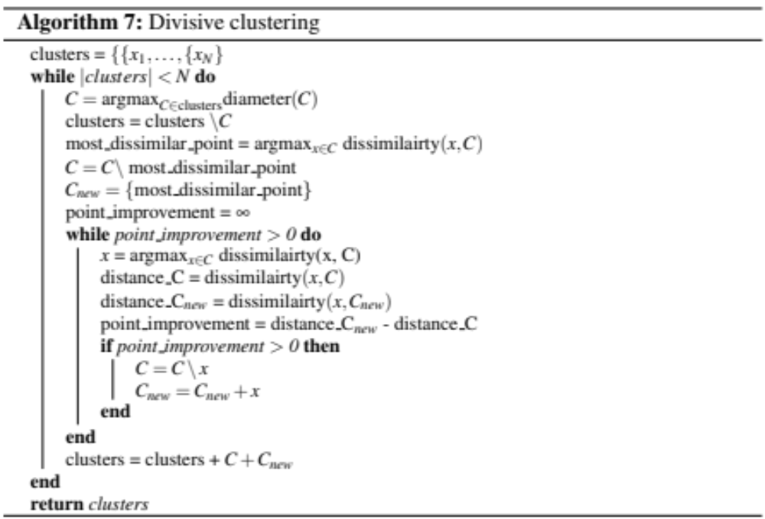
Divisive clustering (2)

Slide 44
Subspace clustering (1)
What if we have a huge number of features?
Would everything even out?
  Very likely
  Most clustering approaches do no handle a large number of features well
Subspace clustering can provide a solution:
  Looks at subspace in the feature space
  Focus on the CLIQUE algorithm (cf. Agrawal, 2005)

Slide 45
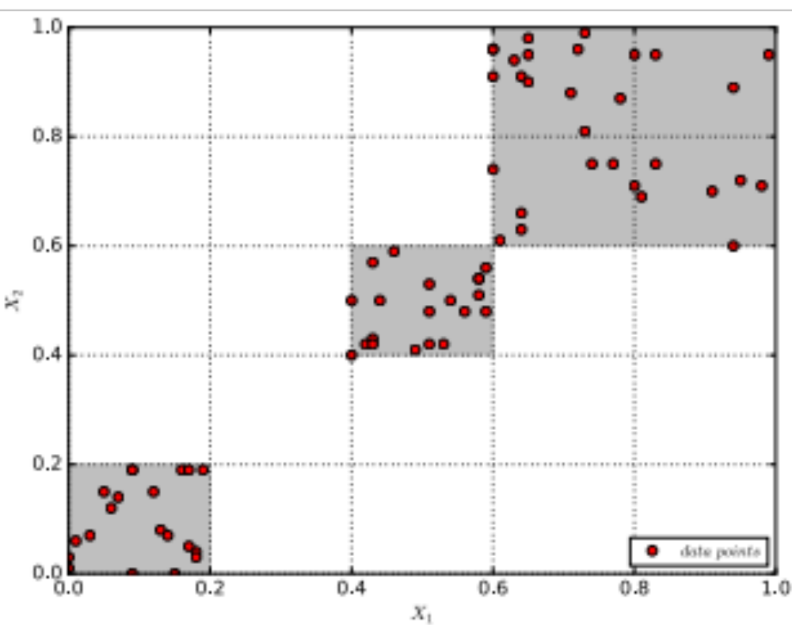
Subspace clustering (2)
First step: we create units based on our features (ε distinct intervals per feature)

Slide 46
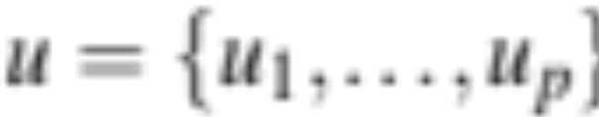
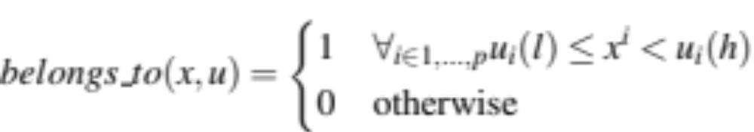
Subspace clustering (3)
A unit is defined by upper and lower boundaries per feature:
u_{i}(l) is the lower bound, u_{i}(h) the upper bound for the value of attribute i
An instance x is part of the unit when its value fall in the boundaries:

Slide 47
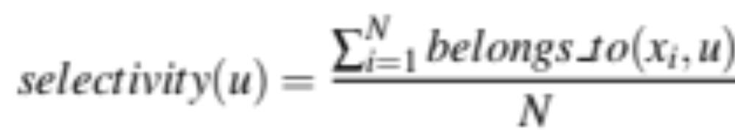
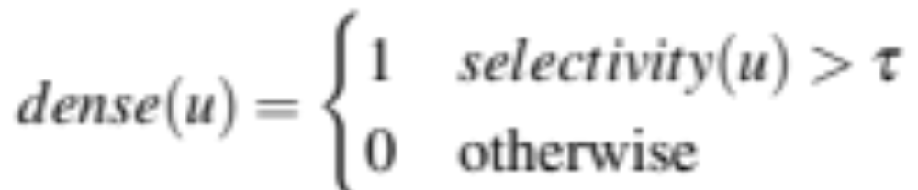
Subspace clustering (4)
We can define the selectivity of a unit as:
And given a threshold τ a unit is dense when:
Previous figure showed dense units (grey)

Slide 48
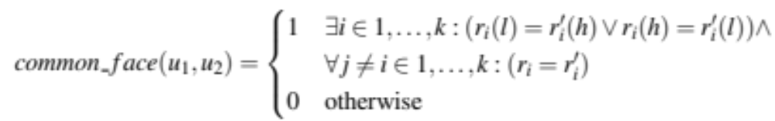
Subspace clustering (5)
We want subspaces (subsets of attributes), so our units do not have to cover all attributes
We can have units that cover k attributes
Units have a common face when:

Slide 49
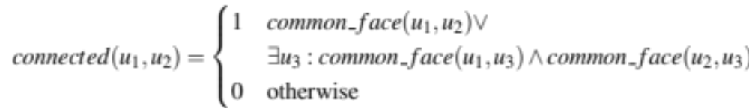
Subspace clustering (6)
Units are connected in a cluster when they they share a common face or when they share a unit that is a common face to both:
We strive to find dense units using a combination of attributes to form the clusters

Slide 50
Subspace clustering (7)
We start with one attribute and work our way up using some fancy algorithms
Once we have found all the dense units we find the clusters
The details on the precise computational steps are provided in the book

