Slide 1
Machine Learning for the Quantified Self
Chapter 6
Mathematical Foundations of Supervised Learning

Slide 2
Overview
Previously: we performed clustering
Today: let us turn supervised
  Fundamentals
  Learning setup
  Brief overview of learning algorithms
  Our CrowdSignals case study

Slide 3
Supervised learning (1)
What do we mean when we say ”machines can learn”?
  Task
  Historical data
  Improvement on task performance
Mitchell: “A computer program is said to learn from experience E with respect to some class of tasks T and performance P, if its performance at tasks in T improves with E.”

Slide 4

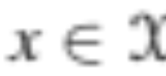
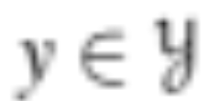


Supervised learning (2)
In supervised learning we want to learn
  a functional relationship, alternatively called
  an unknown target function
Here we map an observation
to the target (or g)
Here, represents the space of all possible inputs (and all possible targets)
Not likely to be deterministic
  Measurement errors
  Noisy target (e.g. because we do not have all observations)

Slide 5
Supervised learning (3)
Assume unknown conditional target distribution p(y|x)
Gives probability of y given that x is fixed
If we calculate f(x) we add noise from a noise distribution
  Bernoulli or categorical distribution for discrete target
  Normal distribution for continuous
More difficult to learn the target function with this noise
In addition we have the distribution of the observations p(x)

Slide 6
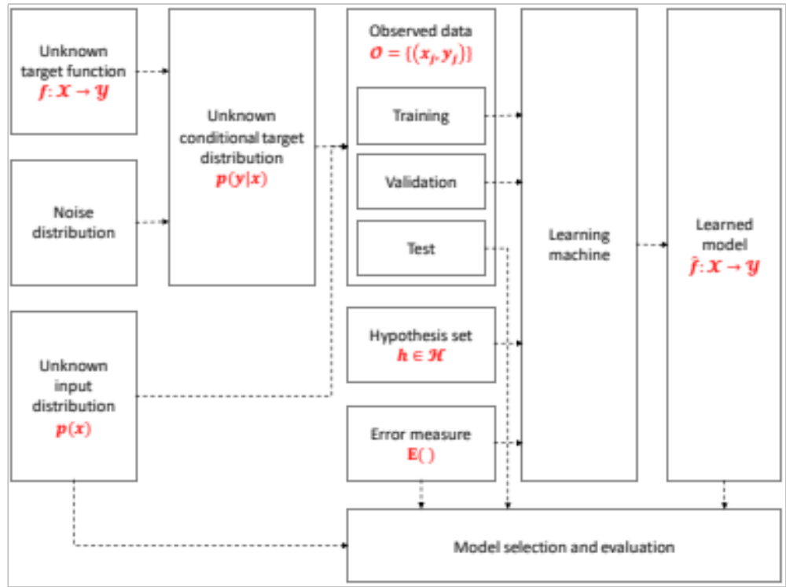
Supervised learning (4)

Slide 7
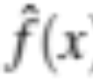
Observed Data
We separate our dataset into a training, validation, and test set
We learn a function that fits our observed data in the training set
Should stratify training set in case of unbalanced dataset
Evaluate generalizability of upon test set
Stop learning process based on validation set
Small dataset: cross validation

Slide 8
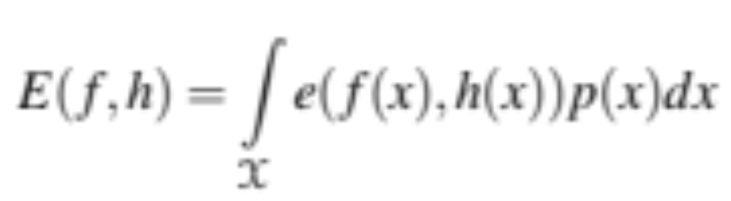
Error measure (1)
Assume we have a hypothesis for the target function h
How far apart is h from f ? E(f, h)
  risk
We can compute it per point e(f(x), h(x))
  loss
From e to E (given p(x)):

Slide 9
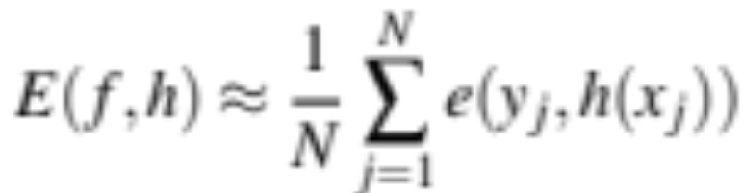
Error measure (2)
Could we computer this?
  Nope
We approximate it using the data we have
What definitions do we have for e?
  Classification example: classification rate, F1, AUC, …..
  Regression: mean squared error, mean absolute error, …..

Slide 10
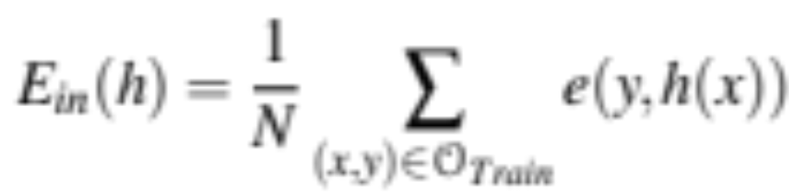
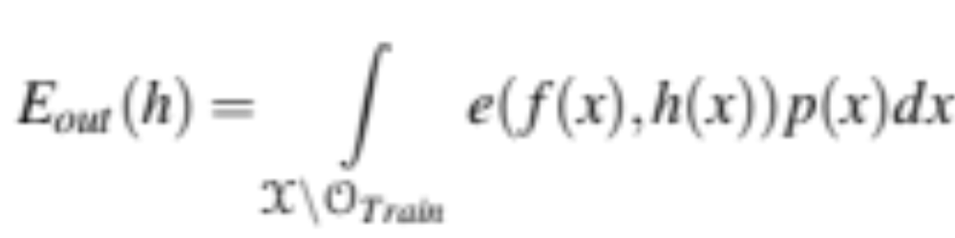
Error measure (3)
In sample error:
Out of sample error:

Slide 11
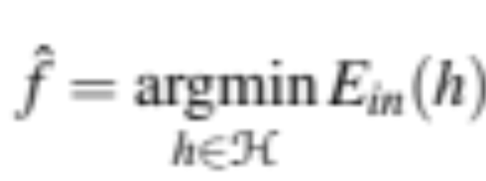
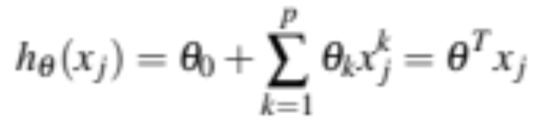
Hypotheses
We select the hypothesis that minimizes the in-sample error:
What is the set of hypotheses?
  For linear regression:

Slide 12
Model selection
We select the hypothesis that has the lowest in-sample error on the validation set
We should be careful about overfitting and not use too many features

Slide 13
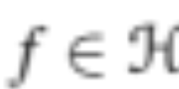
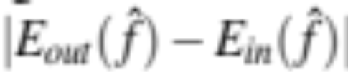
Learning theory
Are we able to learn the perfect model (f)?
  Even with infinite training examples the answer is often “no”
  Why? Because we cannot guarantee that
Despite this, learning is possible if the in-sample error is a good estimator of the out-sample error
Difference with higher N is most likely very small

Slide 14
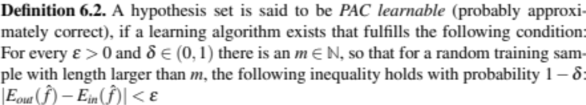
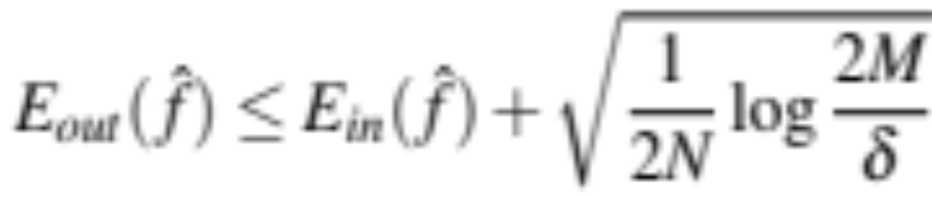
PAC Learnable (1)
We can make this a bit more formal:
Assume we have M hypotheses, then:
Hence, every finite set of hypotheses is PAC learnable

Slide 15
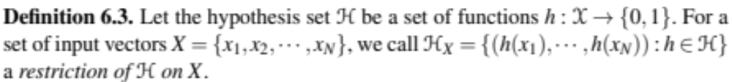
PAC Learnable (2)
What if we have an infinite set of hypotheses?
Let us focus on a binary classification problem and assume we have a function h that is applied to all N instances in our set:

Slide 16

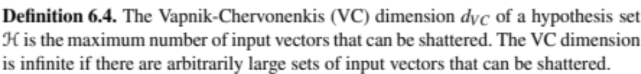
VC Dimension (1)
How many hypotheses do we have?
  2^{N}
A hypothesis set shatters X when it can represent every possible labeling (i.e. the 2^{N})
We then define:

Slide 17
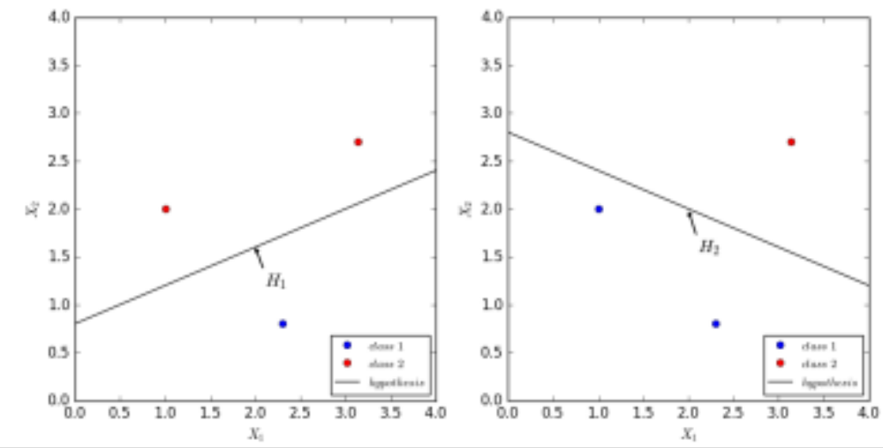
VC Dimension (2)
We need to show this for an example, e.g. two real-valued attributes and the set of hypotheses involves a line
  Can we represent all combinations for three points?

Slide 18
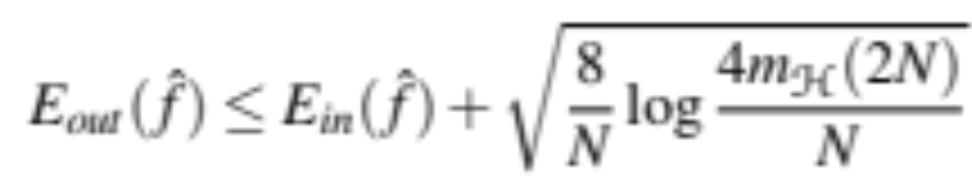
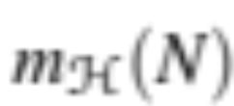
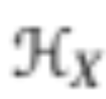
VC Dimension (3)
Can we do it for 4?
  Nope, VC-dimension is 3
Now a nice result: all hypothesis sets with finite VC-dimension are PAC learnable
In addition we can shown that:
With being the growth function
  Measures the maximum number of elements for all possible restrictions

Slide 19
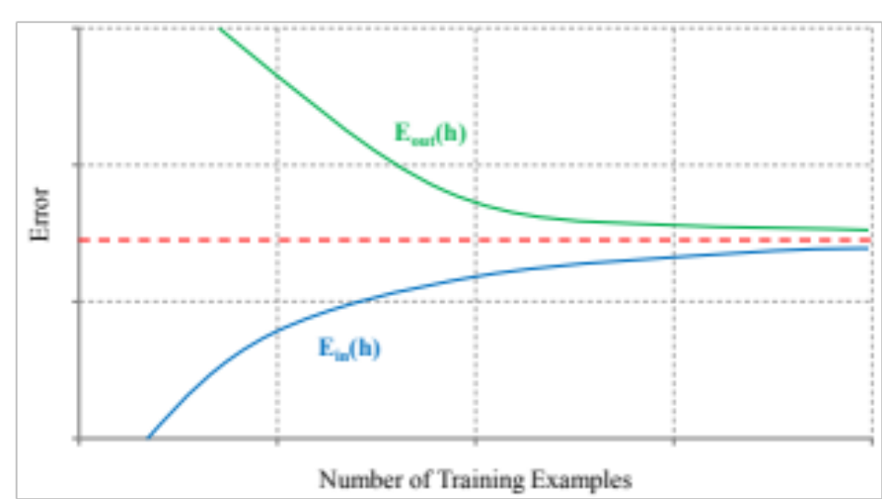
Implications (1)
What are the implications?
  With few training examples, it is easy to obtain a low in-sample error
  As N increases we will converge to a maximum
  The out of sample error will decrease

Slide 20
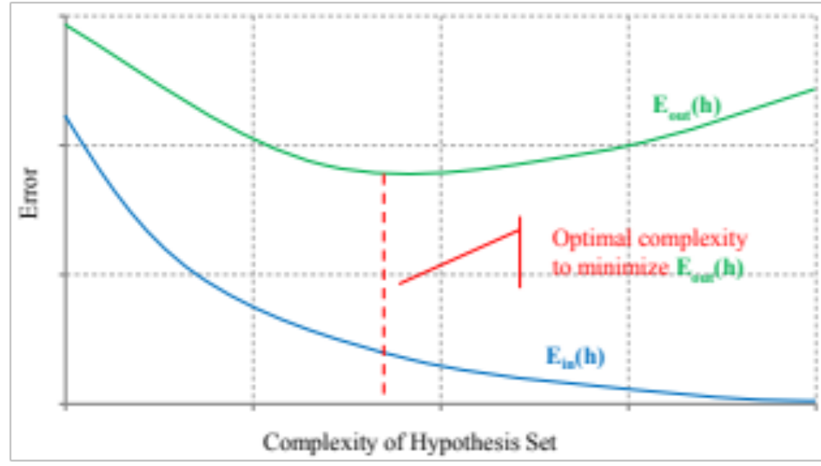
Implications (2)
Given a fixed N we can study the influence of more complex hypotheses

Slide 21
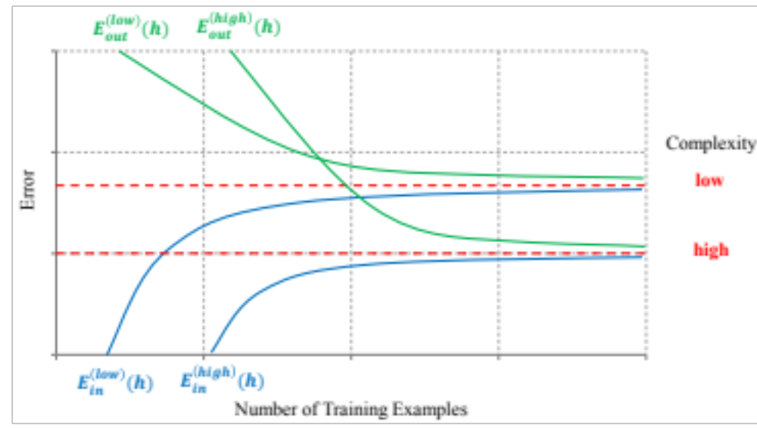
Implications (3)
Complexity versus training examples:

