Slide 1
Machine Learning for the Quantified Self
Chapter 7
Predictive Modeling Without Notion of Time

Slide 2
Predictive modeling without notion of time
Ok, let us start learning
We will consider learning algorithms that do not take time into account explicitly
  Of course we do have the temporal features we identified before
We first need to consider the learning setup
  Do we want to learn individual models?
  Do we want to learn to predict well for the future (only for temporal data), or for unseen individuals?

Slide 3
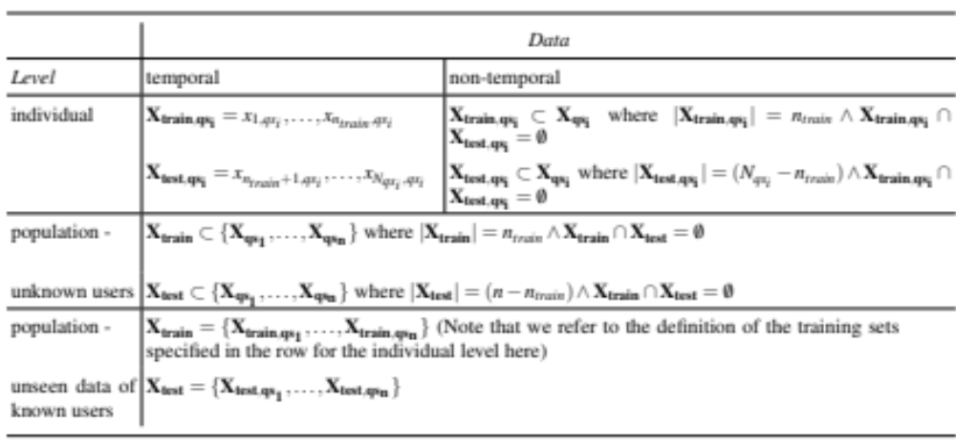
Learning setup
Here are the options we have (validation set done in the same way):

Slide 4
Learning algorithms
Assume you know the basic learning algorithms
Quick recap, two slides per learning algorithm
  Neural Networks
  Support Vector Machines
  K-Nearest Neighbor
  Decision trees
  Naïve Bayes
  Ensembles

Slide 5
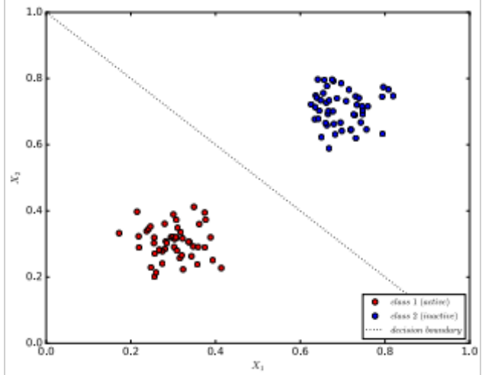
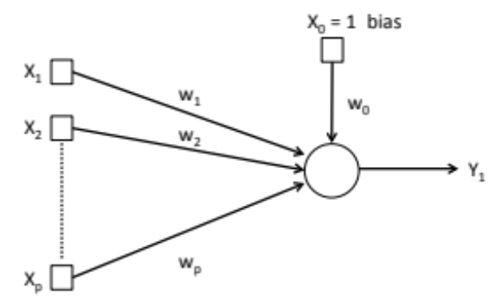
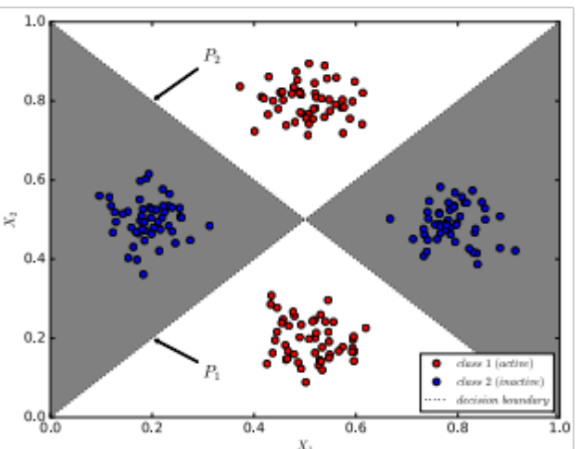
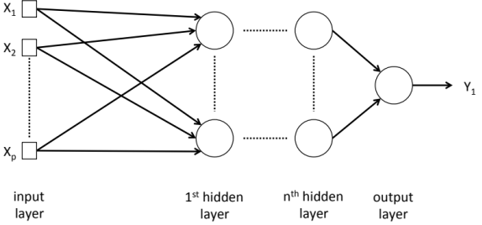
Neural Networks (1)
Perceptron
Multi-Layer Perceptron

Slide 6
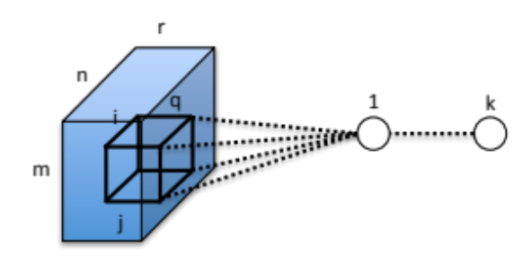
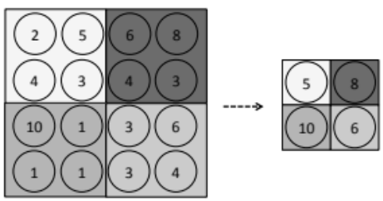
Neural Networks (2)
Convolutional neural networks
  Extract features using:
    Convolutional layers
    Pooling layers
  Followed by a “regular” neural network

Slide 7
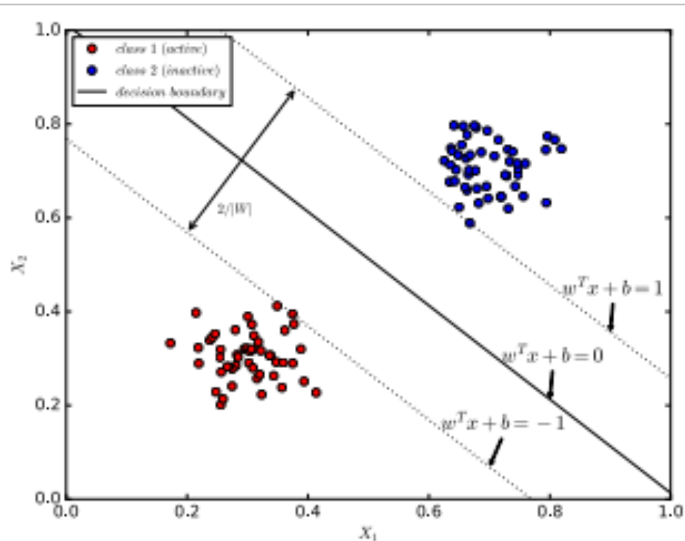
Support Vector Machines (1)
Find hyperplane that maximizes separation between classes

Slide 8
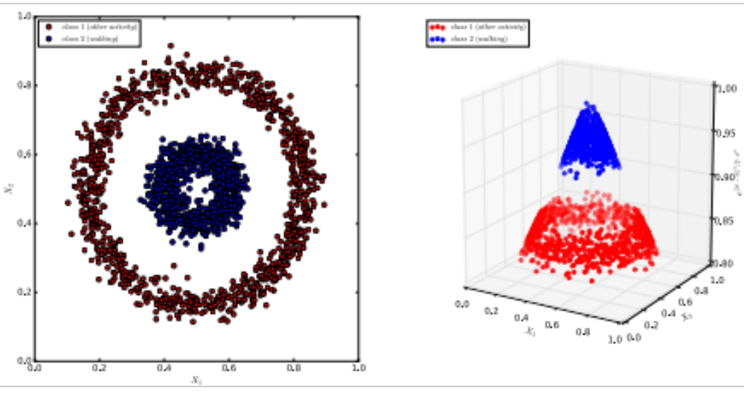
Support Vector Machines (2)
Kernel functions

Slide 9
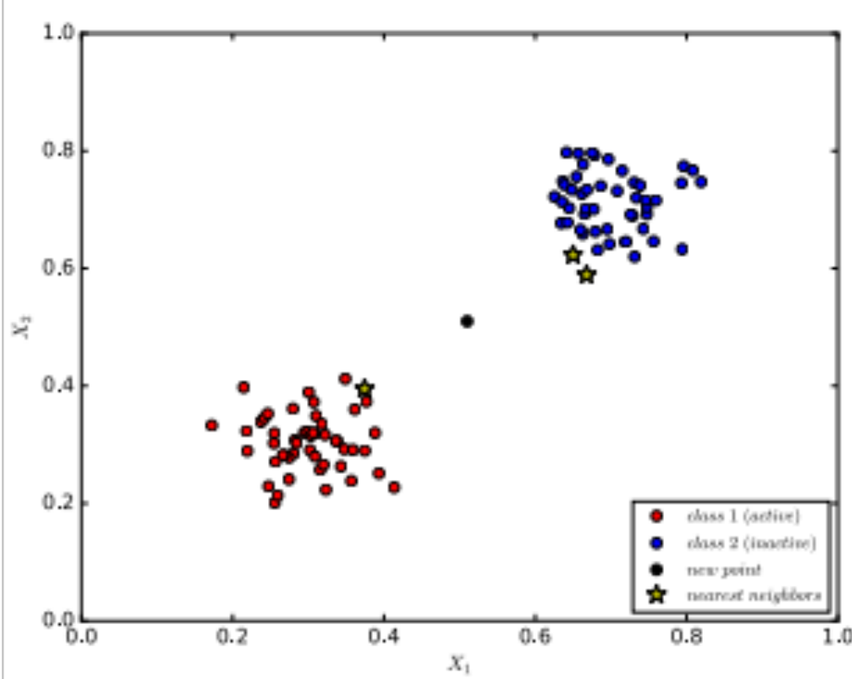
K-Nearest Neighbor (1)
Find k closest examples
  use distance functions discussed before

Slide 10
K-Nearest Neighbor (2)
Assign classes based on some function, for example:
  Majority class
  Average value

Slide 11
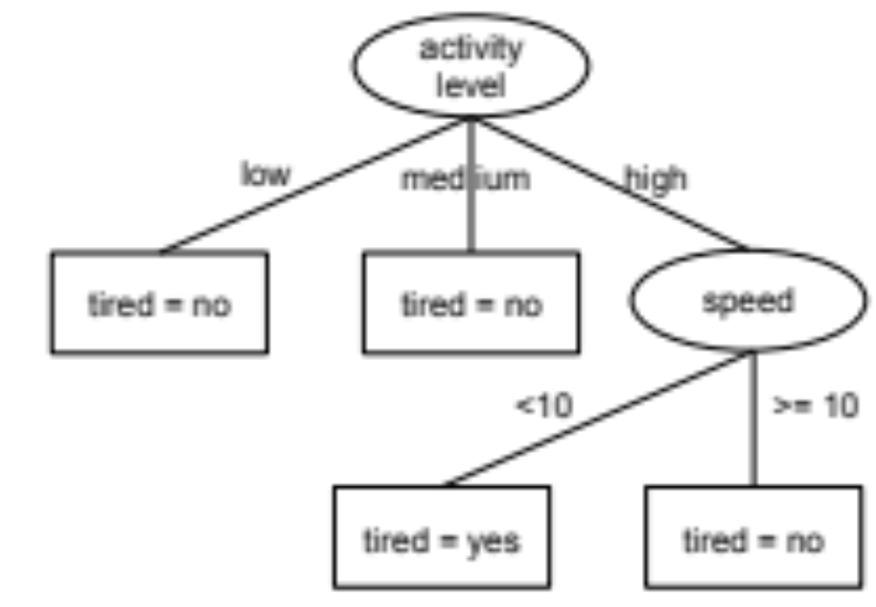
Decision tree (1)
Create a tree to decide on target value

Slide 12
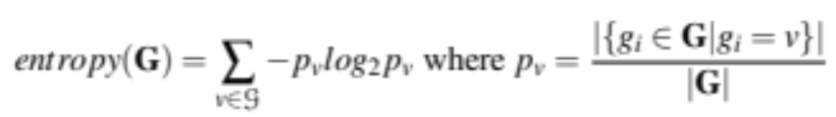
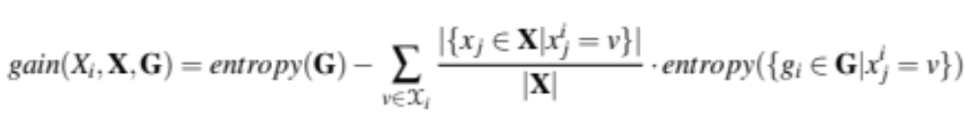
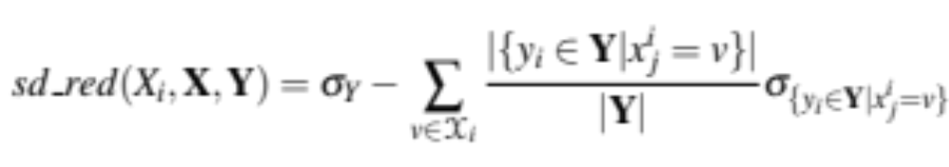
Decision tree (2)
Use criterion to decide on which attributes are most important (i.e. should be selected first)
  Categorical target:
  Numerical target:

Slide 13
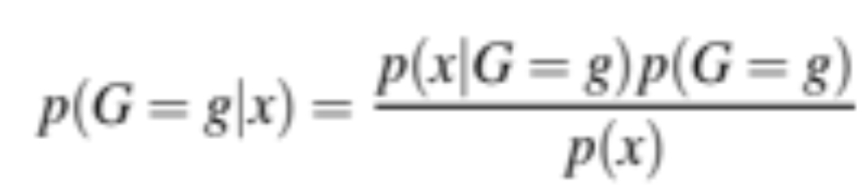
Naïve Bayes
We use Bayes formula to express the probability of a target value g given our observations x:

Slide 14
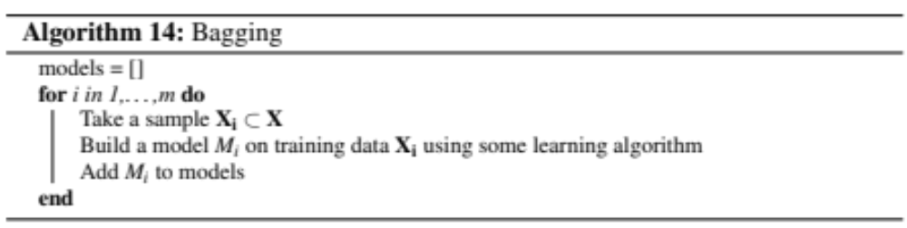
Ensembles (1)
Bagging
  Create multiple models on samples of the data
  Combine output of models using some aggregation function
  Tackles variance problem

Slide 15
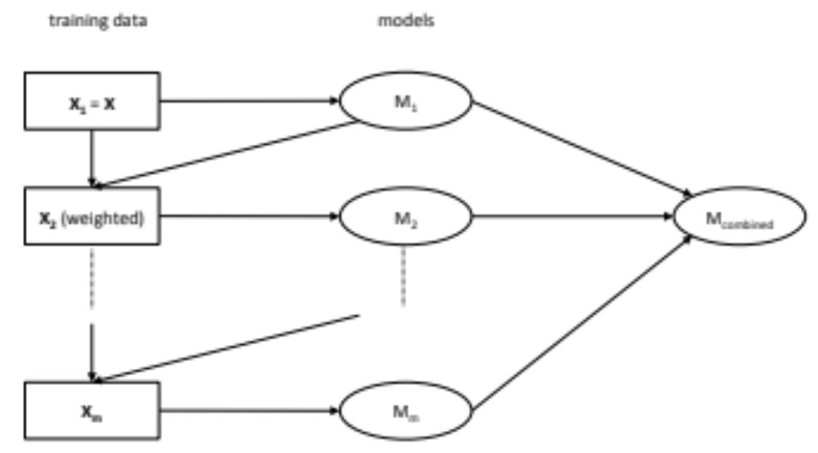
Ensembles (2)
Boosting
  Build models sequentially and focus models on where we made mistakes before
  Focuses on bias problem

Slide 16
Practical considerations
Ok, let us start to apply the learning algorithms!
  We need to be careful not to overfit (think of the first set of slides)
  We can select features using forward and backward selection
  We can consider regularization (punishing more complex models)

Slide 17
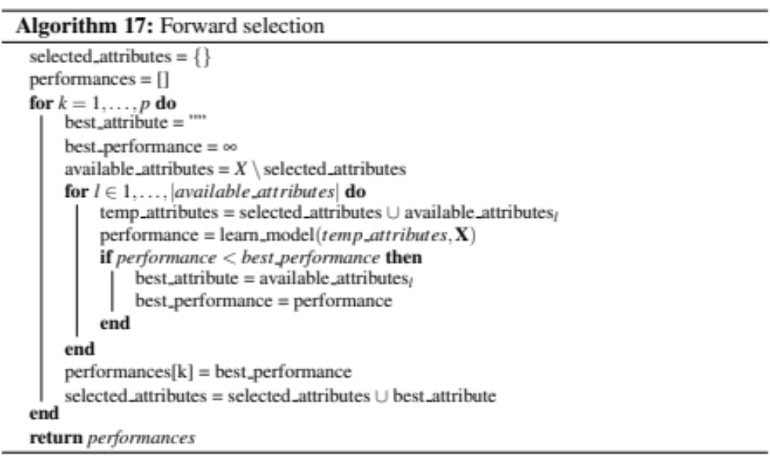
Forward selection
We iteratively add the most predictive feature:

Slide 18
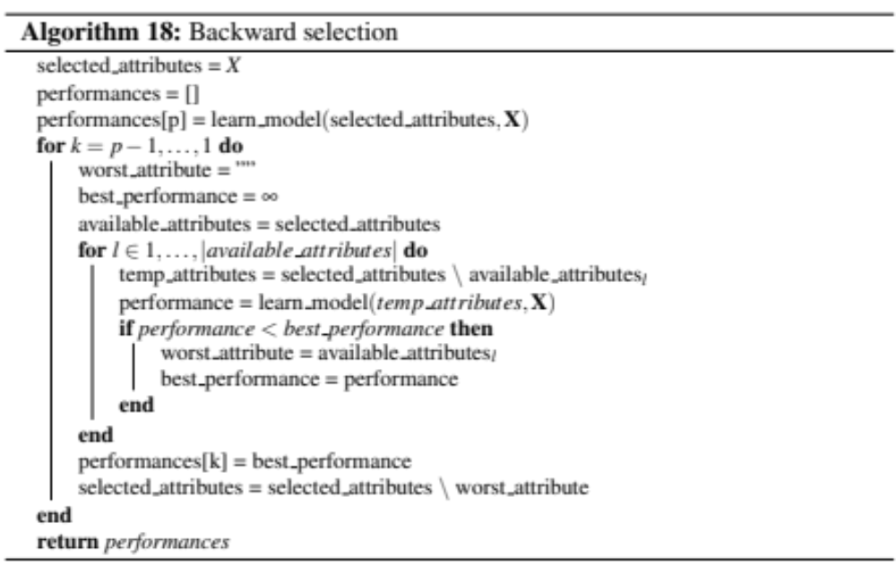
Backward selection
We iteratively remove the least predictive feature:

Slide 19
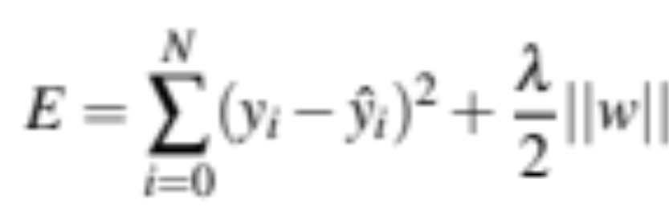
Regularization
We add a term to the error function to punish for more complex models
  For neural networks:

Slide 20
CrowdSignals
Remember, we have two tasks for our CrowdSignals dataset:
  Predict label (activity)
  Predict heart rate
We consider the first with a non-temporal setup and the second with a temporal setup

Slide 21
Predicting the label
We currently have a set of binary attributes for each label value
  We need to transform these to a single categorical attribute
  How do we do this? What if we have multiple “1”’s per instance?
  We only use instances where we have a single activity marked with a 1
  Results in 1837 instances (out of 2895)

Slide 22
Splitting the data
How do we split the data into training and test?
  We assign 70% of the instances to the training set and 30% to the test set
  We do so in a stratified way
  Once again, we ignore the time component

Slide 23
Feature selection (1)
We have 517 features if we use all the ones we have identified
  Initial features (21)
  PCA (7)
  Time domain features, mean + standard deviation (2 x 28 features = 56)
  Frequency domain (18 frequencies, 24 initial features = 432)
  Cluster (1)
Should we select some features?

Slide 24
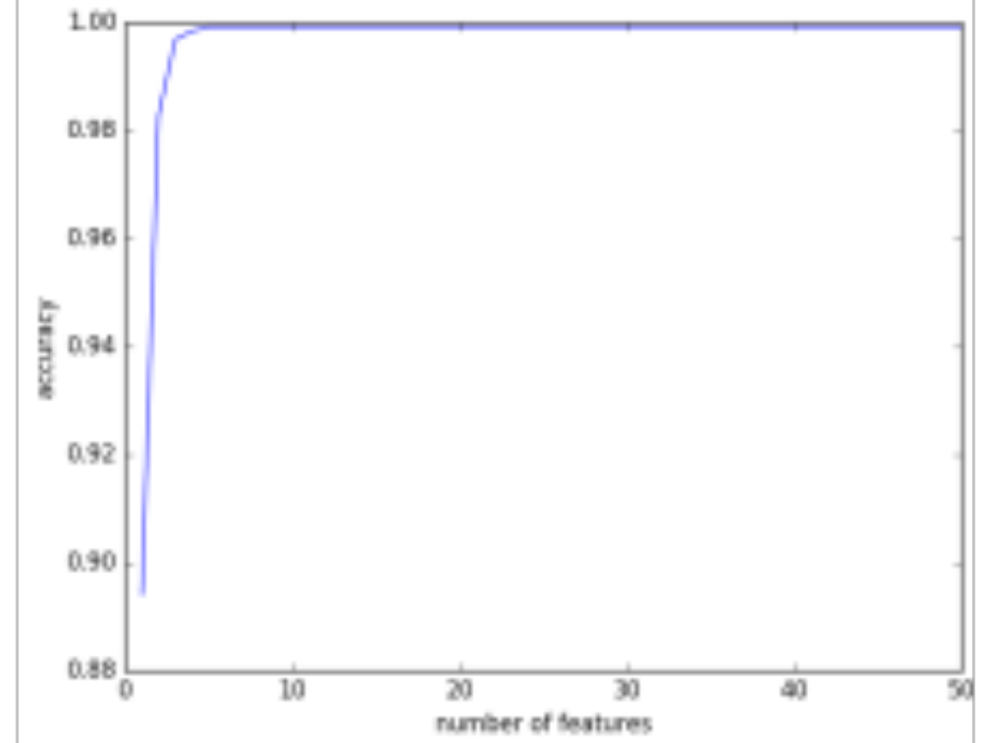
Feature selection (2)
Forward selection:

Slide 25
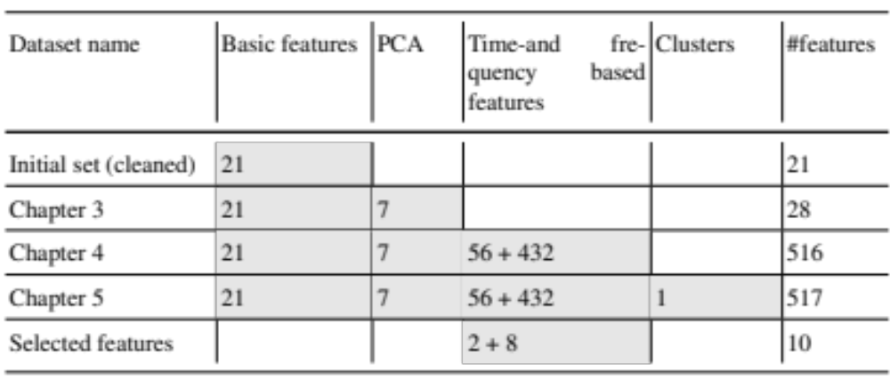
Feature selection (3)
We end up with different options which we will try:

Slide 26
Influence of parameter settings (1)
How does model complexity influence our performance in this case?
  Remember the theoretical results we have seen
  We can tailor the parameters of the models
  We can change the weight of the regularization terms

Slide 27
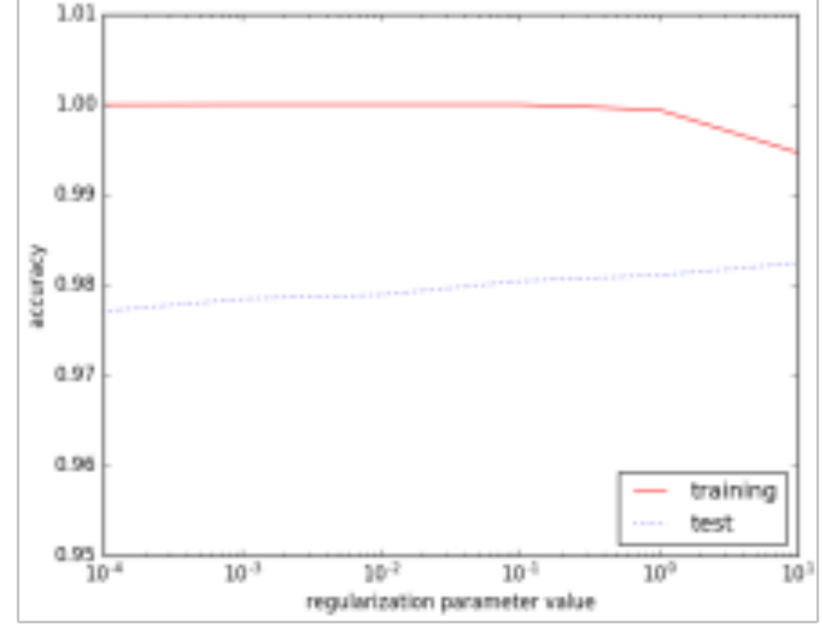
Influence of parameter settings (2)
Neural network and regularization term

Slide 28
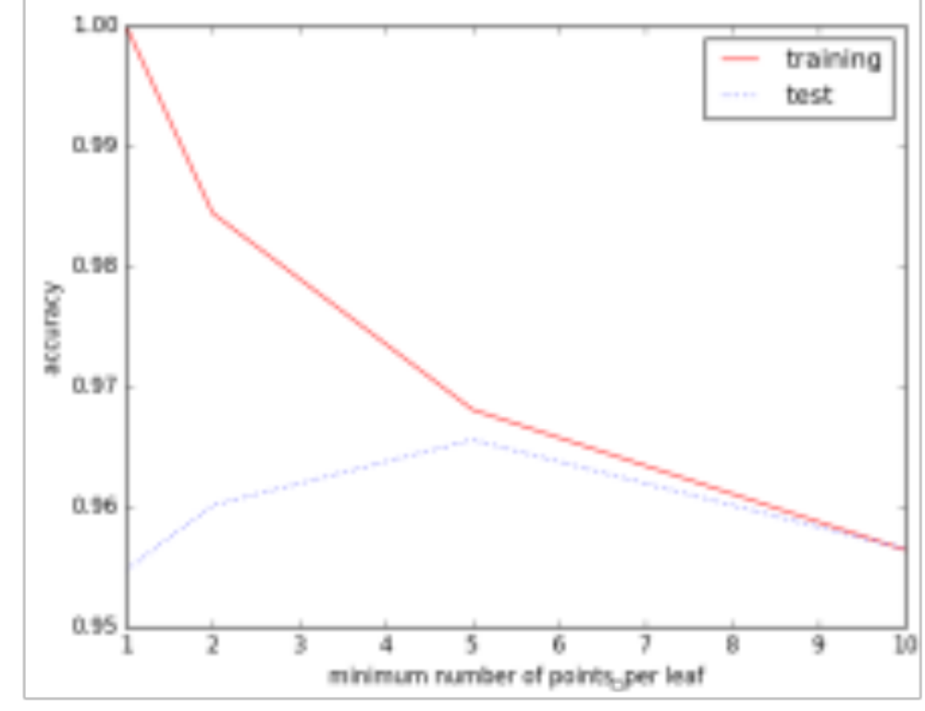
Influence of parameter settings (3)
Decision tree and points per leaf:

Slide 29
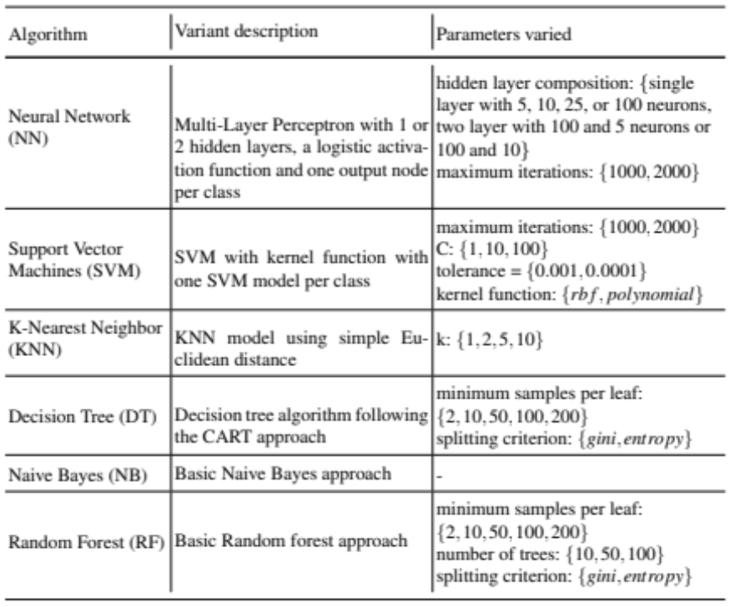
Influence of parameter settings (4)
We try different parameter settings
  study the generalizability based on a cross validation on the training set

Slide 30
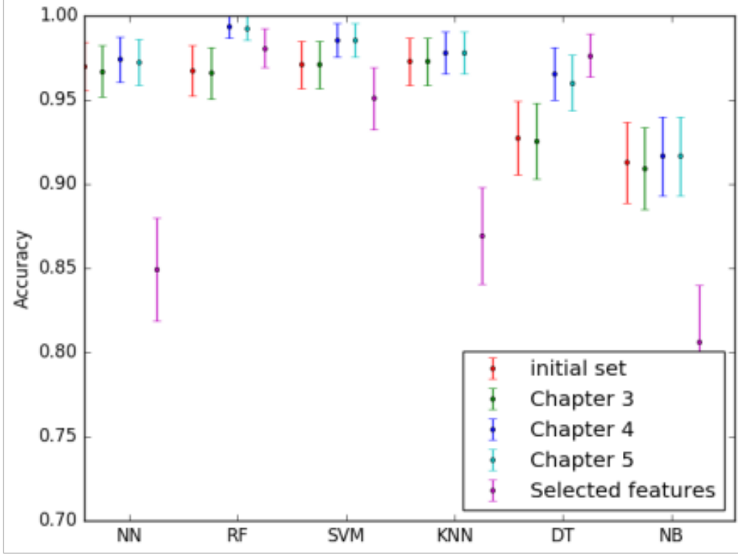
Results test set (1)

Slide 31
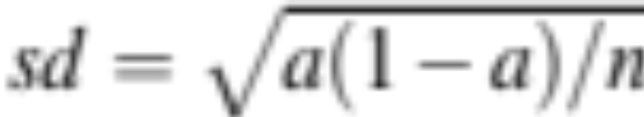
Results test set (2)
How did we computer the 95% confidence intervals?
  a is the accuracy
  n the number of samples in the test set

Slide 32
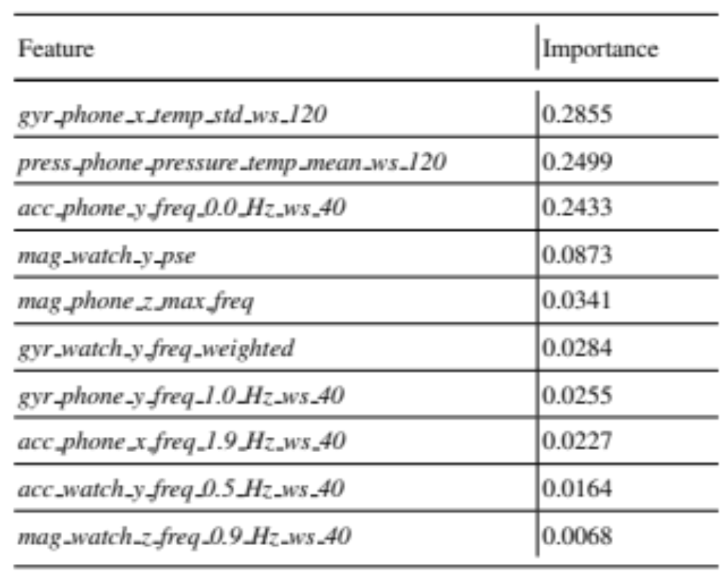
Results test set (3)
Important features (random forest):

Slide 33
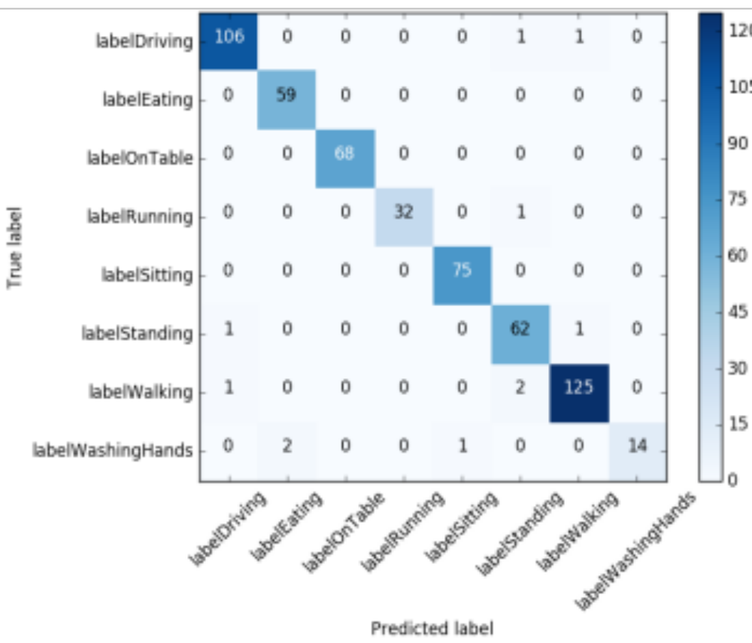
Results test set (4)
Confusion matrix:

Slide 34
Results test set (5)
Why are the results this good?
  Dataset has limited variation
  Spans only short time period
  …

Slide 35
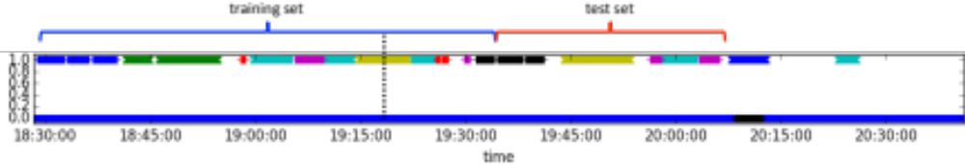
Predicting the heart rate
We take it as a temporal problem
  Want to learn to predict future time points well
How do we split the training and test set here?
Why this way?

Slide 36
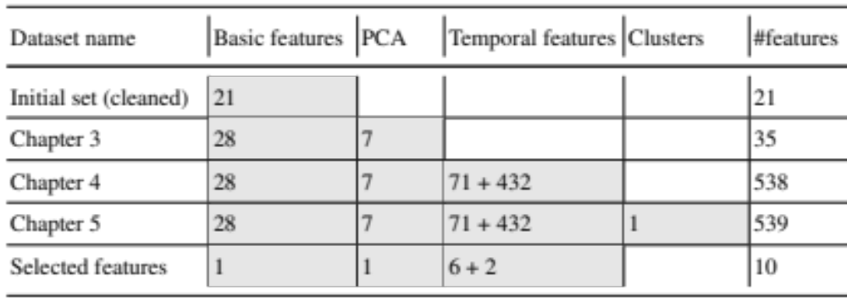
Features

Slide 37
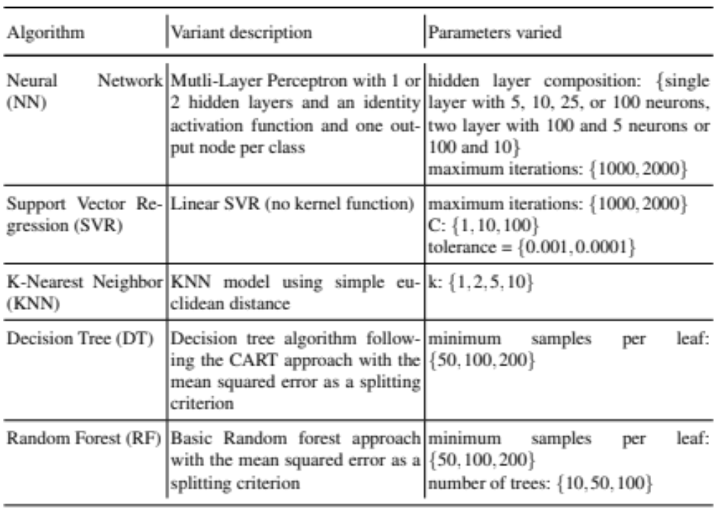
Algorithms we tried

Slide 38
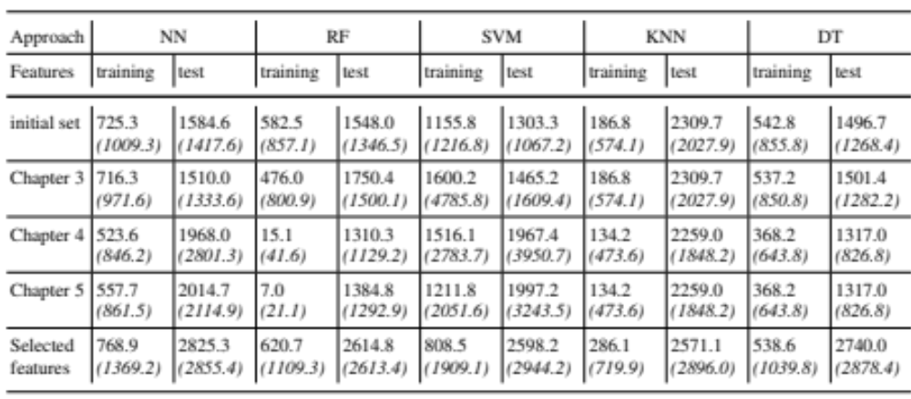
Results (1)

Slide 39
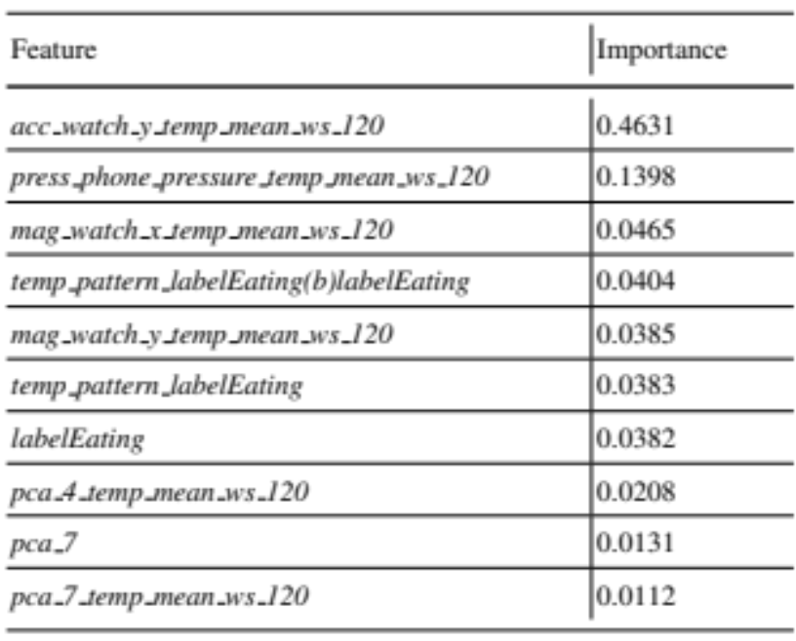
Results (2)
Standard deviation computed based on predictions per instance on the test set
Predictors random forest:

Slide 40
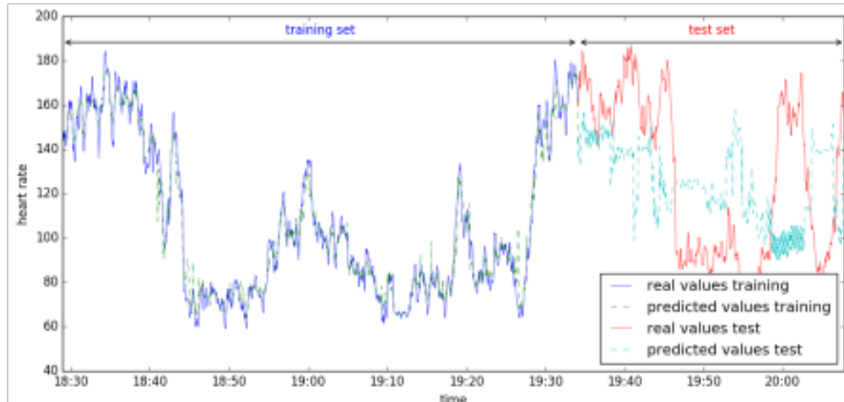
Results (3)
Visual predictions:

Slide 41
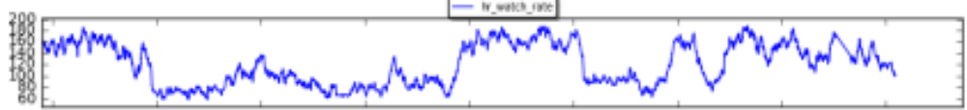
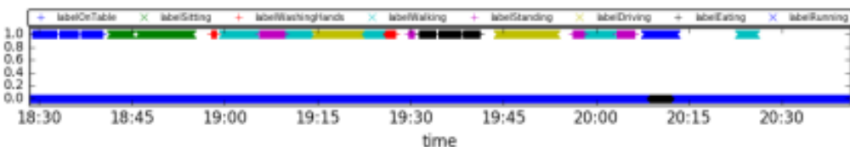
Why is it so bad?
Ideas?

