Slide 1
Machine Learning for the Quantified Self
Chapter 8
Predictive Modeling with Notion of Time

Slide 2
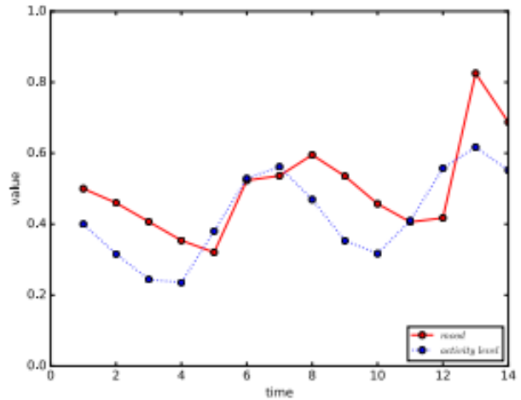
Overview
Previously: we looked at learning algorithms that did not model time explicitly
Today: we will look at algorithms that consider time explicitly
  Time series
  Recurrent neural networks
  Dynamical systems models

Slide 3
Time Series
Time series focus on:
  Understanding periodicity and trends
  Forecasting
  Control
Time series can be decomposed in three components:
  Periodic variations (daily, weekly, … seasonality)
  Trend (how the mean evolves over time)
  Irregular variations (left after we remove the periodic variations and trend)

Slide 4
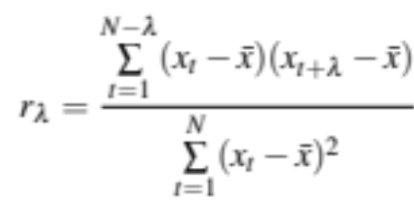
Stationarity (1)
Important concept: stationarity
  Trends and periodic variations are removed
  Variance of the remaining residuals is constant
Prerequisite or intermediate step for many algorithms
Additional criterion: the lagged autocorrelation should remain constant (note: x_{t} represents the value of one attribute):

Slide 5
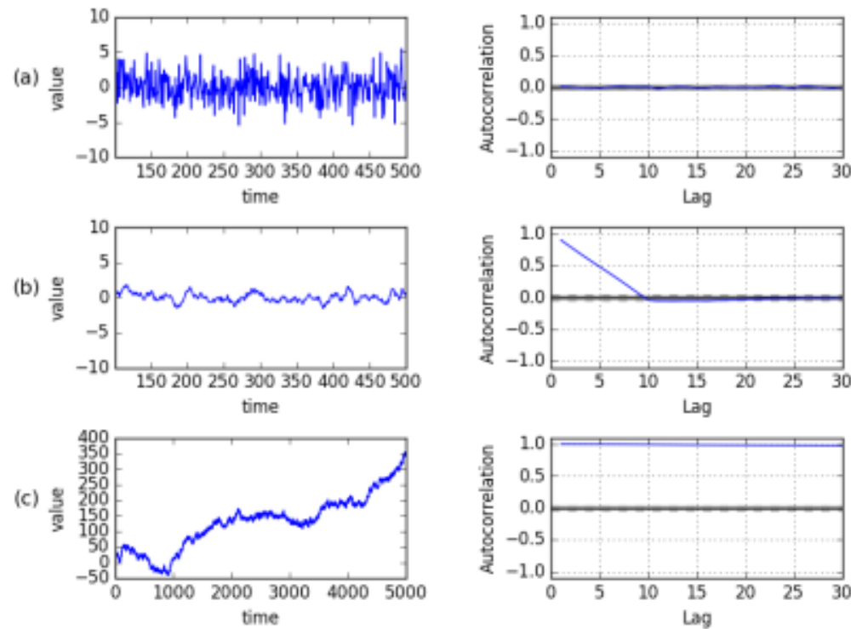
Stationarity (2)
Autocorrelation represents in how far there is a correlation between a time series and a shifted version of itself (with λ steps)
random
some memory over
past time points
cumulative sum of (a)
– non-stationary

Slide 6
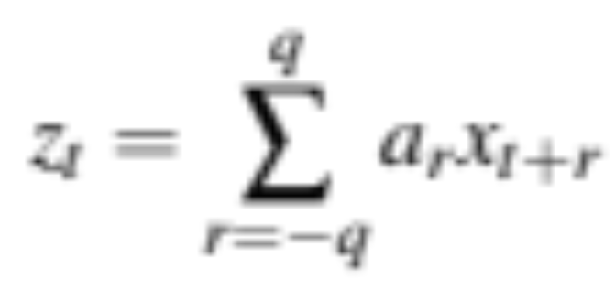
Filtering and smoothing (1)
Let us assume our time series of values x_{t} with a fixed step size Δt
We can apply a filter to our data, taking q points in the future and past into account:
This generates a new time series z_{t}

Slide 7

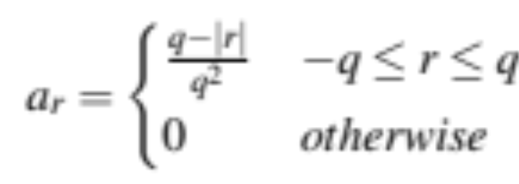
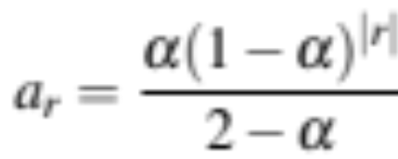
Filtering and smoothing (2)
What could a_{r} look like?
  If we take it is just the moving average
  If measurements closer to t are more important we can use a triangular shape:
  Or exponential smoothing (only past time points mostly):

Slide 8
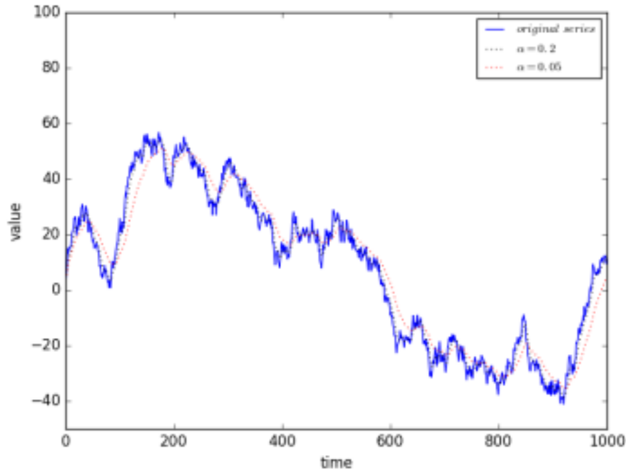
Filtering and smoothing (3)
Example exponential smoothing

Slide 9
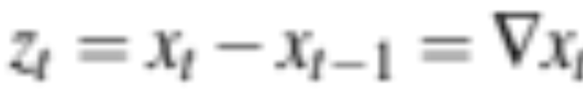
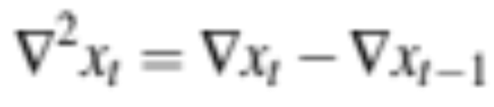
Filtering and smoothing (4)
Now how can we remove a trend?
Let us take a filter again, but a simple one:
This takes the different between the current and previous measurement
  A long term trend has more or less the same influence on the previous and current time point
We can apply this operator d times (e.g. d=2):

Slide 10
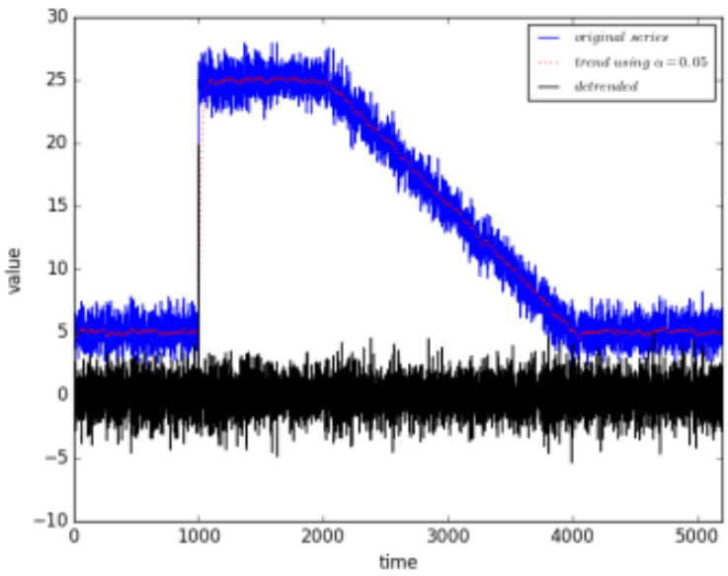
Filtering and smoothing (5)
But x_{t-1} might not be a good estimation of the trend, we can therefore also use an exponential smoothing z_{t} and take x_{t} – z_{t}

Slide 11
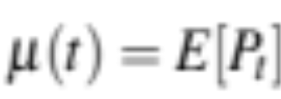
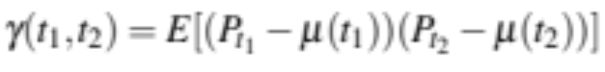
ARIMA (1)
Of course we would like to forecast, let us turn to ARIMA
  Assume a measurement at time point t is generated by a probability distribution P_{t}
  The expected mean is:
  The auto-covariance function is:
  A series is stationary when the mean is constant and when the auto-covariance only depends on the time difference λ = t₂ – t₁

Slide 12
ARIMA (2)
We assume that the probability distribution at time point t is regressed on its own lagged values (p past measurements to be precise)
W_{t} is the noise we encounter. We can account for the noise by a moving average component (with q past values)
Overall the model becomes:

Slide 13
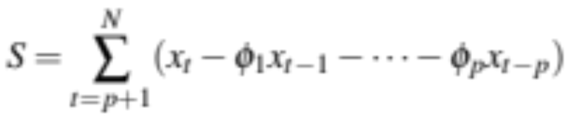
ARIMA (3)
In addition, we consider differencing with an order d
So how do we find the values for p, q, and d?
  For p we can look at the correlation between x_{t} and x_{t-p} (Partial Autocorrelation Function)
  We can do a grid search over the other parameters and determine the goodness of fit (e.g. using the Akaike Information Criterion)
And how about the other parameters?
  We use our data, e.g. for autoregressive component:

Slide 14
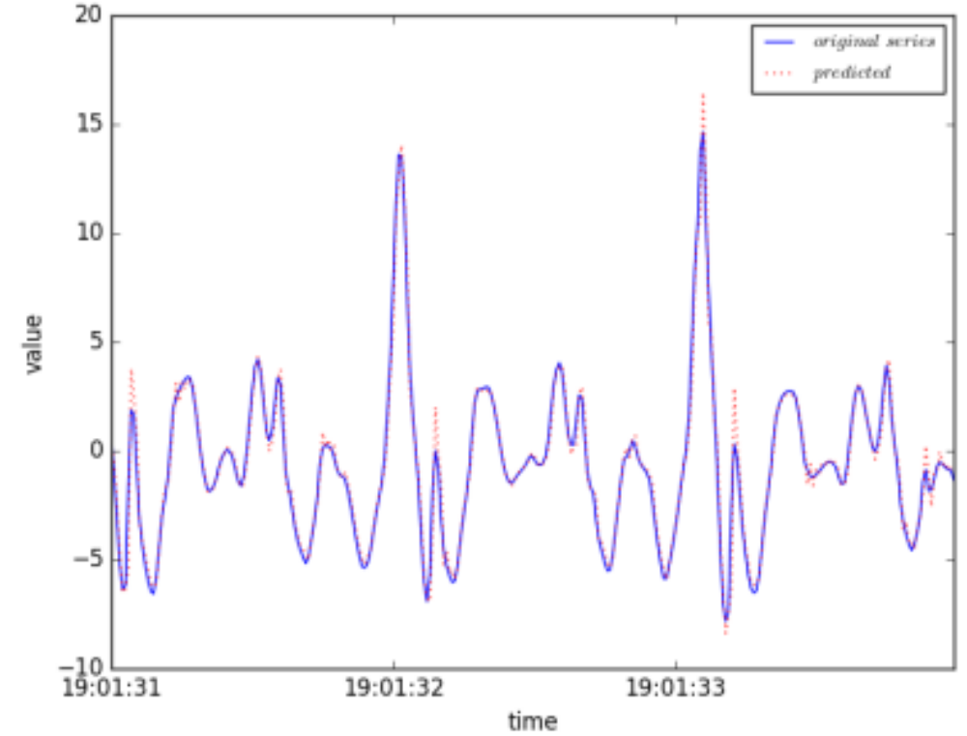
ARIMA - example (1)
One step ahead prediction (p=3, q=2)

Slide 15
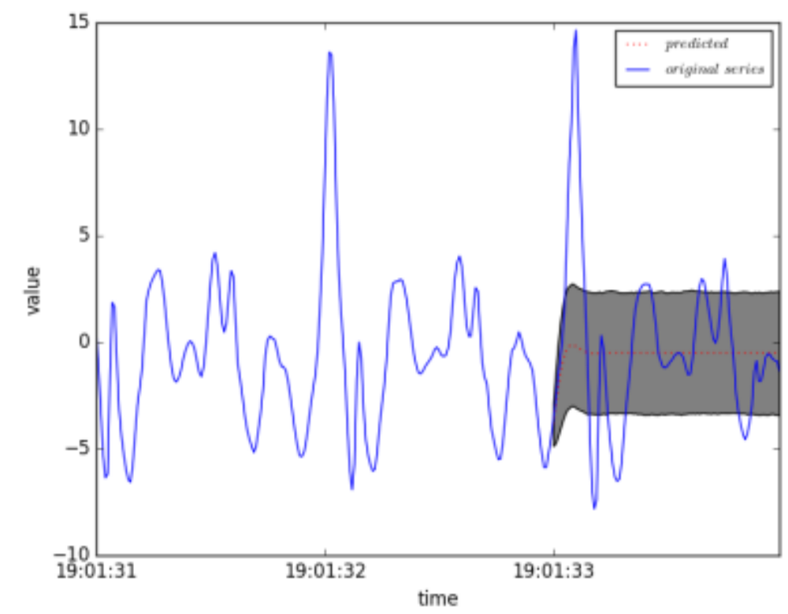
ARIMA - example (2)
Multiple steps ahead prediction (p=3, q=2)

Slide 16
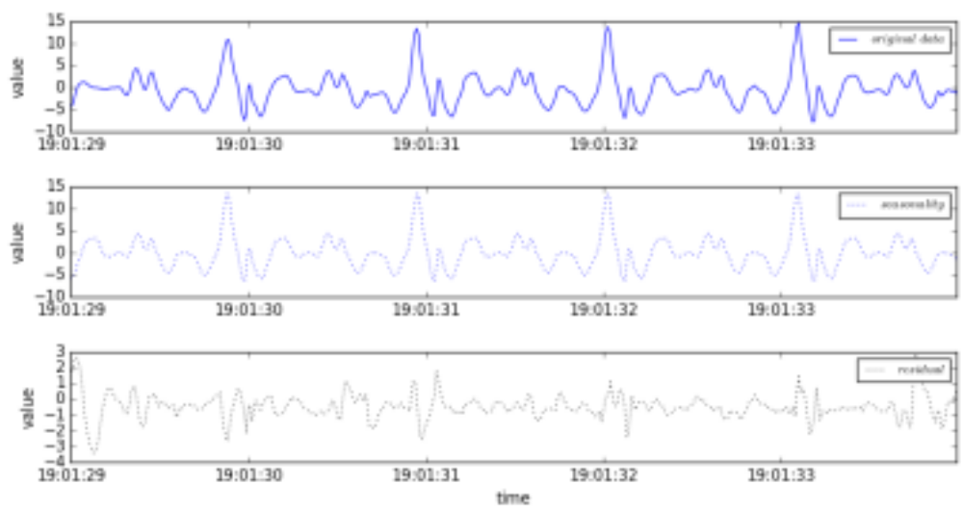
ARIMA - example (3)
Seasonality decomposition

Slide 17
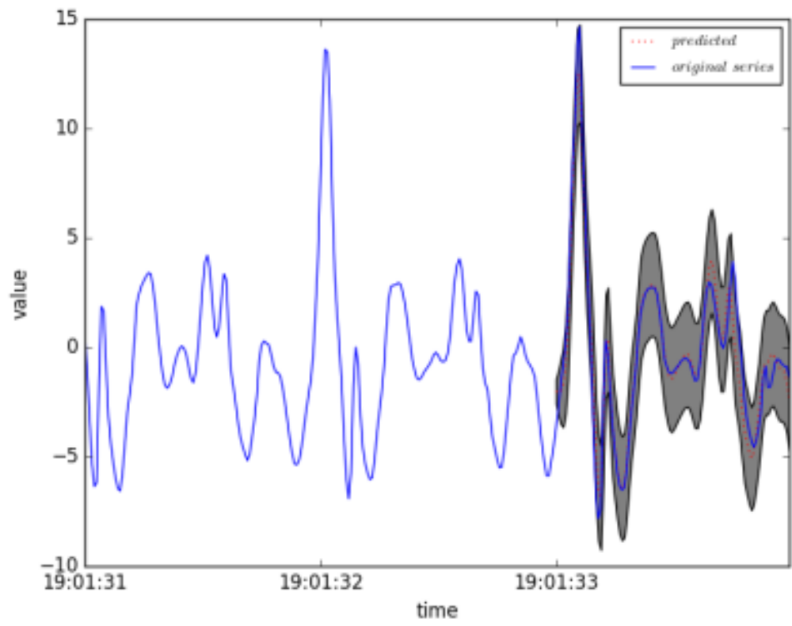
ARIMA - example (4)
Multiple steps ahead prediction with seasonality (p=3, q=2)

Slide 18
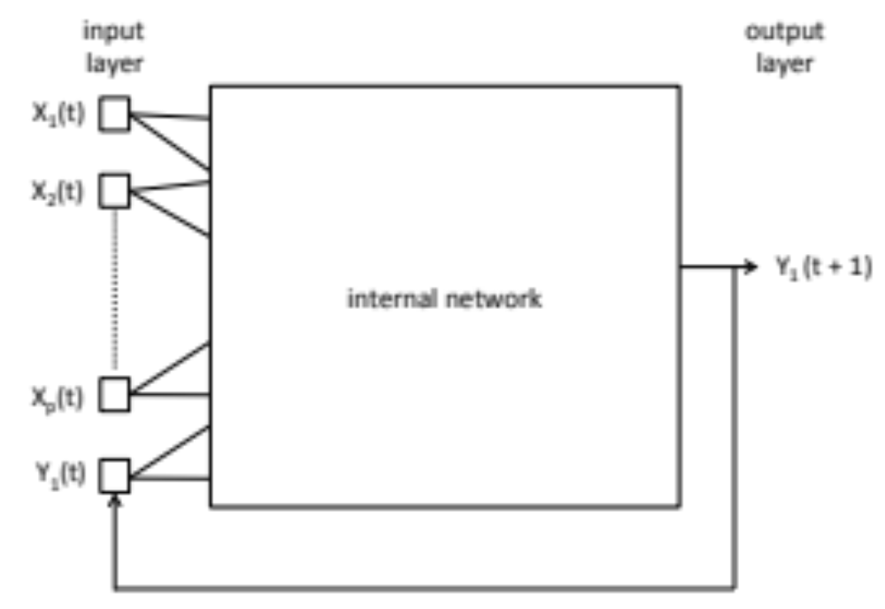
Neural networks with time
Variant of neural networks that take time component into account explicitly
Let us consider the simplest variant first:

Slide 19
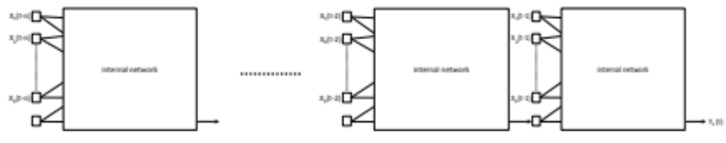
Recurrent neural networks (1)
Not very different from our previous neural networks, but cycles make training tricky
  How do we handle this?
  We unfold the network, and apply back propagation again

Slide 20
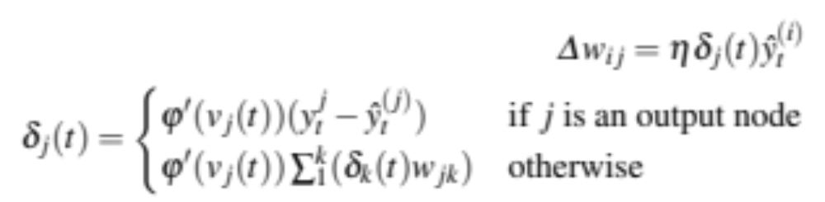
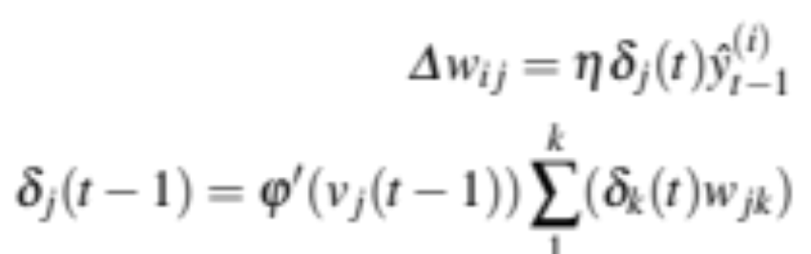
Recurrent neural networks (2)
How does this work mathematically?
  Update of regular connections remains the same:
  For recurrent connections we take:

Slide 21
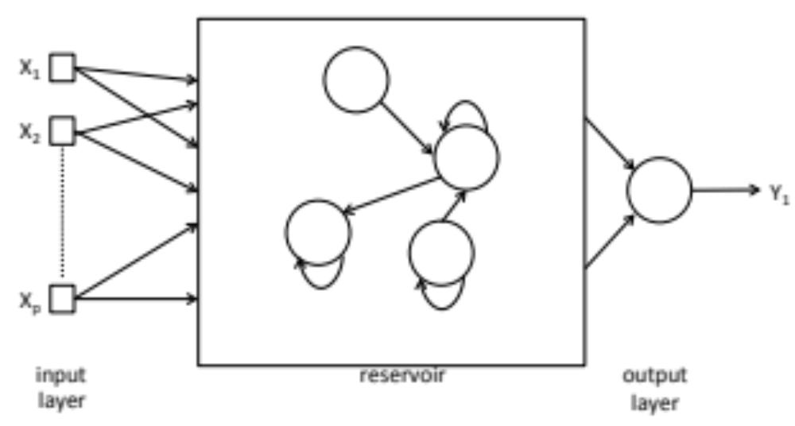
Echo state networks (1)
Training of RNN’s is difficult
Echo state networks try to tackle this problem
Have a reservoir of randomly collected neurons

Slide 22
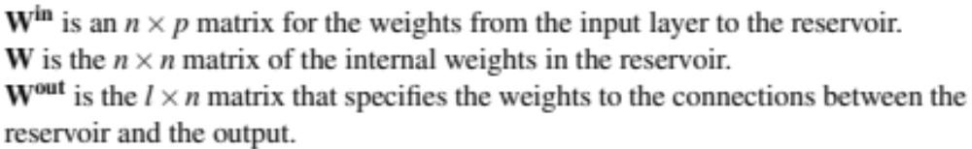
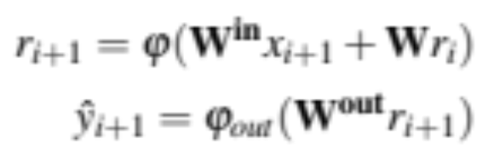
Echo state networks (2)
We have several matrices of weights:
W^{in} and W are randomly set and fixed, we only learn W^{out}
We compute the output as follows:

Slide 23
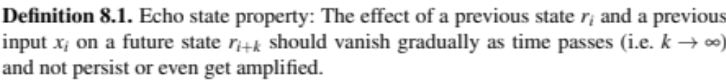
Echo state networks (3)
And we simply learn a W^{out} that minimizes the difference between the actual and predicted y
How should we create the random reservoir?
  It should satisfy the echo state property

Slide 24
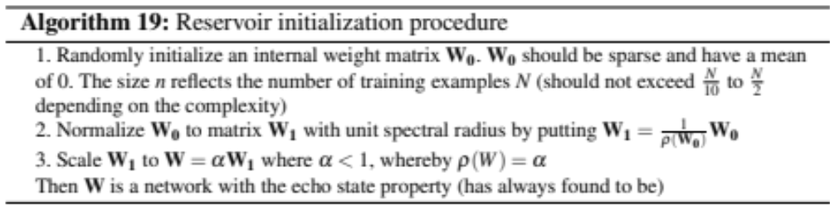
Echo state networks (4)
And how do we establish this?
  Follow this procedure:

Slide 25
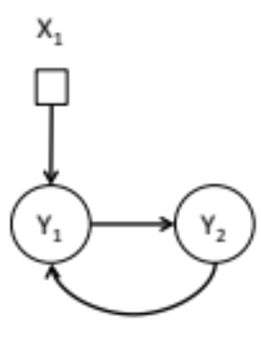
Dynamical Systems Models (1)
The final type of temporal model we will focus on are dynamical systems models
Express differential equations between attributes and targets

Slide 26
Dynamical Systems Models (2)
Equations are based on domain knowledge (e.g. scientific papers)
Models do contain parameters that can be tuned
  that is where the machine learning will come into play

Slide 27
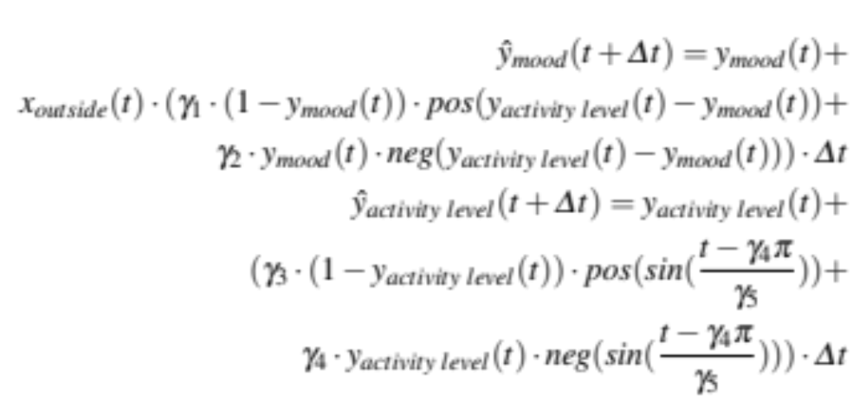
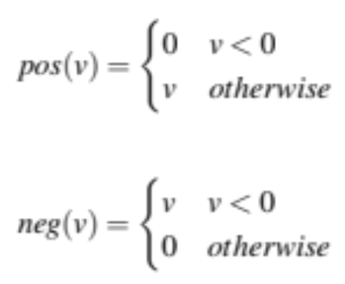
Dynamical Systems Models (3)
Let us consider an example model
  model the relationship between activity and mood (think of the example of Bruce)
with

Slide 28
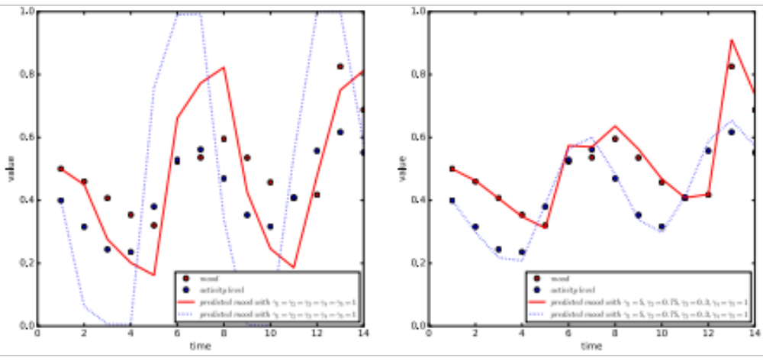
Parameter optimization (1)
How important are the parameters?

Slide 29
Parameter optimization (2)
How do we find appropriate parameter settings?
  Manual tweaking requires a lot of labor
  We have data available that allows us to find “the best” parameter values using machine learning
  Assume λ is a vector of parameter values, then the error we see is

Slide 30
Simulated Annealing (1)
Let us first focus on a very simple algorithm: simulated annealing
  We randomly move in our parameter space
    so we randomly select values for our parameters
  Is that all?
    Nope, we assume a temperature of our process, and a maximum number of iterations (k_{max})
    We accept parameter vectors that are better
    Depending on the temperature we can also accept parameter vectors that are worse (exploration)
    The closer we get to the end (the lower the temperature), the lower the probability of accepting vectors with worse performance

Slide 31
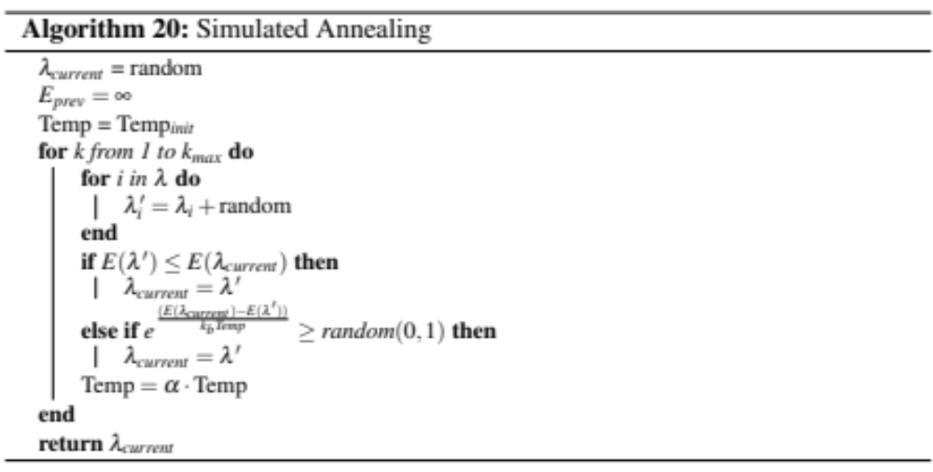
Simulated Annealing (2)

Slide 32
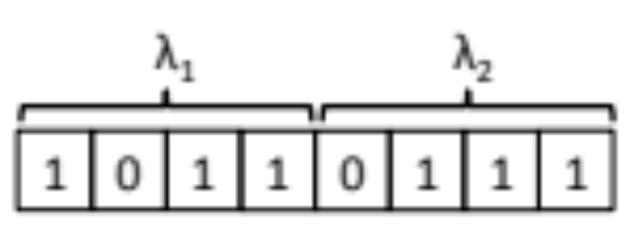
Genetic Algorithms (1)
Second option is to optimize the parameters using genetic algorithms
We consider the simple GA
We encode our parameter values as bits (genotype), these are individuals
We create a whole population of these individuals

Slide 33
Genetic Algorithms (2)
From the population, we select parents for a mating pool
We perform crossover and mutation
We select a new population for the next generation
We continue this for a number of generations

Slide 34
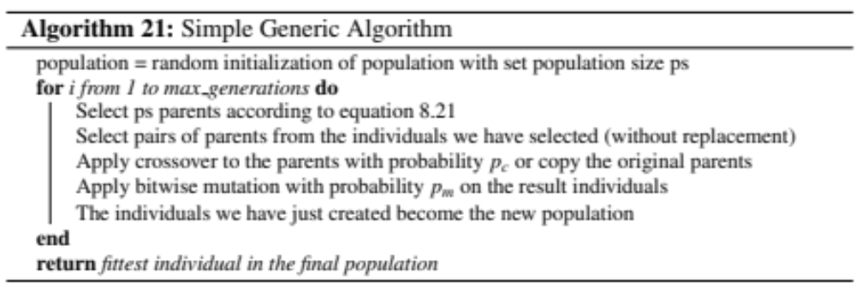
Genetic Algorithms (3)

Slide 35
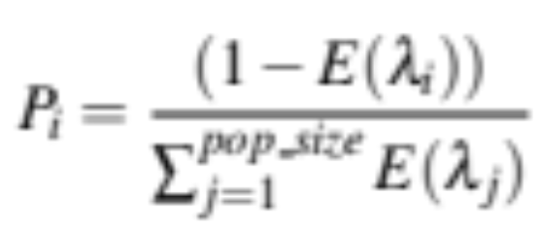
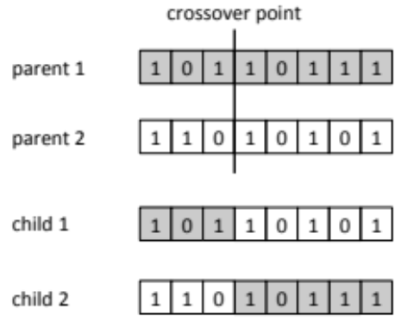
Genetic Algorithms (4)
Selection of individuals is done by a roulette wheel:
Crossover is straightforward (if we apply it to the parents), select a crossover point:
Mutation is done per bit, with a probability p_{m}

Slide 36
Multi-Criteria Optimization
What if we have multiple targets?
We could just take the average error over all targets (in fact, we have done so)
We might however be interested in the trade-off between different targets
This is then a multi-criteria optimization problem
We call a dynamical systems model with certain parameter values λ a model instance

Slide 37
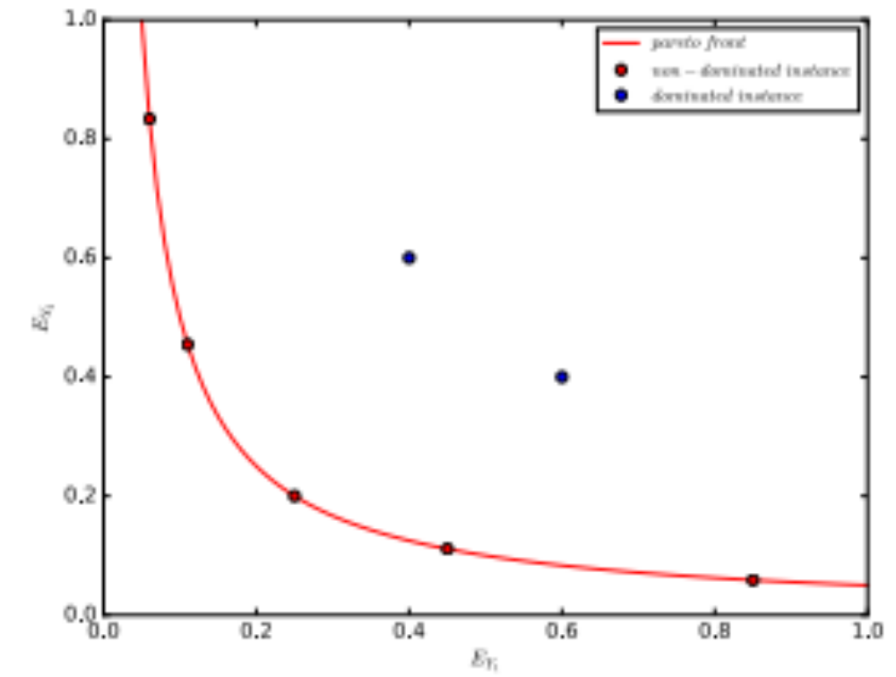
Pareto efficiency (1)

Slide 38
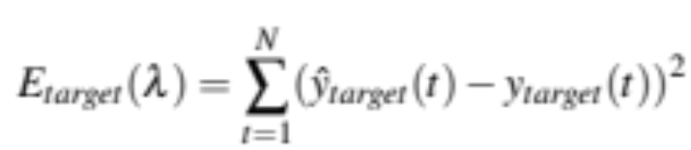
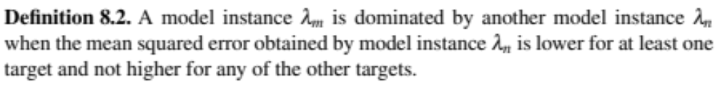
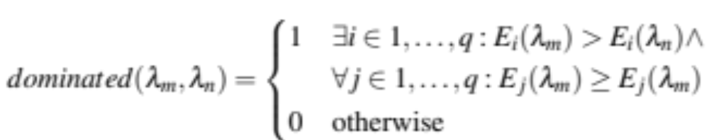
Pareto efficiency (2)
We assume an error function per target
We want to look for non-dominated instances
Formally:

Slide 39
NSGA-II (1)
The NSGA-II algorithm can find these non-dominated model instances
NSGA = Non-Dominated Sorting Genetic Algorithm
It has a population of solutions (like the simple GA)
We create fronts from the population

Slide 40
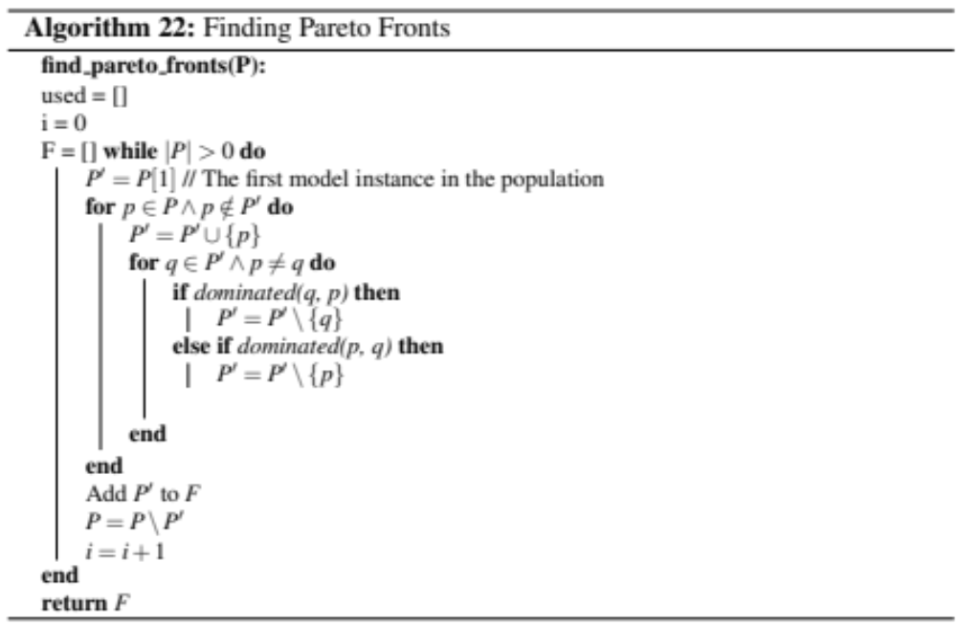
NSGA-II (2)

Slide 41
NSGA-II (3)
We would like to get a nice spread of solutions across the Pareto Front
We compute the distance of points to other points in the front and sort the points based in this distance (highest distance first)
Points on the boundary are set to infinite distance

Slide 42
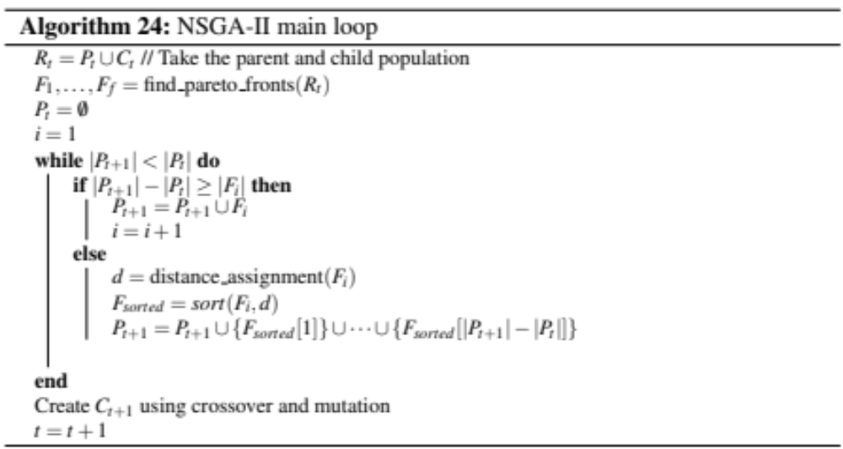
NSGA-II (4)

Slide 43
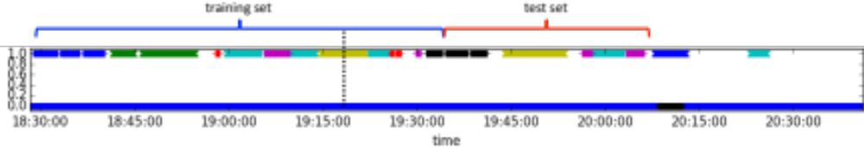
Case study
Let us move to the CrowdSignals again
Recall from last time: how did we tune the parameters?
  Cross validation
  Does that make sense now?
  Nope it does not…..

Slide 44
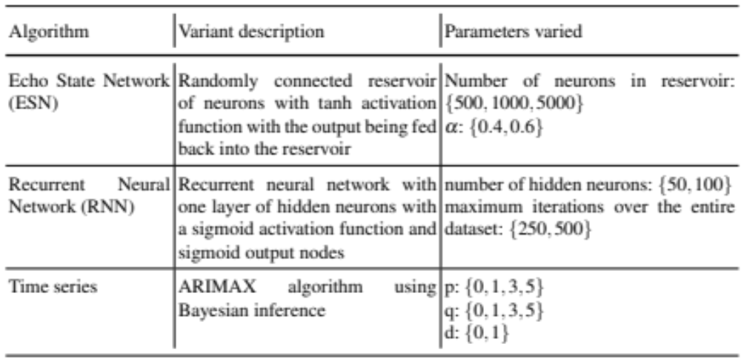
Algorithms used
What techniques do we use?
  Note: normalize values to [0,1] and [-0.9,0.9]/[0.1, 0.9]

Slide 45
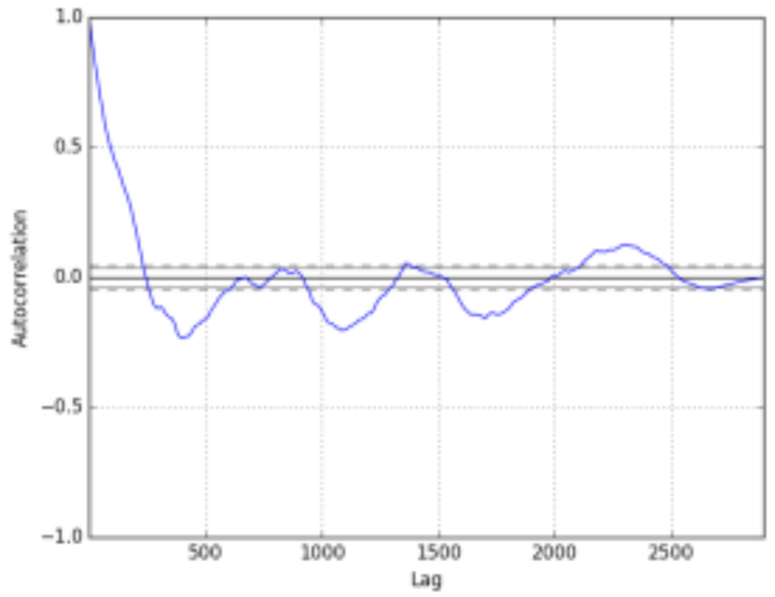
Time series
Autocorrelations we observe:
Stationary time series (Dickey-Fuller test)

Slide 46
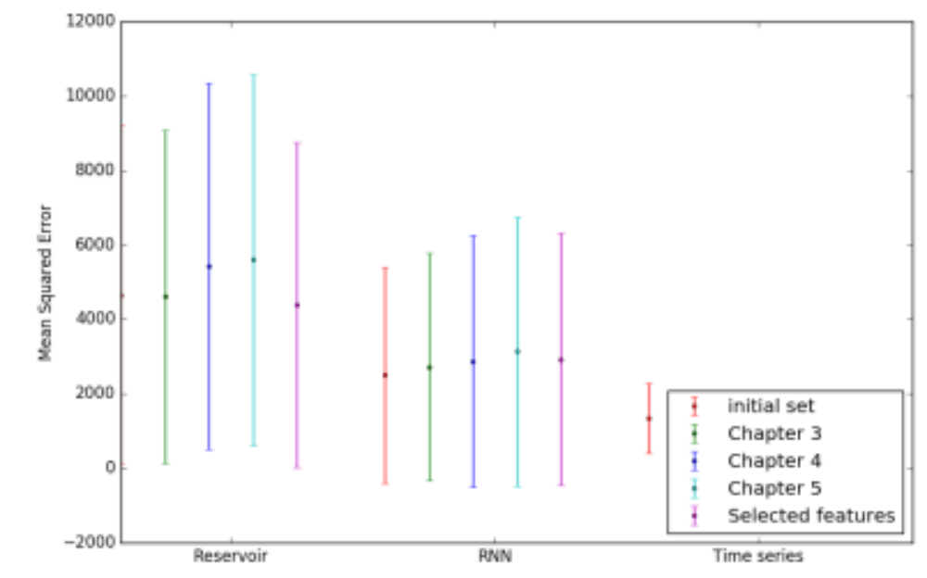
Results (1)
Results:

Slide 47
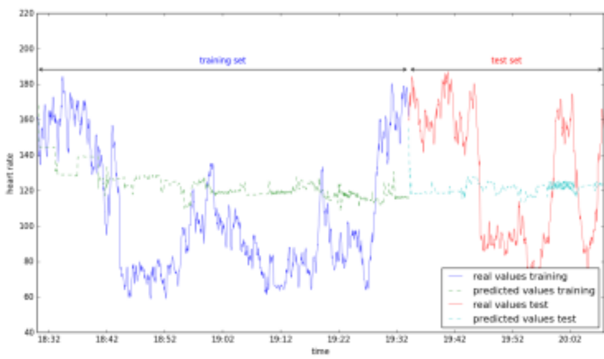
Results (2)
Time series:

Slide 48
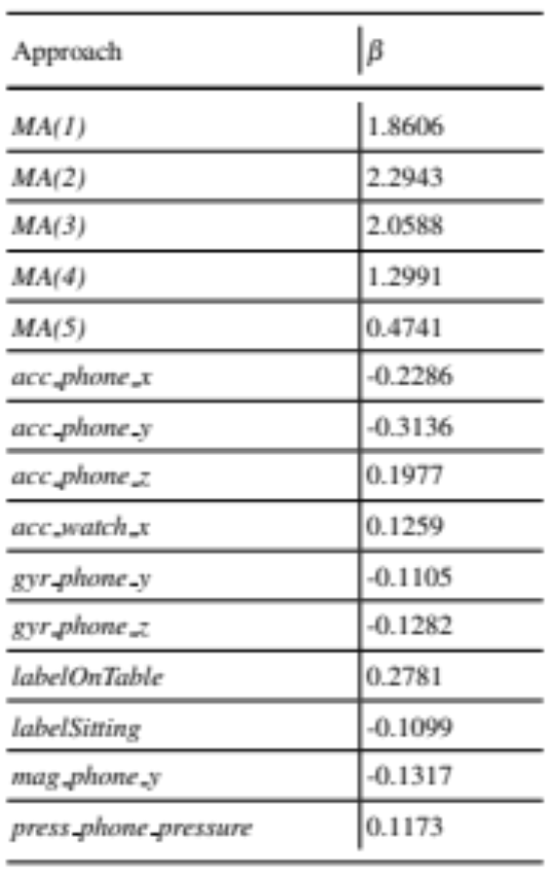
Results (3)
Time series feature importance:

Slide 49
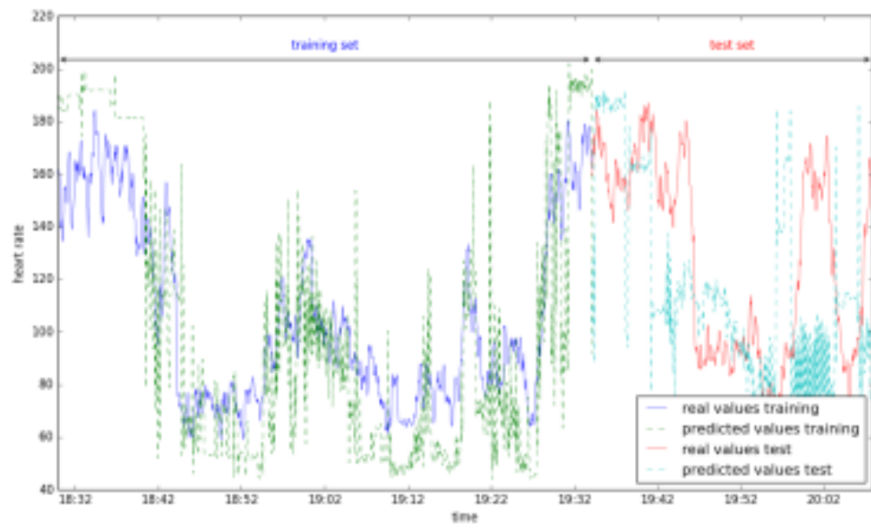
Results (4)
Recurrent Neural Network:

Slide 50
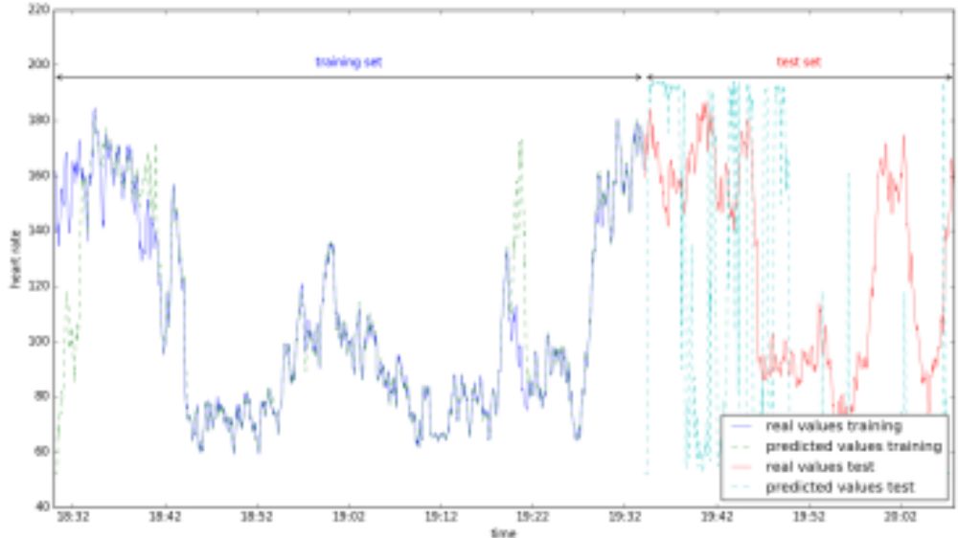
Results (5)
Echo State Network:

