Slide 1
Machine Learning for the Quantified Self
Lecture 7
Reinforcement Learning

Slide 2
Overview
We have been talking data and making predictions
What if we want to influence the user?
What intervention/action should we select?
We can use reinforcement learning to figure this out
  Note: not widespread in terms of applications for the quantified self yet
  We discuss the basics, but many improvements have been made over the years

Slide 3



Basics of Reinforcement Learning (1)
We assume two actors:
  The user (mostly called the environment in RL) – the quantified selfs
  The agent providing the support – the software entity we are aiming to create
  The agent can observe the state of the user at time point t:
  We derive an action to perform based on this:
  We obtain a reward:

Slide 4
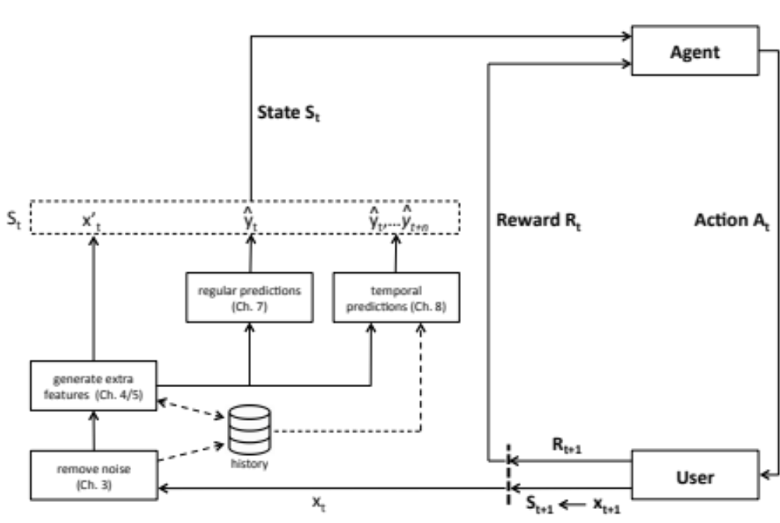
Basics of Reinforcement Learning (2)
The loop:

Slide 5
Basics of Reinforcement Learning (3)
We do not strive for immediate reward only, but rewards we accumulate in the future, called the value function
A policy maps a state to an action (when to do what)
We should balance exploration and exploitation

Slide 6
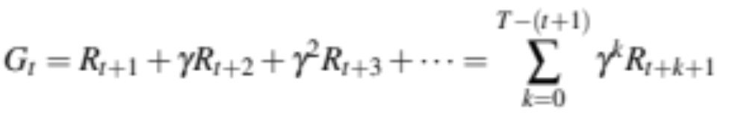
Basics of Reinforcement Learning (4)
Let us define the G (value function) better:
  γ is the discount factor
  T is the end time we consider (could be ∞)
The Markov Properly underlies many of the algorithms we consider

Slide 7
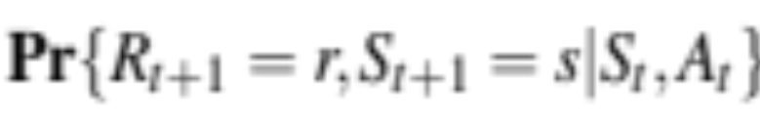
Markov Property
We can express a probability of ending up in a state with a reward based on the entire history:
We can also define it based on the previous state and action only:
If the probabilities are equal we satisfy the property
    True for the quantified self?

Slide 8
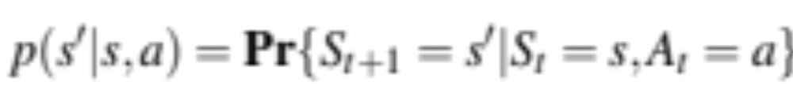
MDP (1)
Let us assume the property is satisfied
We can model our problem as a Markov Decision Process (MDP) with a finite number of states
Transition probability from one state s tot a state s’:
The expected reward for this transition:

Slide 9

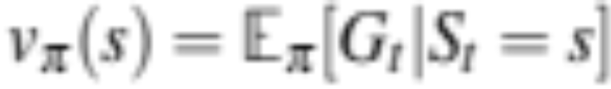
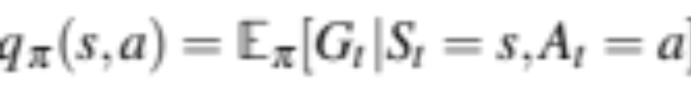
MDP (2)
A policy selects a probability of an action in a state:
For a policy π, the expected value in a state s given that we follow policy π thereafter is called the state-value function:
And the expected return of a policy if we select action a in state s is called the action-value function:

Slide 10
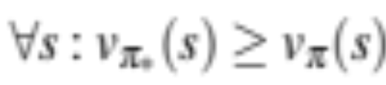
MDP (3)
We want to find policies with the highest state-value function over all states:
Similarly we want to find the optimal action-value function

Slide 11
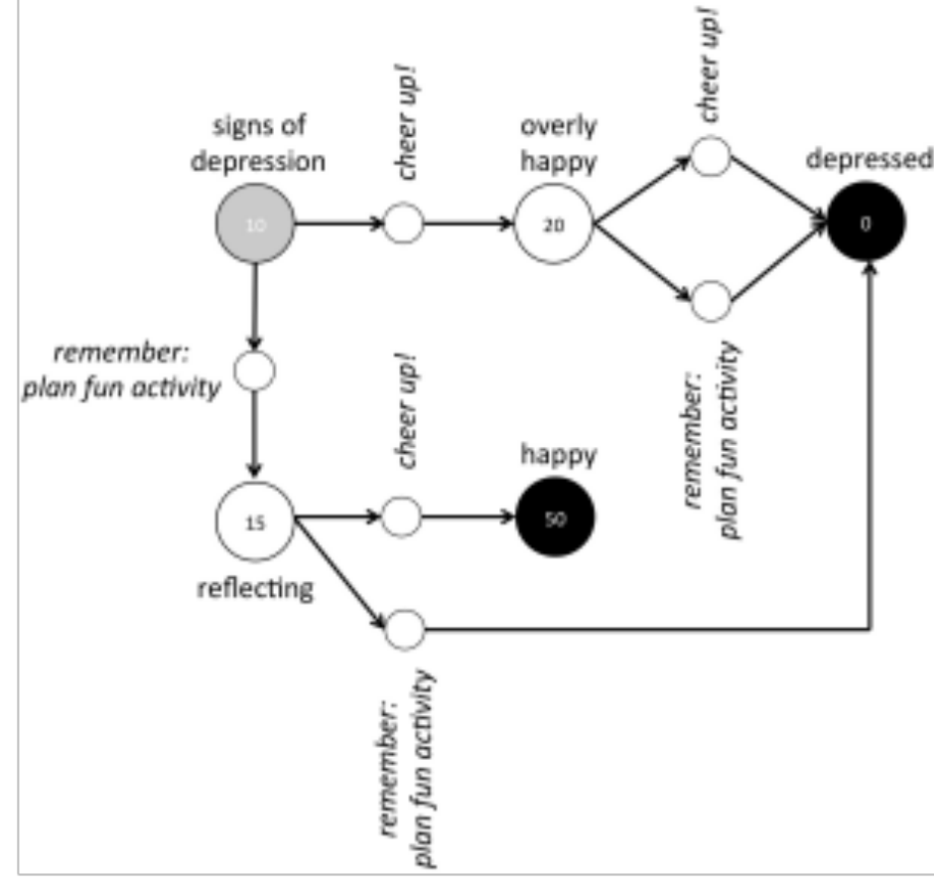
MDP (4)
Example:

Slide 12
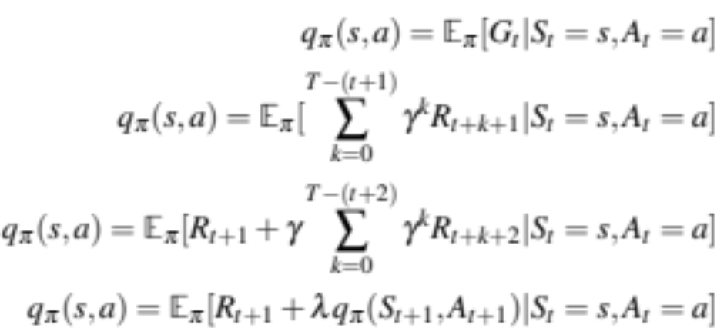
One Step Sarsa (1)
Let us start learning
Let Q(S_{t},A_{t}) denote the learned action value function for a policy π
Let us operationalize our goal:

Slide 13
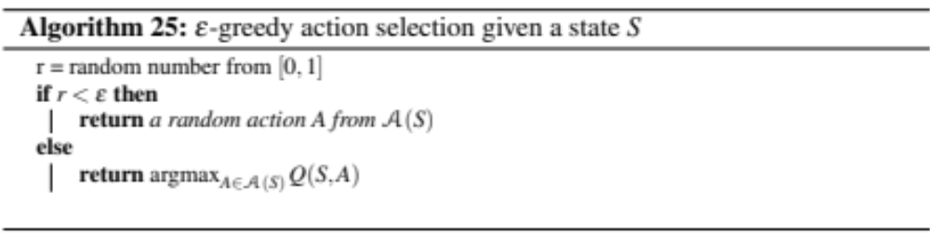
One Step Sarsa (2)
We update our value for the state as follows:
We select the action based on these Q-values, an example is ε-greedy:

Slide 14
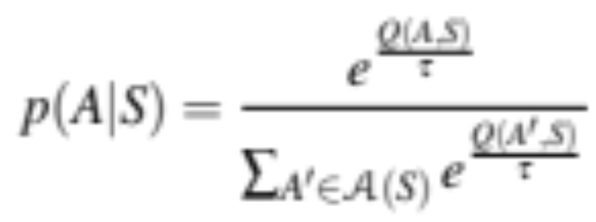
One Step Sarsa (3)
Or alternatively a softmax (τ is temperature):

Slide 15
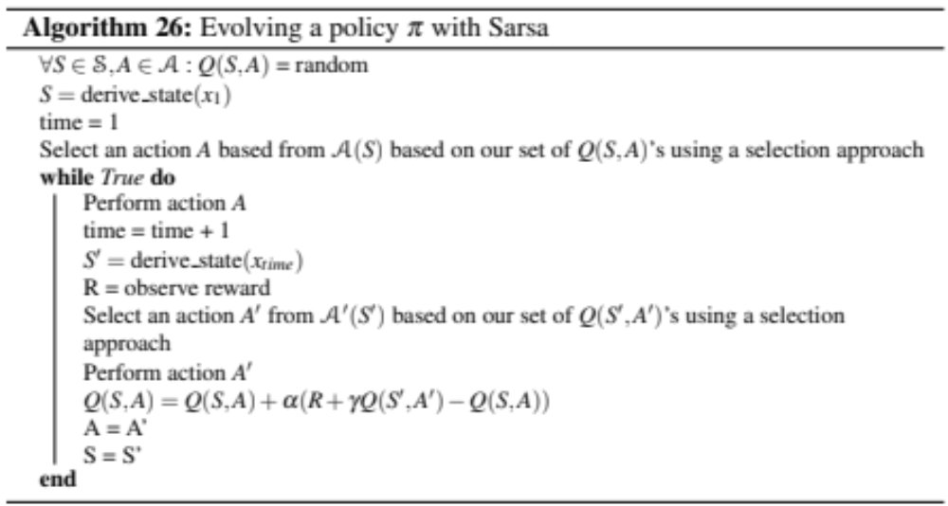
One Step Sarsa (4)
Complete algorithm

Slide 16
One Step Sarsa (5)
For Sarsa, we pick our actions in the same way at each step
This is called on-policy

Slide 17
Q-Learning (1)
For Q-learning, we do not perform the next action before updating our Q-values
We just assume that we select the highest value in the next state
Off-policy approach

Slide 18
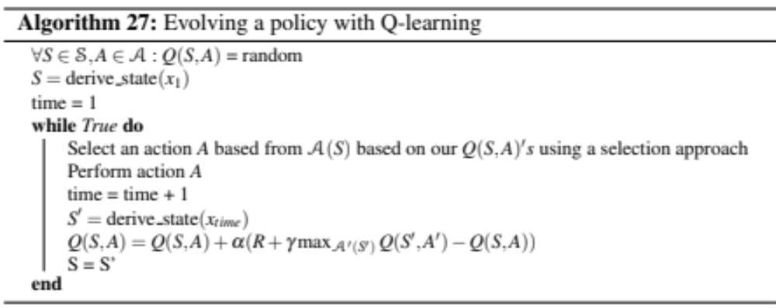
Q-learning (2)
Complete algorithm

Slide 19
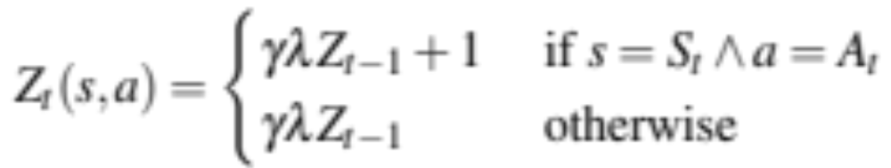
Multiple steps ahead (1)
Previously we only looked one step ahead, and could not put credit to actions that contributed longer in the past
Eligibility traces allow us to do this
We use Z_{t}(s,a) to denote an eligibility trace

Slide 20
Multiple steps ahead (2)
And we include this in our update equations
  The more frequently an action is selection, the more we update the values
  For Sarsa:
  For Q-learning:

Slide 21
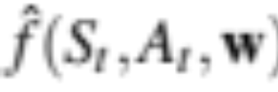
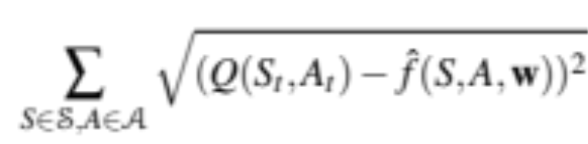
Approximate solutions
We have assumed a value for each possible Q(S,A), but is this realistic?
  Nope, there might be many
  We can build a model that predicts the value for Q(S,A)
  This is a “standard” learning problem we have seen so far, assume a certain model
  with weights w (e.g. a neural network)
  We define the error as:

Slide 22
Handling continuous values in the state space (1)
Final part:
  We have states represented by continuous values, what then?
  We have an infinite state space
  We need to discretize this
  We can use the U-tree algorithm for this purpose

Slide 23
Handling continuous values in the state space (2)
How does it work?
  We build a state tree, that maps our continuous values to a state
  We start with a single leaf
  We collect data for a while
  For all attributes X_{i} we try different splits based on the (sorted) values we have collected
  We test whether the splits result in a significant difference in Q-values using the Kolmogorov Smirnov test
  We select the attribute with the lowest p-value and split on it (if below 0.05)
  We continue collecting data again and repeat the procedure per leaf

